Slide 1


Public Health Certificate Program (PHCP)
Co-Directors:
Hillary CM Nelson, PhD MPH
Michael David, MD PhD

Slide 2
What is public health?
“Public health promotes and protects the health of all people and their communities.
This science-based, evidence-backed field strives to give everyone a safe place to live, learn, work and play.”
https://www.apha.org/what-is-public-health

Slide 3
Why add public health to a PhD?
“NIH’s mission is to seek fundamental knowledge about the nature and behavior of living systems and the application of that knowledge to enhance health, lengthen life, and reduce illness and disability.”
https://www.nih.gov/about-nih/what-we-do/mission-goals

Slide 4
How does PHCP enhance your PhD?
Better appreciate the community health implications of your research topic
Add an epidemiological perspective
Learn how to engage the community
Gain skills in policy and advocacy
Open up new career options
Expand your professional network

Slide 5



What are the requirements?
Formal coursework in public health
PHCP Seminar Series
Public Health project

Slide 6
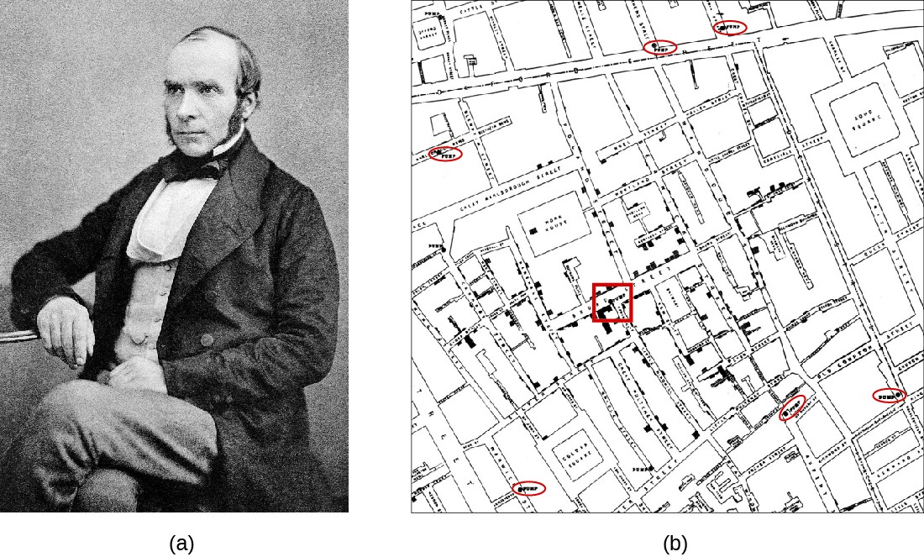

PHCP Coursework
Four Courses:
Introduction to Epidemiology*
Three public health related courses (your choice!)

Slide 7



PHCP Seminar Series
ALL WELCOME!!!!
Breakfast seminars on Tuesdays @ 8:30 am
- Speakers at Penn
- Outside speakers
- PHCPers (3rd year and above)

Slide 8
Public health projects
Similar in scope to an “independent study”, though done over several semesters. Could also be an “experience” instead of a project.
Recent examples:
  Drive-Through Flu-FIT: a Novel Way to Mitigate the Decrease in Colonoscopy Screening during the COVID-19 Pandemic (research paper)
  Validation of a Stenotrophomonas maltophilia Antimicrobial Susceptibility Test (AST) Panel at the Children’s Hospital of Philadelphia
  Case Study: Sex Education in a Middle School Classroom
  Contact tracers: Biggest hurdle in slowing COVID-19 spread is getting people to talk (Philadelphia Inquirer Opinion piece)
  Race reporting guidelines in clinical trials for systemic lupus erythematosus (literature review)

Slide 9
PHCP Alumni
Faculty and postdoctoral fellow positions (various)
Industry positions (various)
Research Scientist, Newborn Screening Program at the New Jersey Department of Health (this followed an ASPL/CDC Emerging Infectious Disease fellowship)
Penn/CHOP Microbiology Fellow, now Co-Director Jeff Hospital Micro Lab
California Epidemiology Investigation Service Fellow, now Californiat Dept of Public Health
CDC Epidemiology Investigation Service (EIS) Fellow

Slide 10
Contact Info
Hillary Nelson, PhD MPH
hnelson@pennmedicine.upenn.edu
Michael David, MD PhD
hnelson@pennmedicine.upenn.edu
Candance Cain (PHCP Coordinator)
Candace.Cain@pennmedicine.upenn.edu
Website: https://www.med.upenn.edu/phcp/

