Slide 1

Overview of Penn Graduate Consulting Club (PGCC)
Notes:
Mute your mics

Slide 2

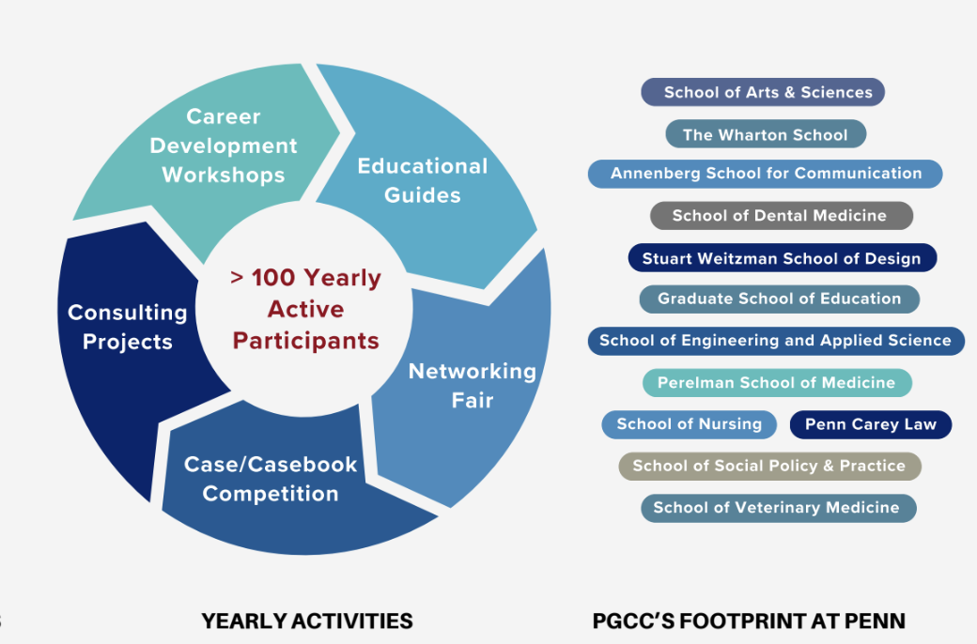
Who are we?
Penn Graduate Consulting Club (PGCC)
We are a student-run consulting organization for non-MBA graduate students and postdocs.
Educate Penn’s graduate student and postdoc communities about the consulting industry.
Prepare Master’s level and Advanced Degree Candidates (ADCs) for a successful career in consulting post-Penn.
Notes:
Flagship GCC at Penn

Slide 3
What is consulting…and why?
Consulting isn’t just “giving advice.”
It consists of:
Identifying problems
Analyzing potential solutions and their implications
Producing actionable recommendations
The skills you have accumulated during your graduate studies prepare you to be successful as a consultant.
Notes:
And depending on the industry, the technical skills

Slide 4
What is consulting…and why?
You:
…are analytical (and/or technically) oriented.
…enjoy working on a team to solve relevant challenges that businesses (of any industry!) face.
…want to have a real, tangible impact in an industry of choice.
…thrive in fast-paced, highly dynamic, and intellectually challenging environments.
…want vast exit opportunities post-consulting.
…are looking to escape academia.

Slide 5

How do we accomplish our mission?
PGCC supports you through every step toward consulting
Discover Consulting
Hands-On Projects
Connect & Explore
Portfolio Building
Case Mastery
🎉
CONSULTING
Intro to consulting
Determine your fit
Deep dive into the industry's dynamics
Engage with clients to solve real-world problem
Develop soft skills needed for consulting
Exclusive networking events with alumni, current consultants, and recruiters
Deep dive into different consulting firm cultures
Hands-on resume and cover letter workshops
Collaboration with Career Service for personalized guidance
Comprehensive case interview preparation sessions
National casing network for you to find case partners
Case competition and casebook competition to showcase your skills

Slide 6
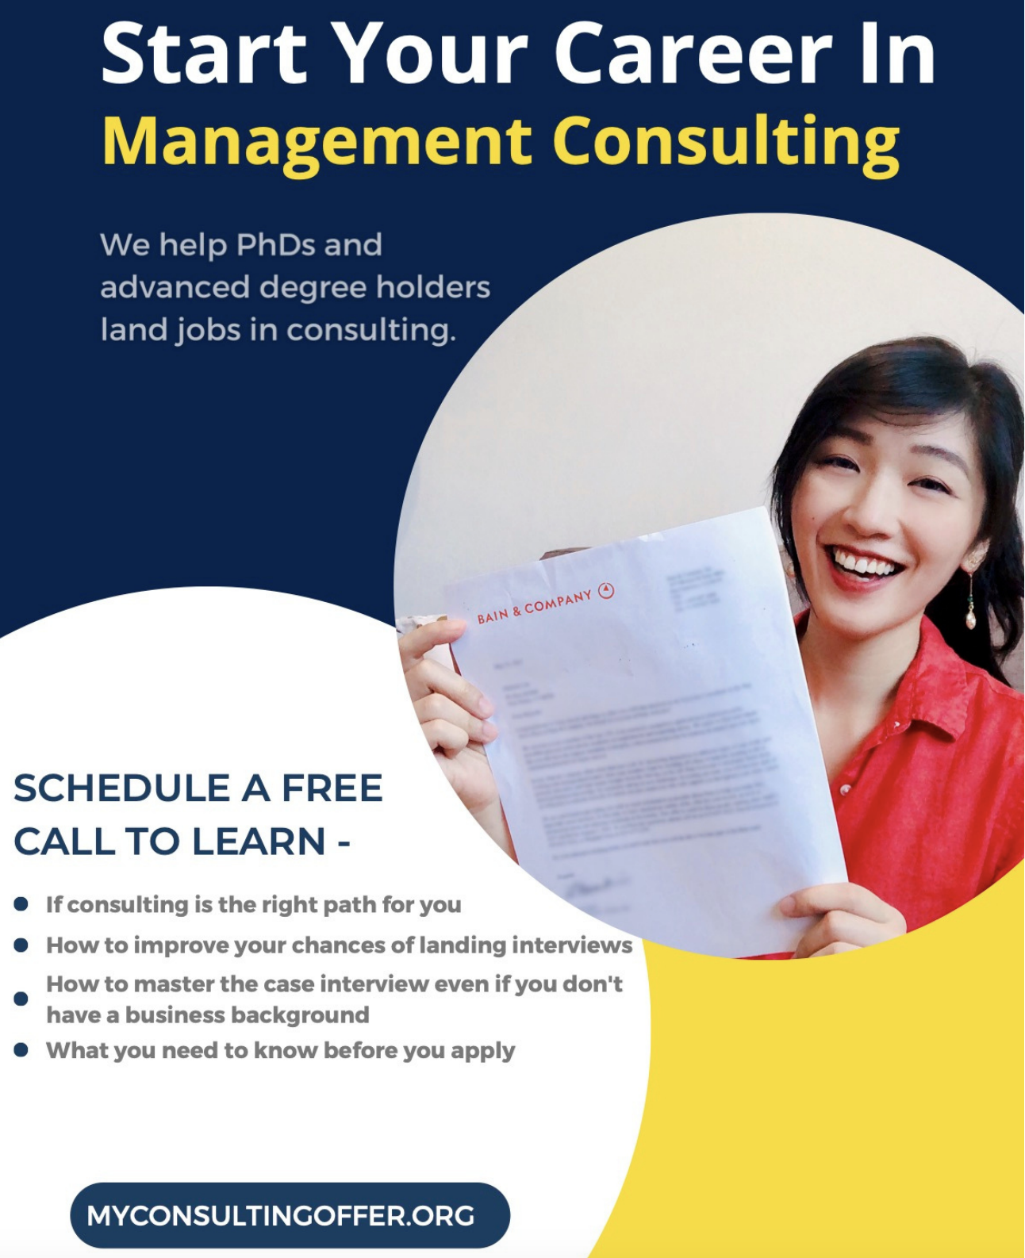
How do we accomplish our mission?
PGCC supports you through every step toward consulting
Discover Consulting
Hands-On Projects
Connect & Explore
Portfolio Building
Case Mastery
🎉
CONSULTING
Intro to consulting
Determine your fit
Deep dive into the industry's dynamics
Engage with clients to solve real-world problem
Develop soft skills needed for consulting
Exclusive networking events with alumni
Deep dive into different consulting firm cultures
Q&A with current consultants and recruiters
Hands-on resume and cover letter workshops
Collaboration with Career Service for personalized guidance
Comprehensive case interview preparation sessions
National casing network for you to find case partners
Case competition and casebook competition to showcase your skills
Workshops
Private lectures
Q&A panels
Networking events

Slide 7
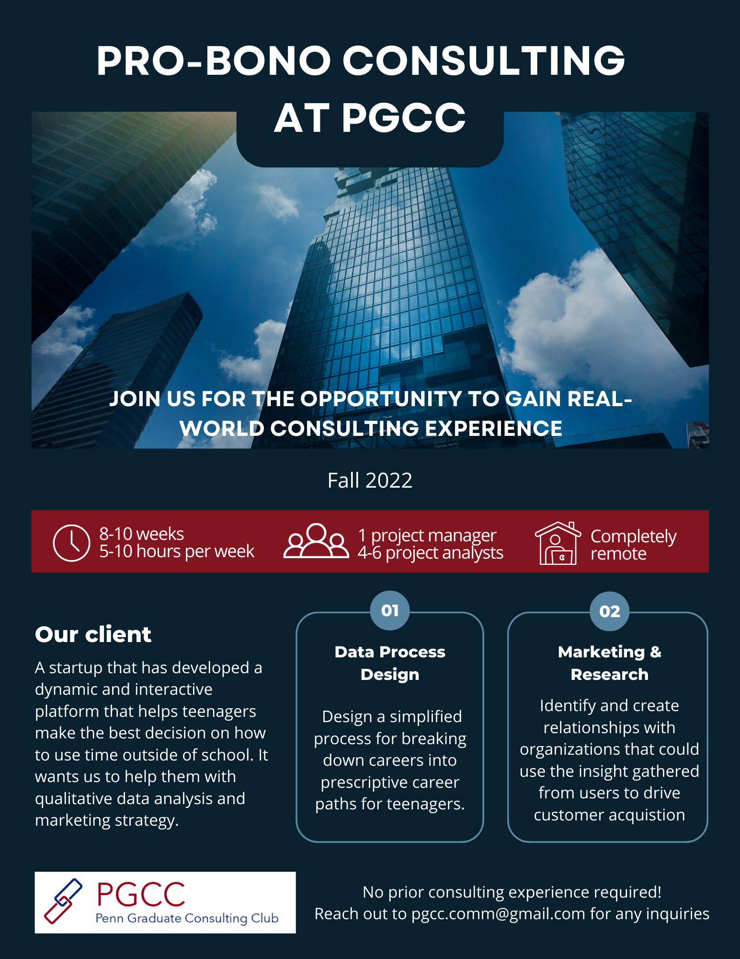
How do we accomplish our mission?
PGCC supports you through every step toward consulting
Discover Consulting
Hands-On Projects
Connect & Explore
Portfolio Building
Case Mastery
🎉
CONSULTING
Intro to consulting
Determine your fit
Deep dive into the industry's dynamics
Engage with clients to solve real-world problem
Develop soft skills needed for consulting
Exclusive networking events with alumni
Deep dive into different consulting firm cultures
Q&A with current consultants and recruiters
Hands-on resume and cover letter workshops
Collaboration with Career Service for personalized guidance
Comprehensive case interview preparation sessions
National casing network for you to find case partners
Case competition and casebook competition to showcase your skills
Pro bono projects
Various industries
Local start-ups to multinational corporations
Training workshops

Slide 8
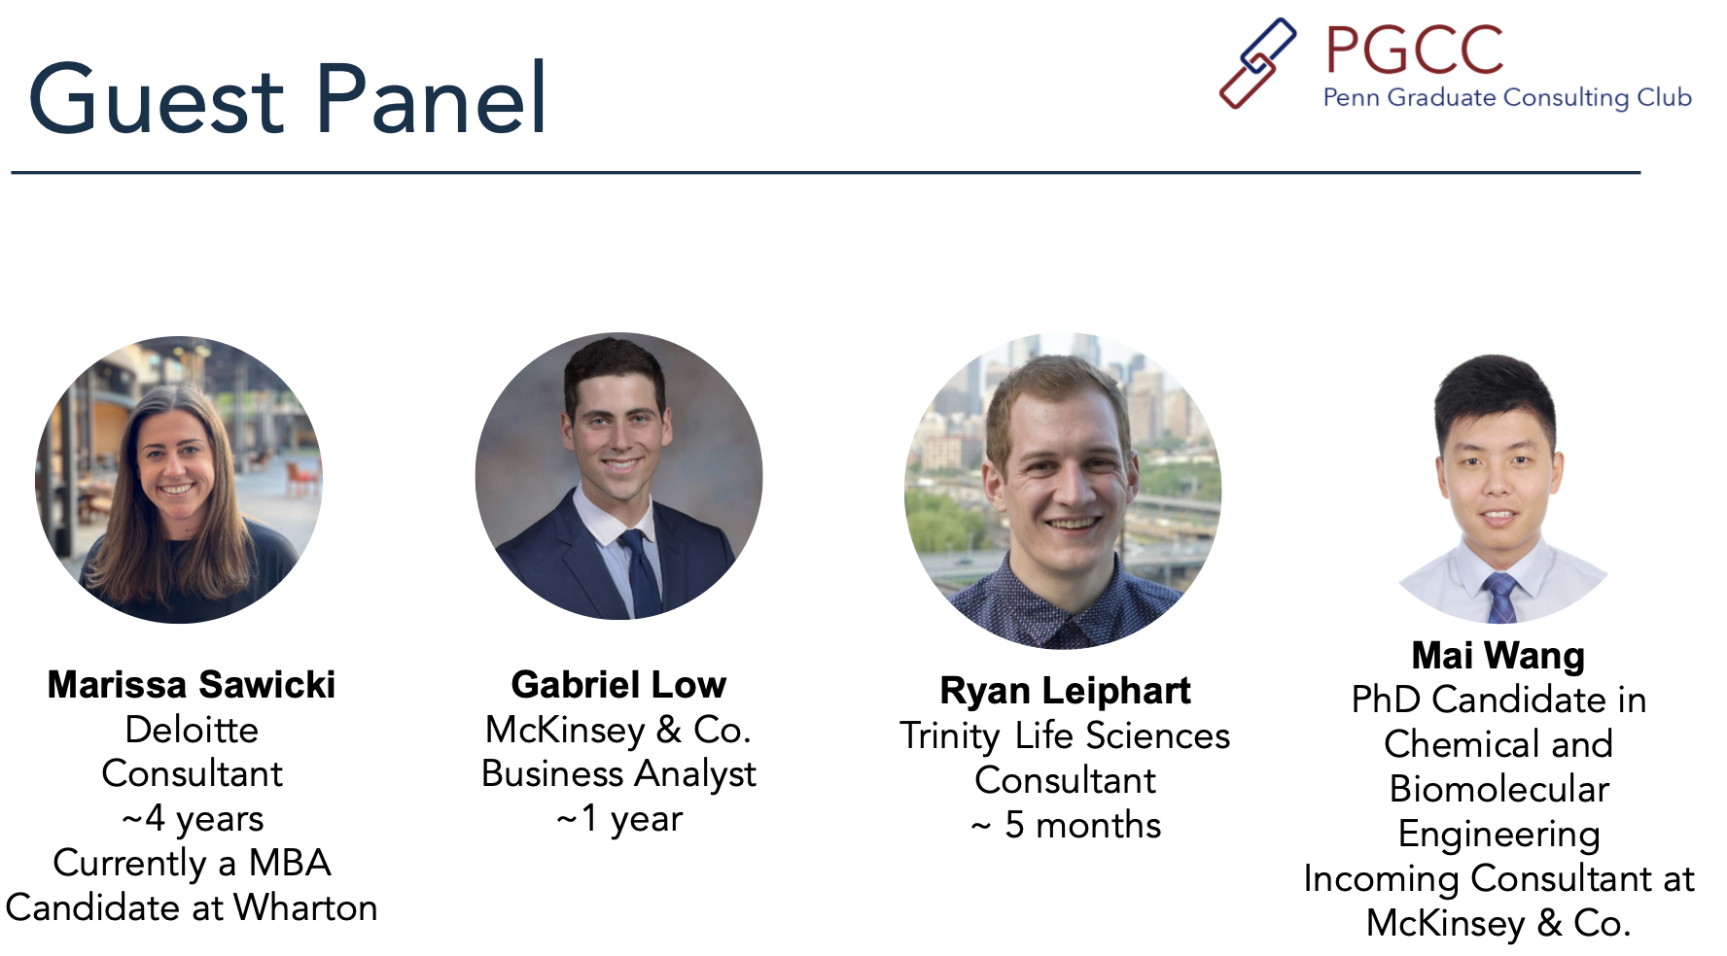
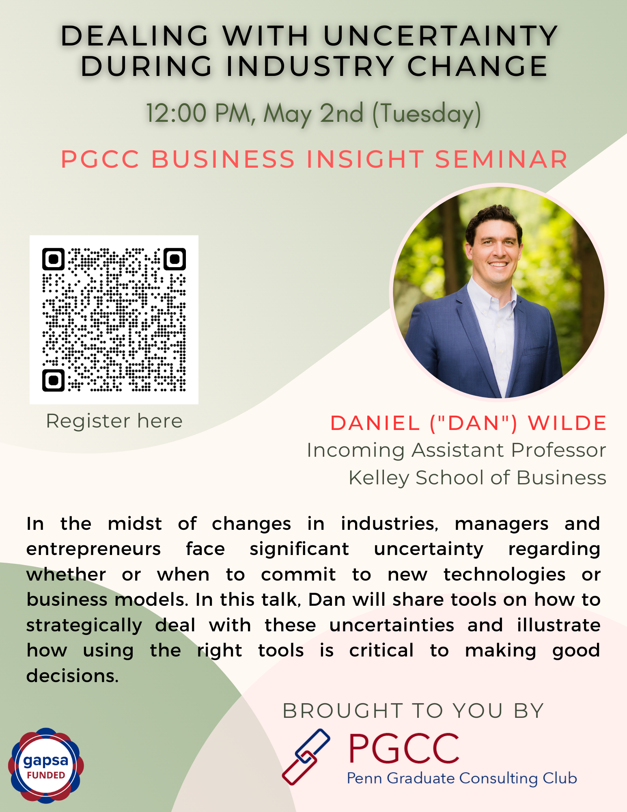
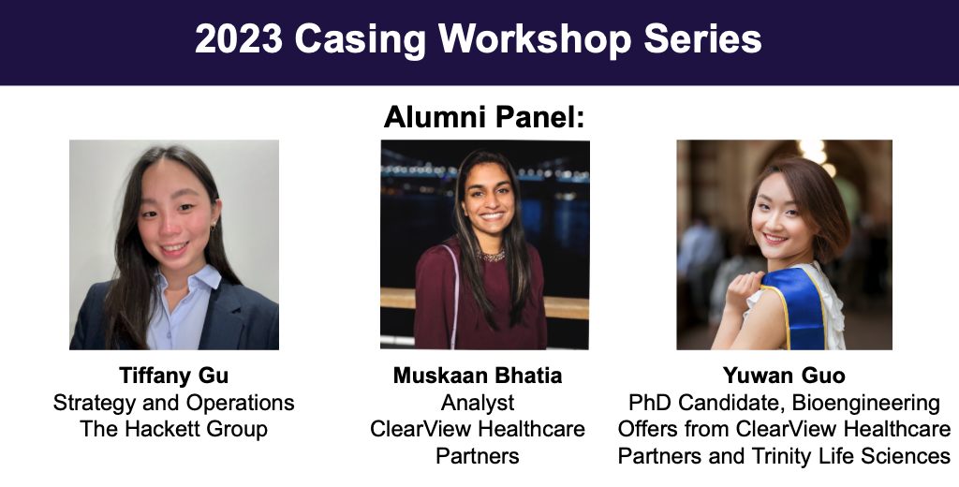
How do we accomplish our mission?
PGCC supports you through every step toward consulting
Discover Consulting
Hands-On Projects
Connect & Explore
Portfolio Building
Case Mastery
🎉
CONSULTING
Intro to consulting
Determine your fit
Deep dive into the industry's dynamics
Engage with clients to solve real-world problem
Develop soft skills needed for consulting
Exclusive networking events with alumni
Deep dive into different consulting firm cultures
Q&A with current consultants and recruiters
Hands-on resume and cover letter workshops
Collaboration with Career Service for personalized guidance
Comprehensive case interview preparation sessions
National casing network for you to find case partners
Case competition and casebook competition to showcase your skills
Career fairs
Networking events
Private recruitment events

Slide 9
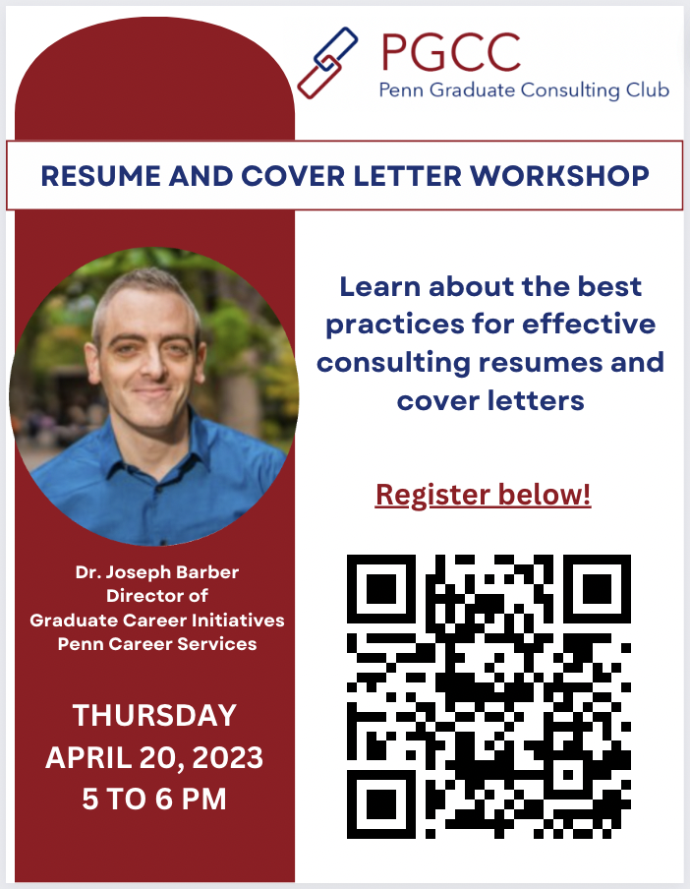
How do we accomplish our mission?
PGCC supports you through every step toward consulting
Discover Consulting
Hands-On Projects
Connect & Explore
Portfolio Building
Case Mastery
🎉
CONSULTING
Intro to consulting
Determine your fit
Deep dive into the industry's dynamics
Engage with clients to solve real-world problem
Develop soft skills needed for consulting
Exclusive networking events with alumni
Deep dive into different consulting firm cultures
Q&A with current consultants and recruiters
Hands-on resume and cover letter workshops
Collaboration with Career Service for personalized guidance
Comprehensive case interview preparation sessions
National casing network for you to find case partners
Case competition and casebook competition to showcase your skills
Application materials prep
Interview prep
Targeted lectures in advanced business topics

Slide 10
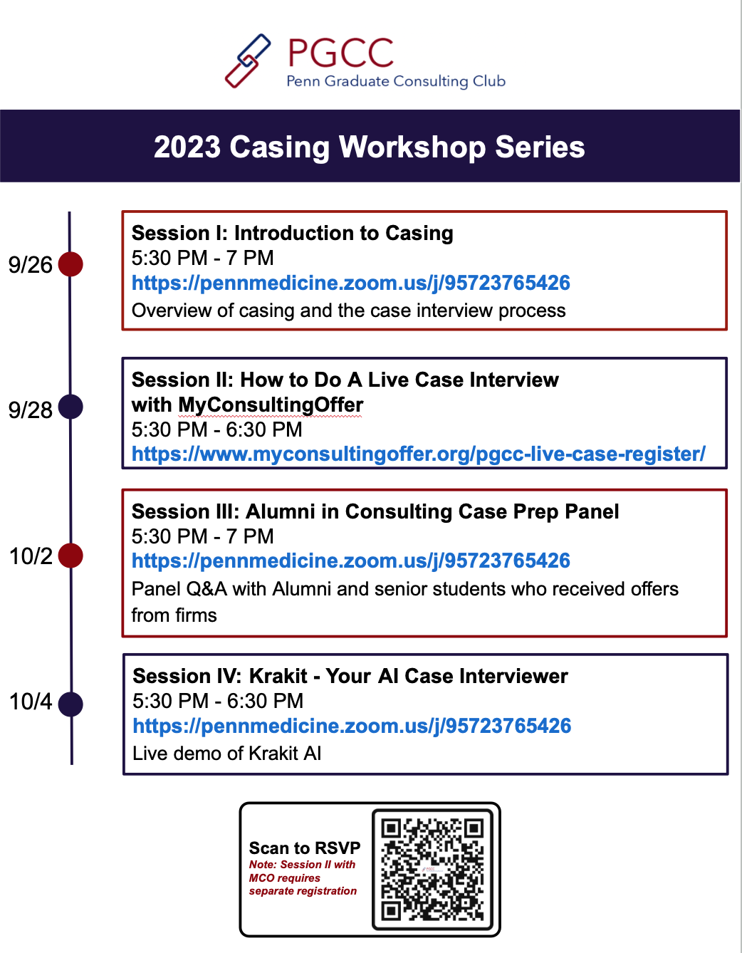
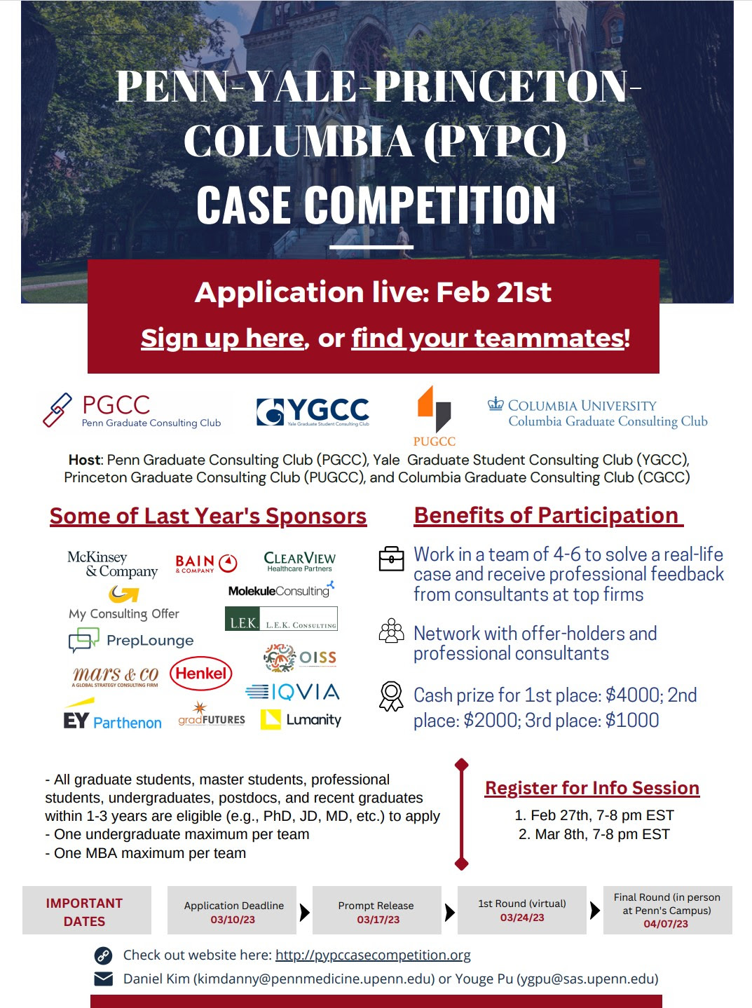
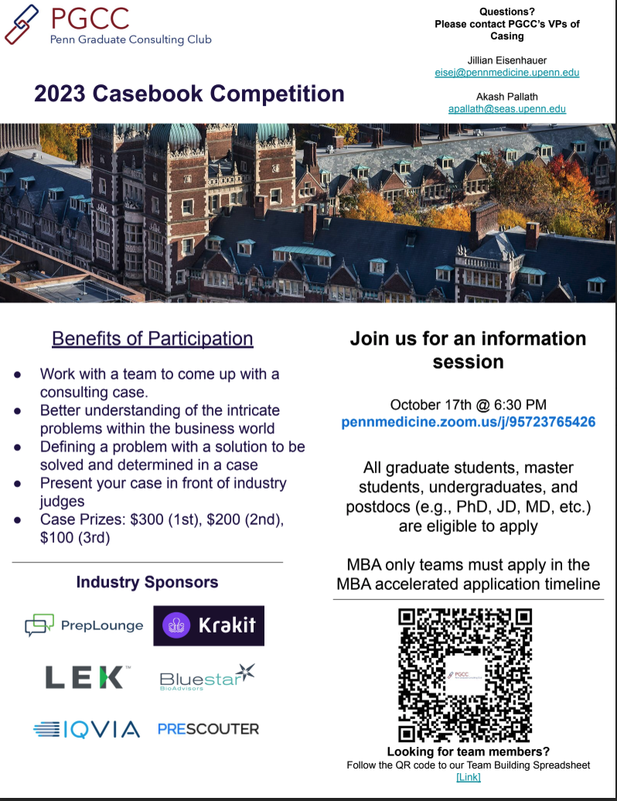
How do we accomplish our mission?
PGCC supports you through every step toward consulting
Discover Consulting
Hands-On Projects
Connect & Explore
Portfolio Building
Case Mastery
🎉
CONSULTING
Intro to consulting
Determine your fit
Deep dive into the industry's dynamics
Engage with clients to solve real-world problem
Develop soft skills needed for consulting
Exclusive networking events with alumni
Deep dive into different consulting firm cultures
Q&A with current consultants and recruiters
Hands-on resume and cover letter workshops
Collaboration with Career Service for personalized guidance
Comprehensive case interview preparation sessions
National casing network for you to find case partners
Case competition and casebook competition to showcase your skills
Find case partners and guided case practice
Case-based competitions
Access to PrepLounge and other 3rd party resources

Slide 11




Stay up to date with PGCC
Subscribe to our weekly newsletter:
Upcoming workshops and events
Career opportunities
Latest business/consulting news
Much more!
https://www.penngradconsulting.com/#get-involved
& follow us on social media
@upenn_pgcc
@Penn Graduate Consulting Club
pgcc.comm@gmail.com

Slide 12
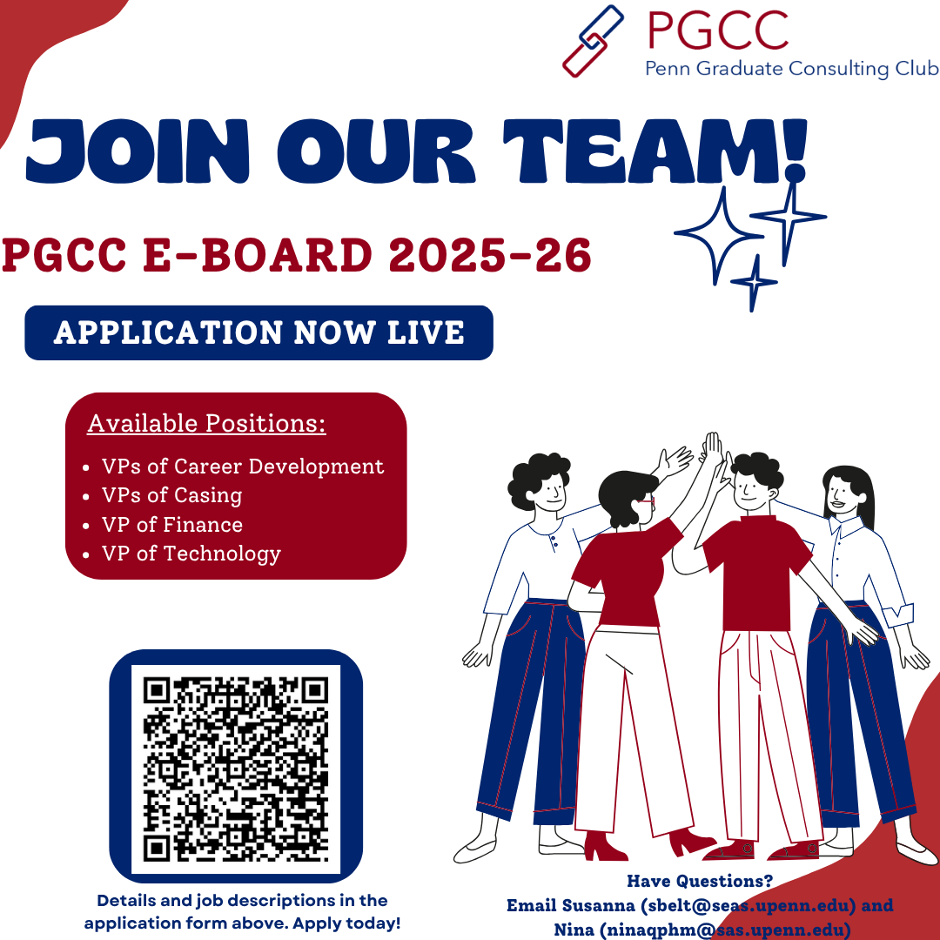
Want to get involved?

