Slide 1





















Penn Biotech Group (PBG) is a student-run organization that exposes students to the life science industry
25+ years
PBG Alumni Network Affiliations
The largest graduate consulting club for advanced degree candidates at Penn, with
years of history
300+
Members actively participate with PBG per year
1300+
PBG alumni working in a variety of healthcare-related industries
9/12
We attracted students from schools at Penn*
*based on statistics from Fall 2020 projects

Slide 2
Expand your professional tool kit with pro-bono consulting projects and educational opportunities
Consulting Projects
Educational Enrichment
Conduct 30-40 consulting projects per year and serve clients in the extended healthcare industry, including pharma, MedTech, payers, startups and venture capital
Delivered 400+ projects in the past 25+ years for organizations ranging from startups to Fortune 500 companies
Historically, more than half of our members pursue management consulting post graduation and find employment at top consulting firms
  McKinsey & Company, Boston Consulting Group, Bain & Company, L.E.K., Herspiegel, ClearView, Putnam, IQVIA etc.
PBG Consulting panel with PBG Alumni
PBG Industry Prep Series with PBG Alumni
Wharton Biotech Conference
PBG Biotech Investment series with healthcare finance leaders
PBG mini-MBA series with healthcare consulting and industry leaders (bi-ennial odd years)
Penn Healthcare Case Competition with Penn HealthX
Firm-hosted lecture programs honing strategy consulting and financial modeling skills of PBG project members
PBG-hosted consulting workshops educating members on providing high-quality deliverables
Case workshops and interview prep
Healthcare-related career panels
300+

Slide 3
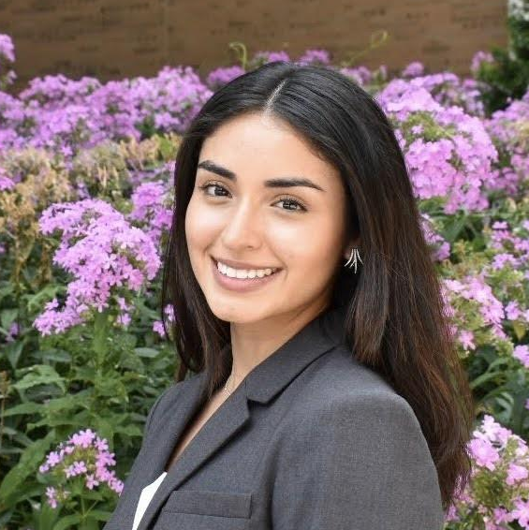
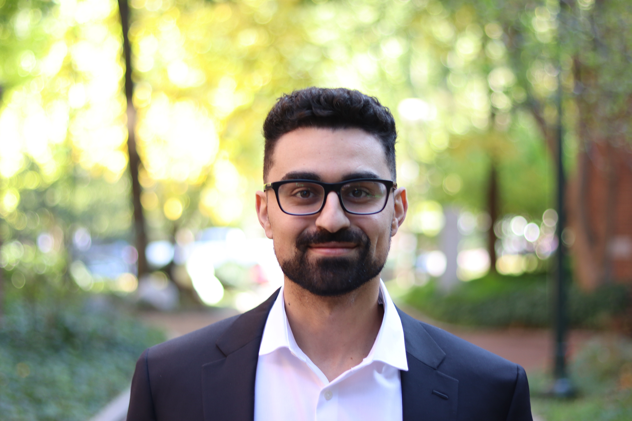


2025-2026 Penn Biotech Group Co-Presidents
Alexandra Martinez Lopez
alex.martinezlopez@pennmedicine.upenn.edu
Rani Baidoun
baidoun@seas.upenn.edu
Taylor Brysgel
taylor.brysgel@pennmedicine.upenn.edu
Attend our Kickoff Event!
September 4th, 2025
More Details to Come
pennbiotechgroup.org

