Slide 1



Trainee Advancement Alliance A Research Trainee Affairs Initiative
What is TAA?
TAA is a non-escalating and confidential service consisting of PSOM graduate students, post-docs, and faculty members dedicated to cultivating a high-caliber research community by establishing robust support mechanisms for trainees navigating challenges and adversity in their academic and professional journeys
Who is it for?
TAA will provide trainee support for all members of the Penn Medicine research training community, especially those who have faced barriers to research and educational success
Examples TAA can help with
Confidential Counseling
Lack of community
Imposter Syndrome
Work-Life Imbalance
Need TAA support?
Visit our website to connect with a TAA member!
Power Imbalances
Discrimination
Unsupportive Lab Cultures

Slide 2





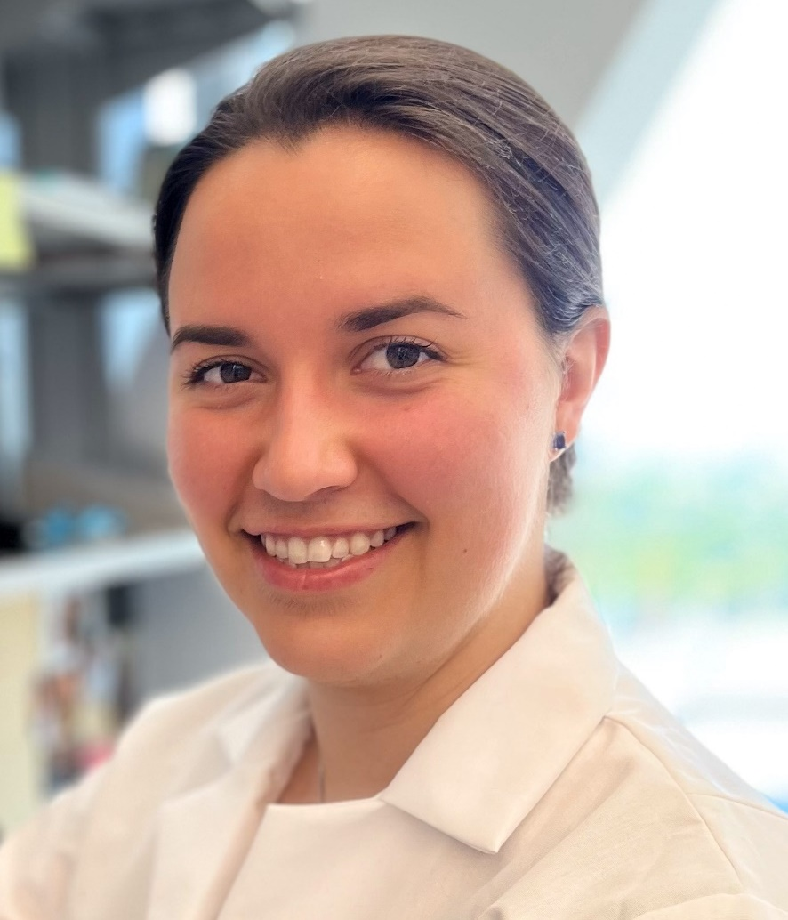

Trainee Advancement Alliance A Research Trainee Affairs Initiative
Dan
Kessler
(faculty)
Kellie Jurado
(faculty)
Fernanda
Holloman
(student)
Robin
Wilder
(student)
Jill
Eisenhauer
(student)
Kat
Mueller
(postdoc)
Mike
Haggadone
(postdoc)
TAA Leadership
Link to TAA Website

