Slide 1
University of Pennsylvania
BGS Orientation
August 2024

Slide 2
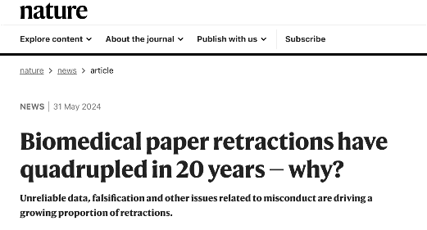
Why?
Because issues like lack of reproducibility, retractions, misconduct, and unreliable data are affecting science more than ever.

Slide 3
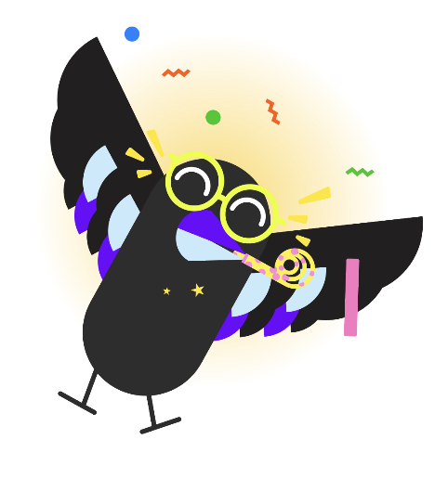
Who we are and what we do
New Center at Penn, funded and supported by the NIH-NINDS.
Two main components:
Online curriculum +
Global Community.

Slide 4
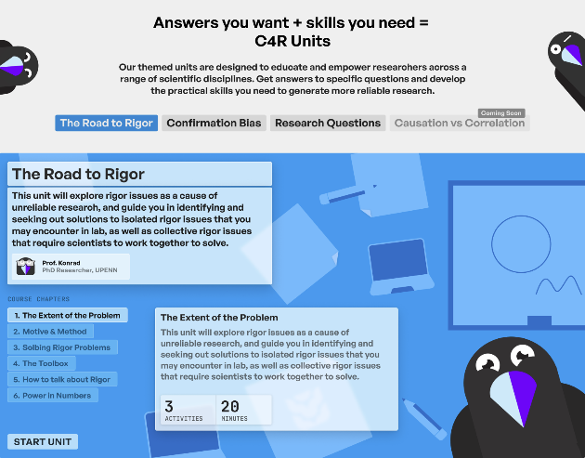
Who we are and what we do
Interactive lessons in research rigor and reproducibility
Acquire the skills everyone assumes you already have
Get the help you need to do better experimental design
Free, online, and open source

Slide 5
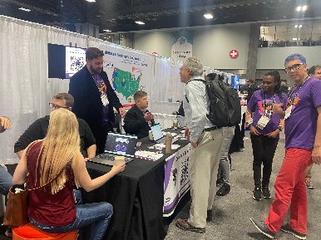
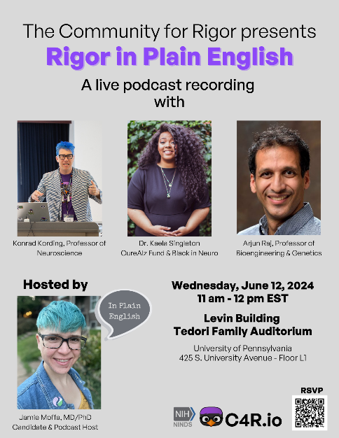
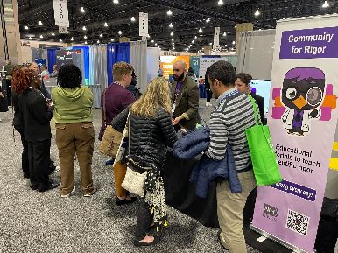
Events: Online and In-Person

Slide 6
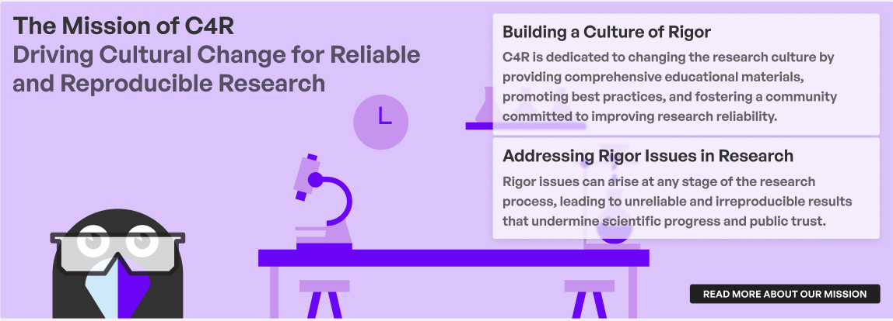
What sets C4R Apart?
What sets C4R apart?
Backed by the NIH/NINDS
Modular and adaptable
Open-source materials
Boilerplate solutions
Behavior & culture change
Global community
Fun and engaging platform

Slide 7
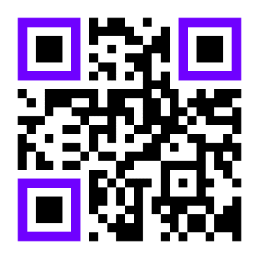
Join the Community for Rigor @
www.c4r.io

Slide 8
Thank you!
Q&A
Carolina García: carogar@seas.upenn.edu Zac Parker: ztp@seas.upenn.edu

