Slide 1


Public Health Certificate Program (PHCP)
Director:
Hillary CM Nelson, PhD MPH

Slide 2
What is public health?
“Public health promotes and protects the health of all people and their communities.
This science-based, evidence-backed field strives to give everyone a safe place to live, learn, work and play.”
https://www.apha.org/what-is-public-health

Slide 3
Why add public health to a PhD?
“NIH’s mission is to seek fundamental knowledge about the nature and behavior of living systems and the application of that knowledge to enhance health, lengthen life, and reduce illness and disability.”
https://www.nih.gov/about-nih/what-we-do/mission-goals

Slide 4
How does PHCP enhance your PhD?
Better appreciate the community health implications of your research topic
Add an epidemiological perspective
Learn how to engage the community
Gain skills in policy and advocacy
Open up new career options
Expand your professional network

Slide 5



What are the requirements?
Formal coursework in public health
Public health project
PHCP Seminar Series

Slide 6
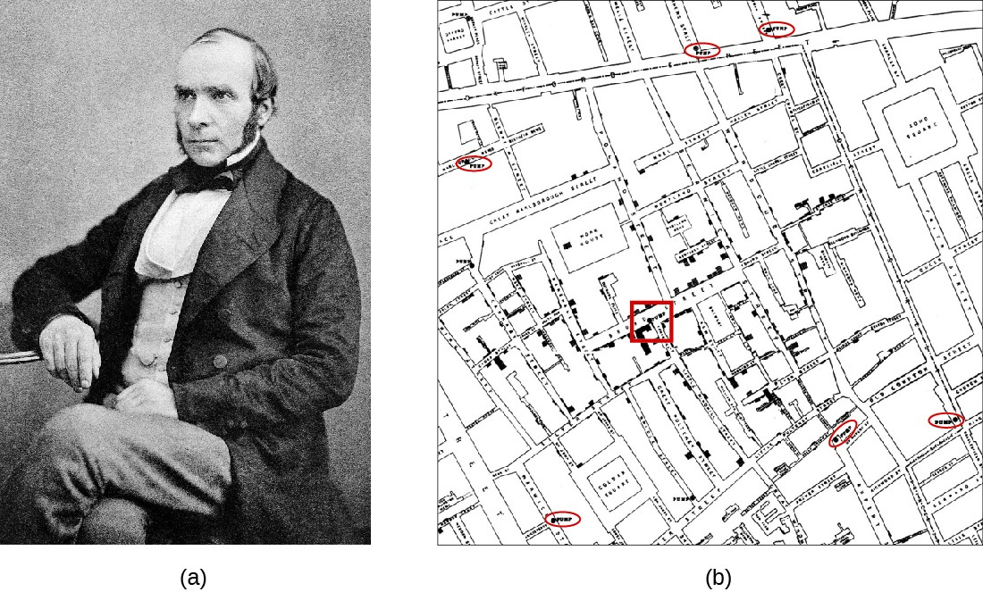

PHCP Coursework
Four Courses:
Introduction to Epidemiology*
Three public health related courses (your choice!)

Slide 7



PHCP Seminar Series
ALL WELCOME!!!!
Breakfast seminars @ 8:30 am
- Speakers at Penn
- Outside speakers
- PHCPers (3rd year and above)

Slide 8
Public health projects
Similar in scope to an “independent study”, though done over several semesters. Could also be an “experience” instead of a project.
Recent examples:
  “Drive-Through Flu-FIT: a Novel Way to Mitigate the Decrease in Colonoscopy Screening during the COVID-19 Pandemic” (research paper)
  James A. Ferguson Emerging Infectious Diseases Research Initiatives for Student Enhancement (RISE) Fellowship (summer experience)
  “Case Study: Sex Education in a Middle School Classroom”
  “Contact tracers: Biggest hurdle in slowing COVID-19 spread is getting people to talk” (Philadelphia Inquirer Opinion piece)
  “Race reporting guidelines in clinical trials for systemic lupus erythematosus” (literature review)

Slide 9
PHCP Alumni
Faculty and postdoctoral fellow positions (various)
Industry positions (various)
Research Scientist, Newborn Screening Program at the New Jersey Department of Health (this followed an ASPL/CDC Emerging Infectious Disease fellowship)
Project Director, Biomedical Programs at The Pew Charitable Trusts
Penn/CHOP Microbiology Fellow
California Epidemiology Investigation Service Fellow
CDC Epidemiology Investigation Service (EIS) Fellow

Slide 10
Contact Info
Hillary Nelson, PhD MPH
hnelson@pennmedicine.upenn.edu
Candance Cain (PHCP Coordinator)
Candace.Cain@pennmedicine.upenn.edu
Website: https://www.med.upenn.edu/phcp/

