Slide 1
Surviving Grad School
BGS New Student Orientation
Megan Stefkovich
5th year graduate student, CAMB (CPM)

Slide 2
Outline
What to expect
Advice for success
Resources
Personal Finance
01
02
03
04
Notes:
This will not be a resource heavy talk, you will get a lot more in-depth information about that in the week to come, this will more so be unsolicited advice thatI would tell myself if I were in your seat again.

Slide 3




What to expect
PhD lifetime
Long, meandering process
Frustrating at times, but also fulfilling
You will learn to succeed despite many responsibilities (research, family/friends, professional engagement, financial)
You will learn to work with many different types of people
You will at times doubt:
  If the PhD is worth it
  If you’re smart enough
Preparing to defend
Me :|
Writing papers
Applying for independent grants, thesis work
Coursework, candidacy exam
You ☺
Coursework, rotations
Notes:
Many stages built in that naturally scaffold your experience (coursework, candidacy exam, applying for independent grants, writing papers, preparing to defend)
You will learn to succeed despite many responsibilities
Directing your own thesis work
Family and friend commitments
Volunteer/outreach (professional engagements)
Financial responsibility
You will learn to work with many different types of people who all care deeply about their jobs and at time are all stretched thin (kind of a low stake, high stress environment where everyone is emotionally tied to the outcome)

Slide 4
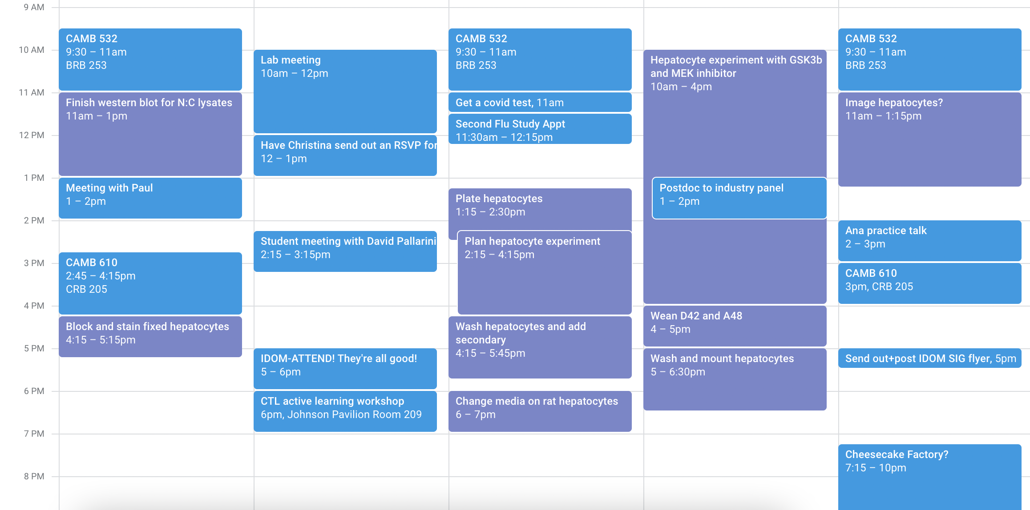
What to expect
Schedule

Slide 5
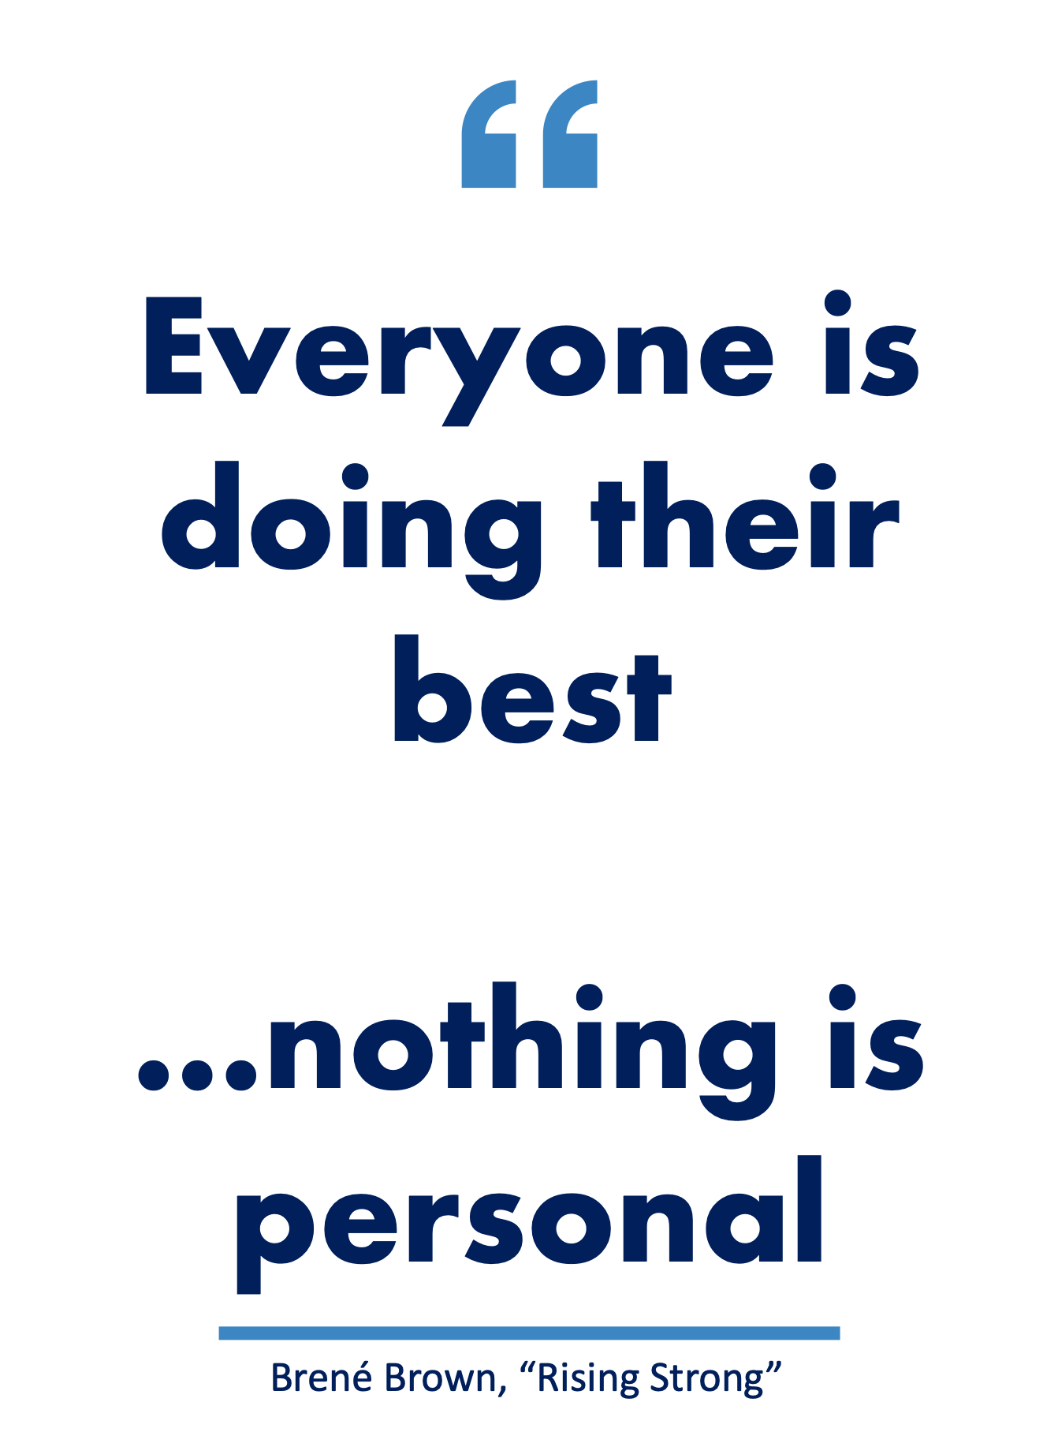
Advice for success
Pick the right mentor
Be professional
Engage in the obligations of the PhD
Take advantage of resources
  Conferences, off-site courses
  Penn’s larger community
  Grants
  Health and dental care, gym
Self care→ set up for success
Let go of prior expectations
Notes:
Engage in the obligations- go to class, talk to your TA’s, ask questions, talk to faculty when they’re teaching classes, volunteer to present at seminars, go to seminars, help with organizing events within and outside your grad group, mentor a student.
Be professional- treat your colleagues with respect, treat your rotation mentor with respect. Show up, do the work, do not come in assuming you know everything. Come in with an attitude to learn
Self care- create a routine that works for you! Smarter not harder- how many hours of sleep do you need? Does exercise help? Meal prepping? Budgeting so you can spend money to make your life easier?

Slide 6

More on picking a mentor
Considerations (in order of evaluation)
Communication style
Level of involvement, meeting frequency
Papers, authorship
What do current/past trainees and rotation students say?
Are they a subject matter expert in your area of interest?
Time-off policy, working hours
Lab management of resources
*You can switch labs and still be successful

Slide 7



Take advantage of resources
BGS office
Penn Graduate community
Academic
BGS weekly bulletin
  Fellowships
  Training grants
  Seminars
  Professional development programs
Individual Development Plan
Your graduate group administrators know everything and want to help
Graduate Student Emergency Fund
Undergraduate Assembly Legal Service
Gittis Legal Clinic
Graduate Student Center
  Language Center
  Writing workshops
GAPSA funding
Conference attendance:
  $1000 to a conference per year
  $1500 for one off-site course
  $1000 for a career development conference
Microsoft office, Prism, Adobe
Training grants (T32)
Individual grants (e.g. F31)
Notes:
Do not forget that you are at an Ivy league institution with a large endowment and lots of brain power at your disposal. Many places to ask for help. Money is often there if use is justifiable.
Penn Carey School of law

Slide 8
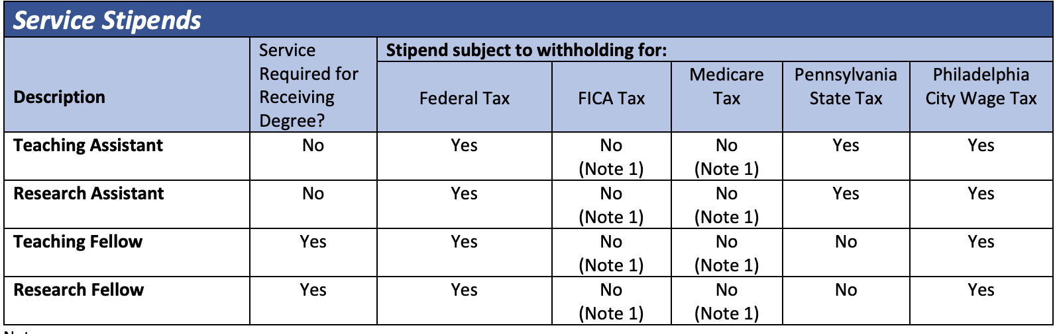
Finances
Taxes
Personal finance
Do not pay state tax
Pay estimated tax at least through 2nd year (until income is W2-based)
  On a T32, F31, or other grant mechanism, university will not withhold taxes
Check your pay slip in Work Day
May be worth having HR Block or similar do your taxes
Create a budget, but do not nickel and dime your safety
  Lots of sample spreadsheets online
If you can, set aside money for retirement
  Graduate student research fellows can now contribute to a Roth IRA
If you have extra savings, put it in a high yield savings account (4-5% interest annually versus 0.5-1.5% in a checking account)
TA’ing becomes an option after 3rd year
Plan vacations for yourself
Notes:
Do not pay state tax- get a signed letter saying you are a research fellow and that you do research to fulfill a graduation requirement, not as a service to the university
Estimated tax- withhold about 250-350 dollars per month. You can calculate your estimated tax payment online to ball park it. Just do your best, set calendar reminders, make the estimated tax payments and keep records of them!
Budgeting can be challenging because costs like rent, food, utilities, fuel go up. 50-30-20 rule doesn’t always work. Do not go cheaper in rent if it means compromising your safety. Facebook has been a good place to interview random roommates.

Slide 9
Thank you for your attention
mstefko@pennmedicine.upenn.edu

