Slide 1
Lab Notebook Management
Sample, Data, and File Organization
BGS Orientation
Tuesday, August 20, 2024
Chelsea Thorsheim (6th Year, CAMB CPM, Arany Lab)

Slide 2
Notebook organization is critical
Find data faster
Easily share protocols, reagents, data
Minimizes mistakes

Slide 3
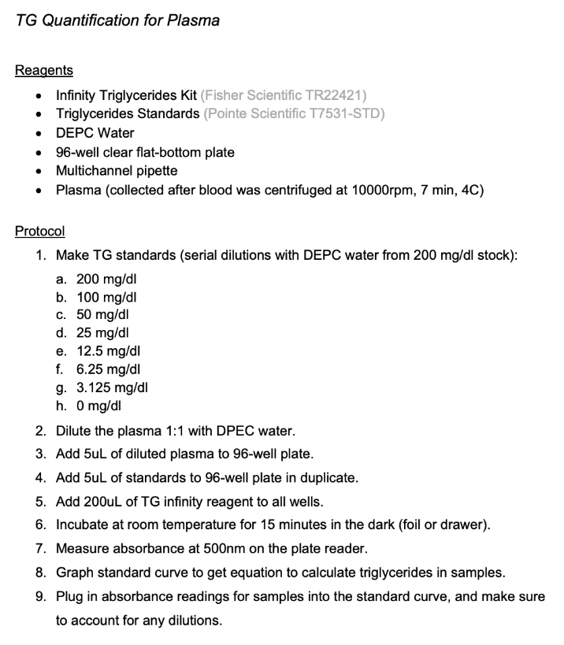
Adopt a system EARLY!
Electronic, paper, or combo?
If all electronic, ELN or your own system?
Standardize your protocols

Slide 4
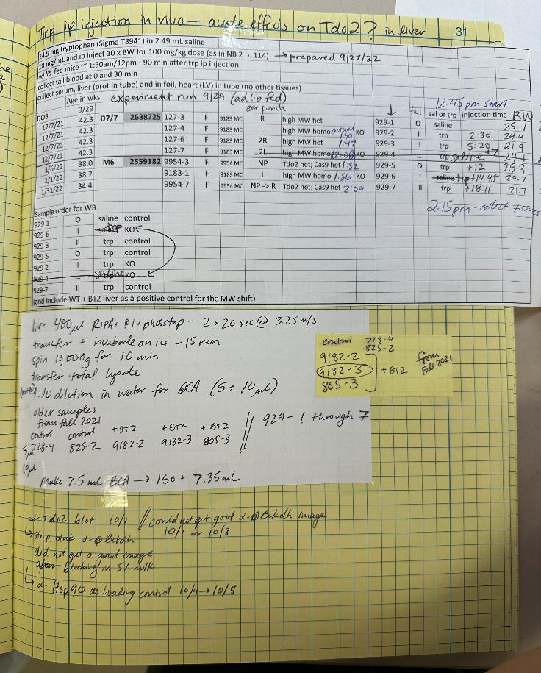
Must-haves in notebook entries
Experimental Identifier
Date
Purpose
Methods/Protocols
Conclusion (if possible)

Slide 5
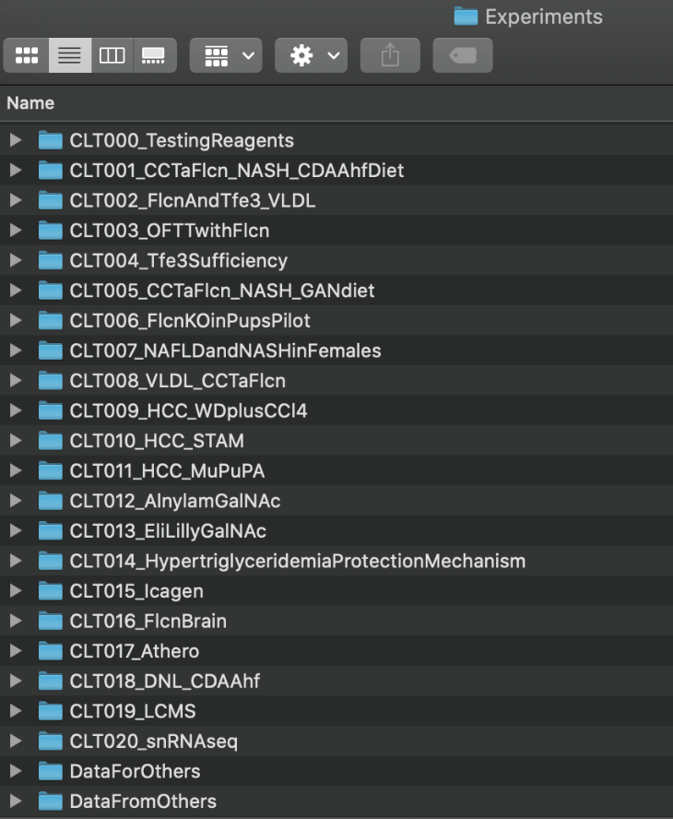
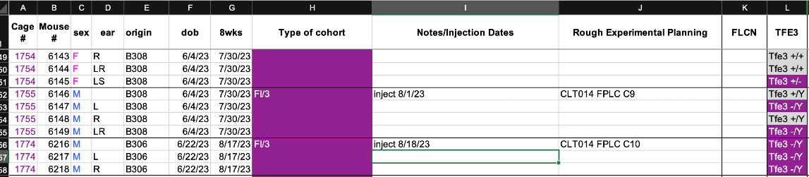
Utilize a number system
Every experiment (or overarching experiment) gets a number
  Include your initials
Every mouse/animal gets a number

Slide 6
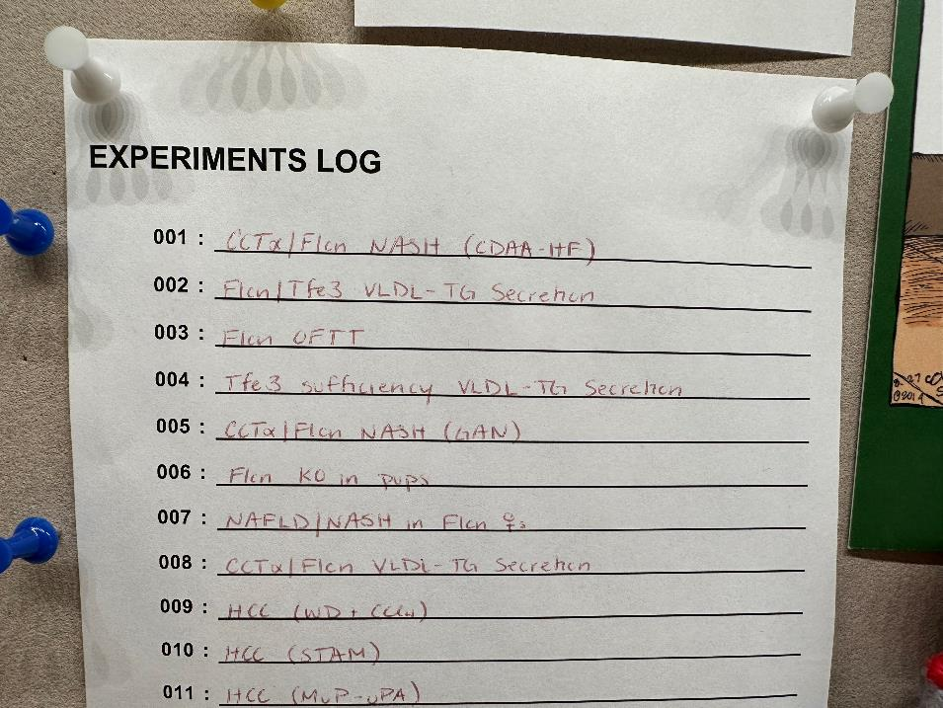
Utilize a number system: Table of Contents
Keep a printout with blank spaces to label experiments
  Put it somewhere easily accessible
  Fill it out consistently

Slide 7
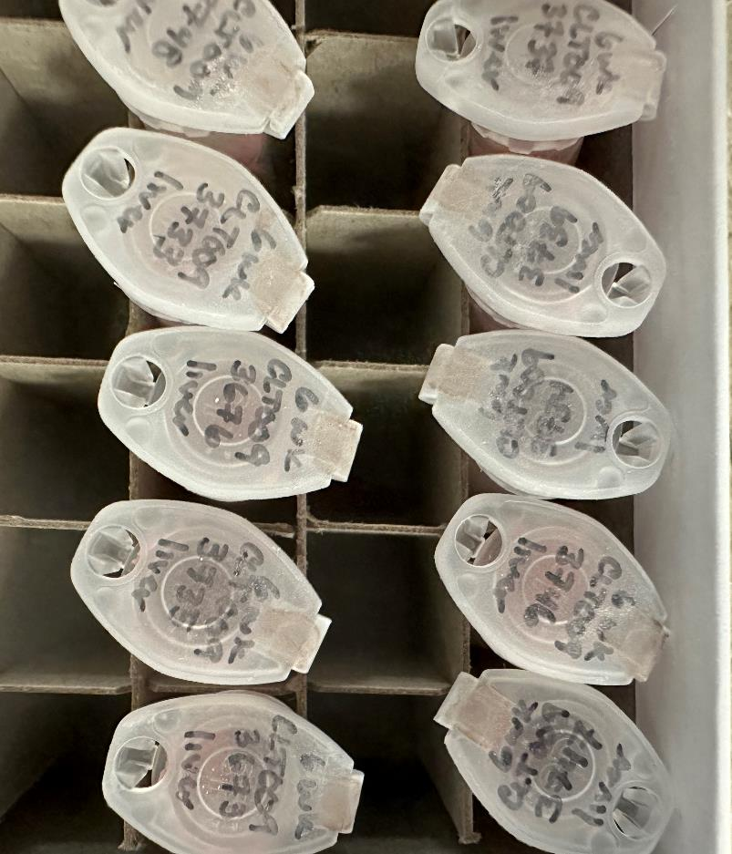
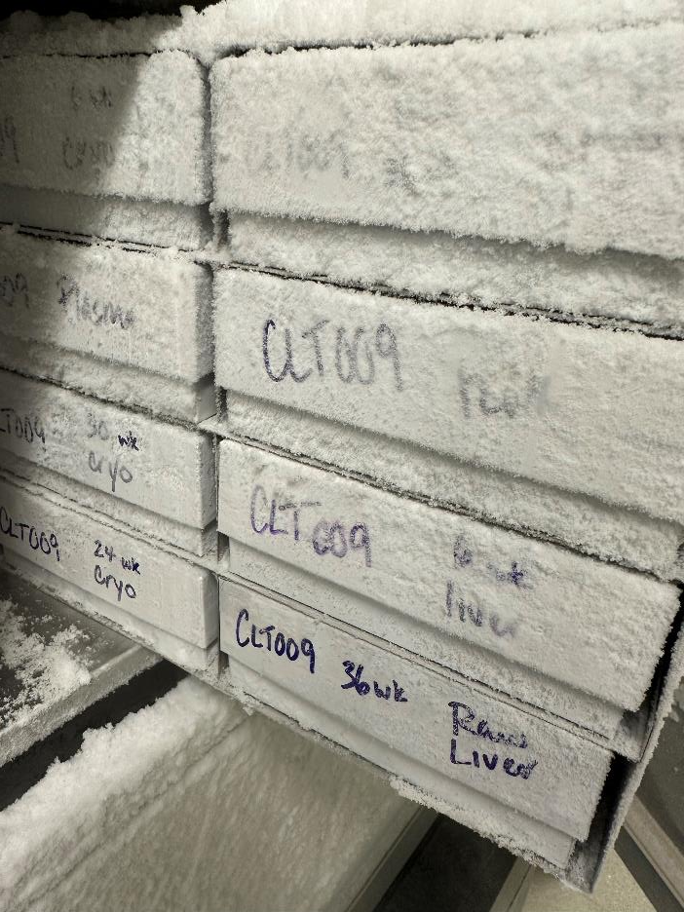
Utilize a number system: Sample organization

Slide 8
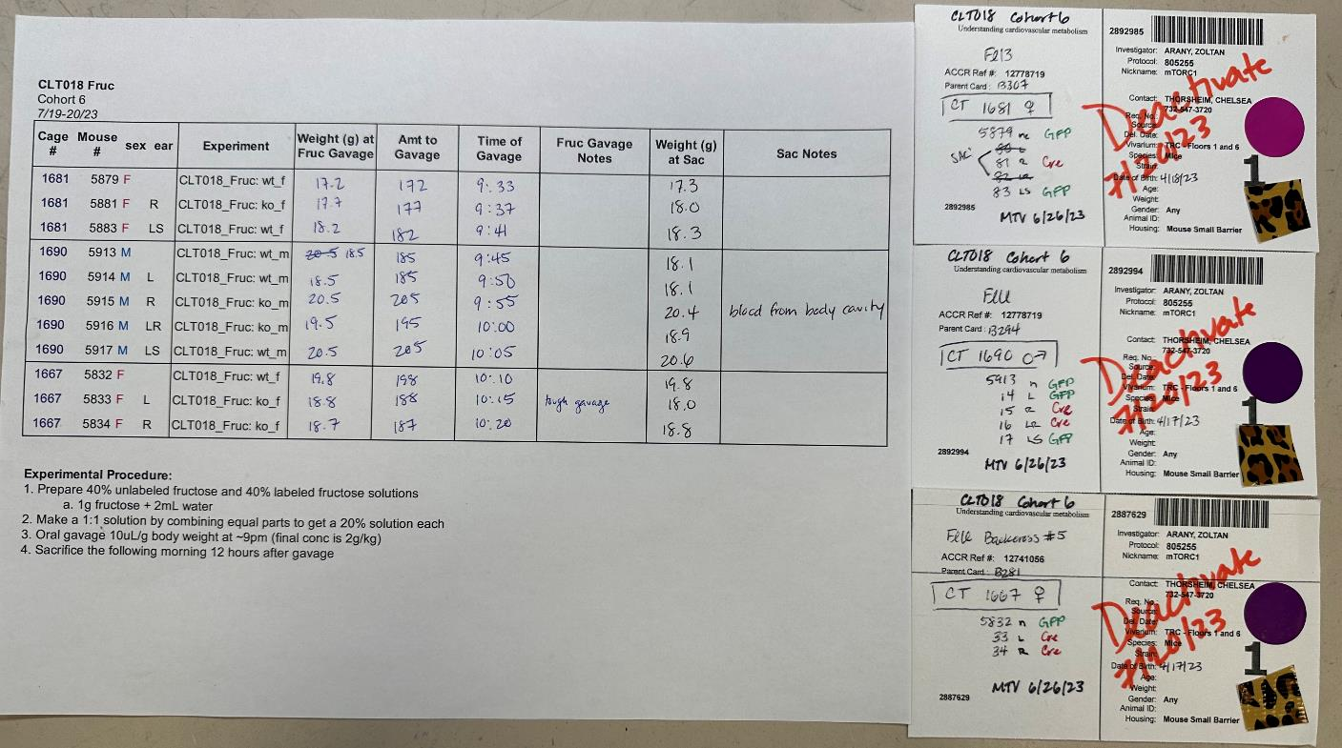
Utilize a number system: Notebook keeping

Slide 9
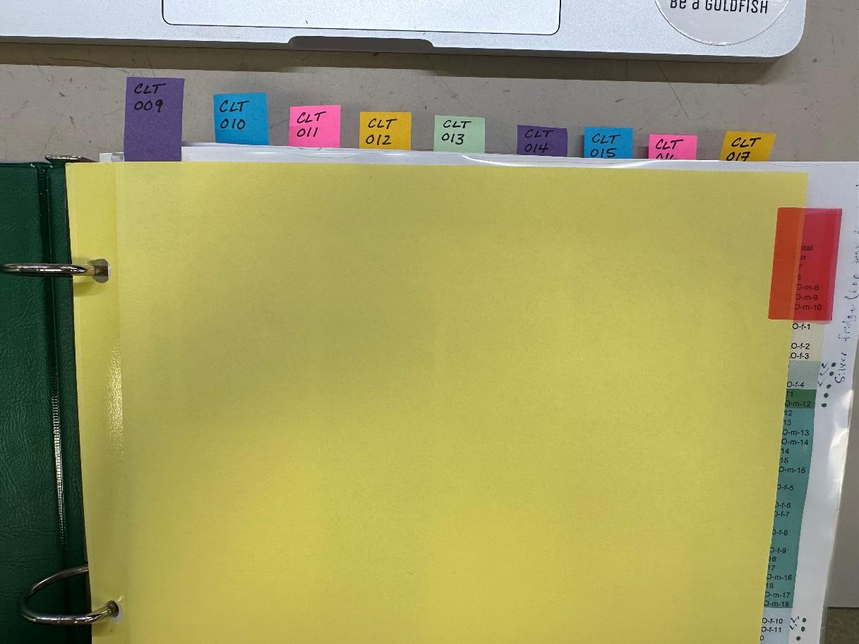
Utilize a number system: Notebook keeping

Slide 10
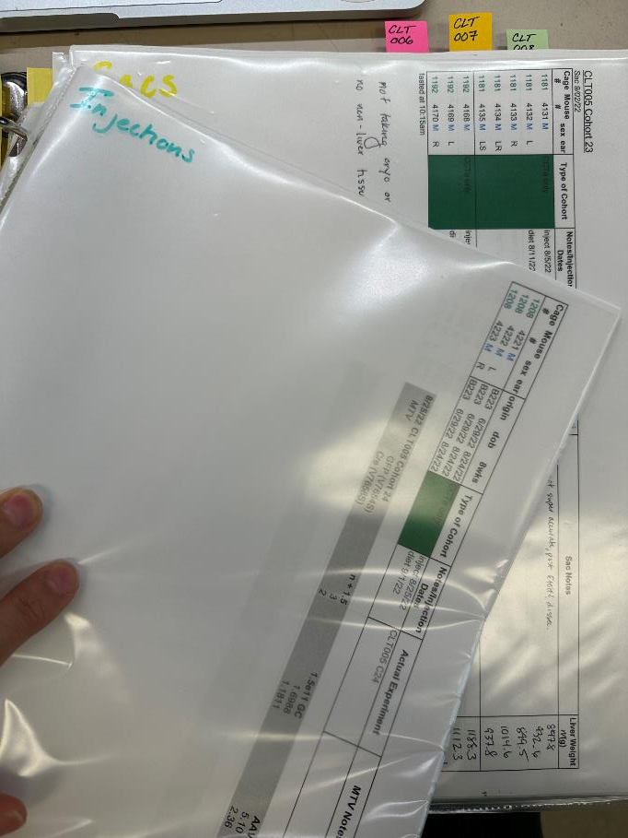
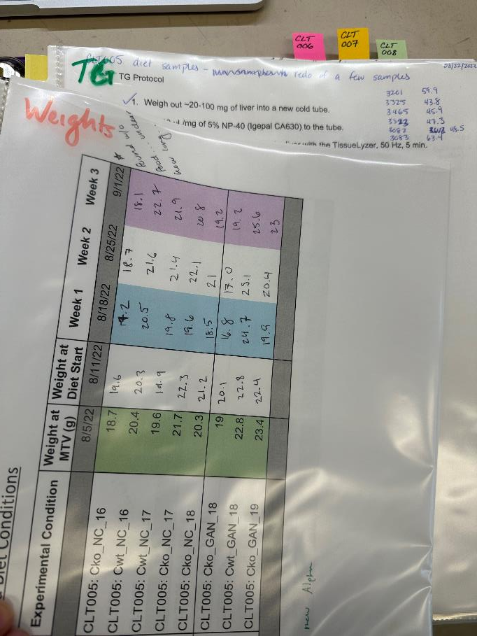
Utilize a number system: Notebook keeping

Slide 11
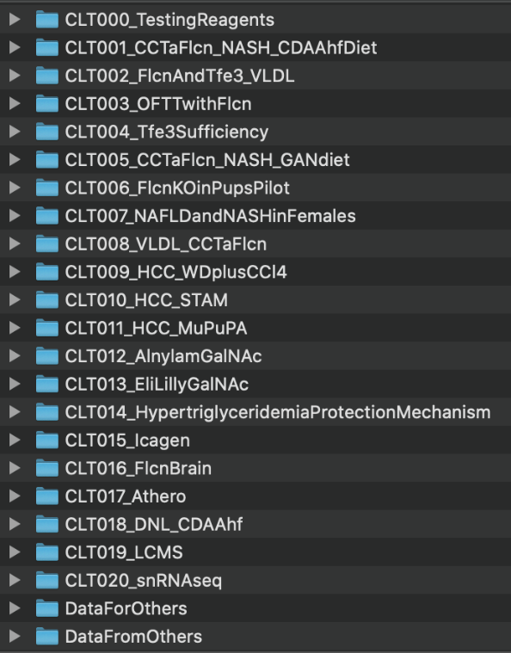
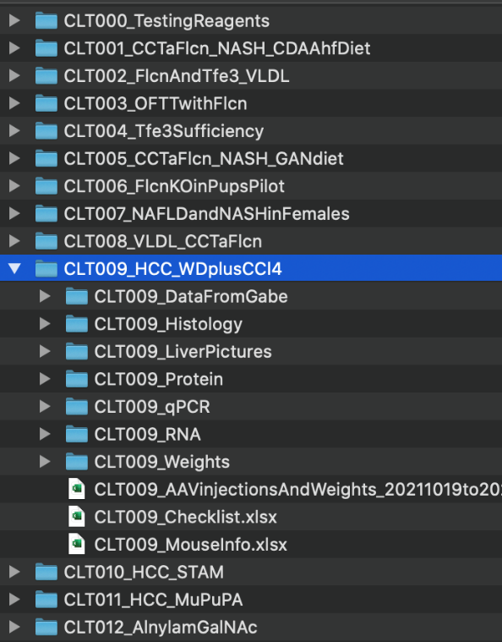
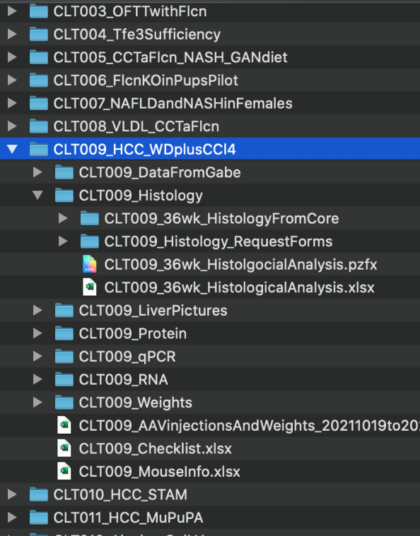
Utilize a number system: File organization

Slide 12
Example #1 of utilizing the number system
Western Blots for CLT014
Experimental Identifier
Date
Purpose
Methods/Protocols
Conclusion (if possible)

Slide 13
Example #1 of utilizing the number system
Western Blots for CLT014

Slide 14
Example #1 of utilizing the number system
Western Blots for CLT014

Slide 15
Example #1 of utilizing the number system
Western Blots for CLT014

Slide 16
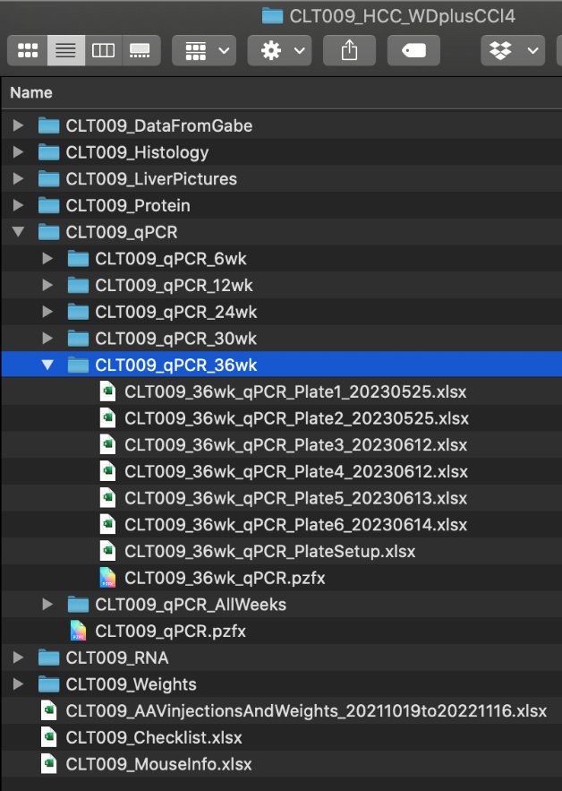
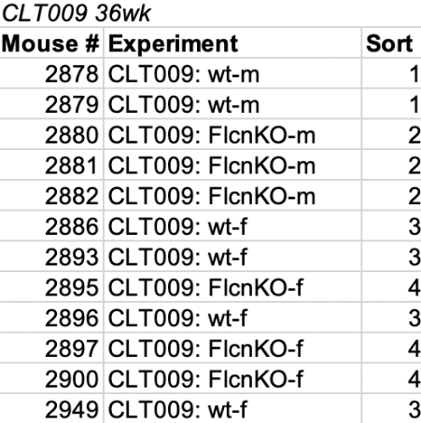
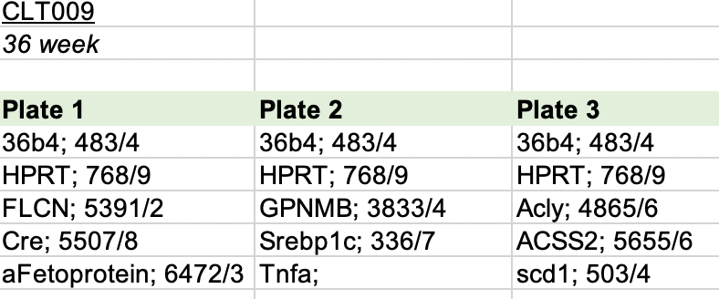
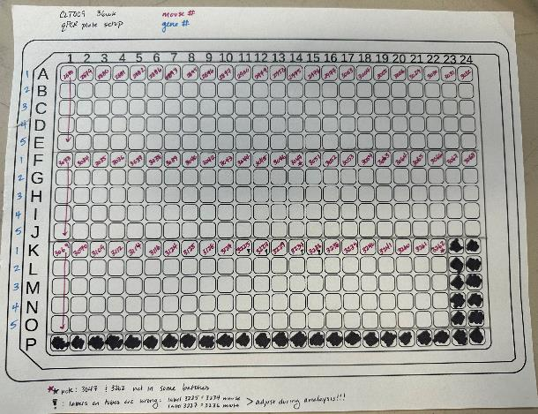
Example #2 of utilizing the number system
qPCRs for CLT009

Slide 17
Advice
Try out different methods during rotations if you have flexibility
  Also ask if there is a particular method that is required of the lab
Don’t make too rigid of a system
  Too much work to maintain the notebook will make you less likely to do it

Slide 18
Key Takeaways
Adopt a system that works best for you and your lab
  All electronic
  All paper
  Combo
Assign numbers to your (overarching) experiments and consistently use those numbers
Someone should be able to go look at your notebook and find all of the information they need to reproduce or find data

Slide 19
Questions?
Chelsea Thorsheim
thors@pennmedicine.upenn.edu

