Slide 1

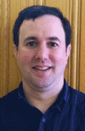
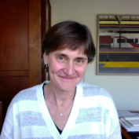
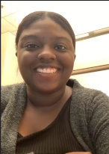
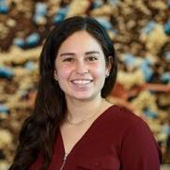
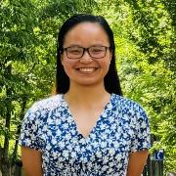
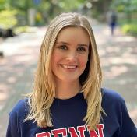
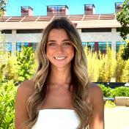
Graduate Training in Medical Science (GTMS)
Co-Director
Jonathan Katz
jpkatz@upenn.edu
Co-Director
Jenni Punt
punt@vet.upenn.edu
Administrator
extraordinaire
Masen Boucher
Jordan McKinney
Abi Chavez
Megan Costa
Candace Cain
Candace.Cain@Pennmedicine.upenn.edu

Slide 2

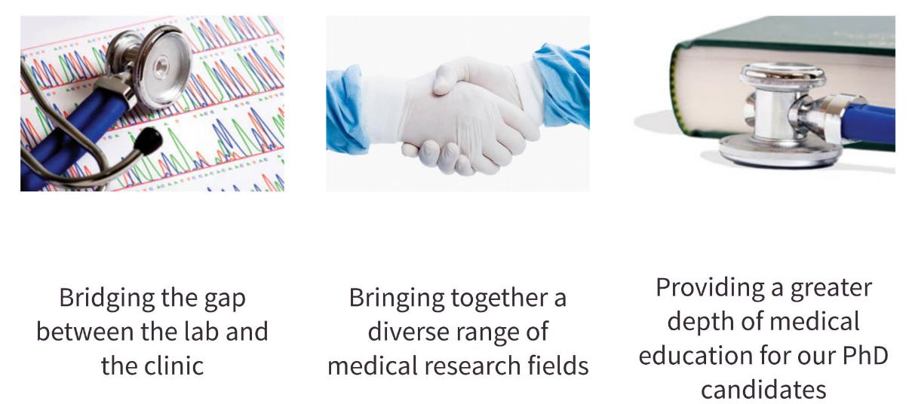
What is GTMS about?

Slide 3
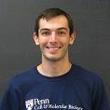
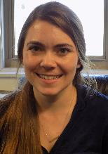
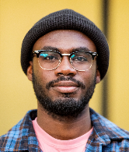
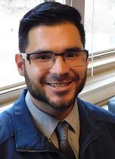
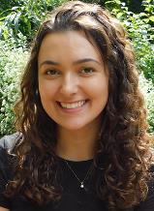
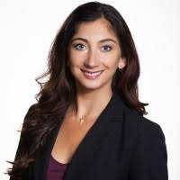
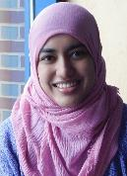
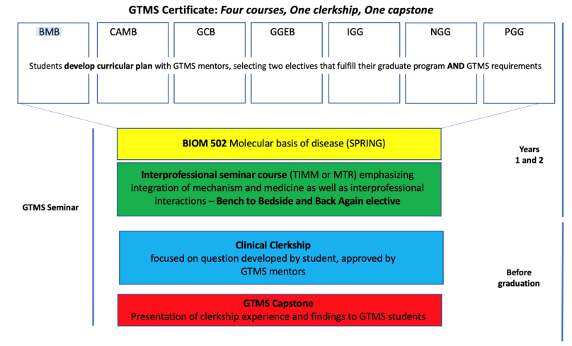
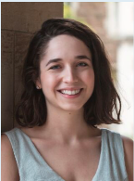
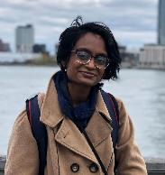
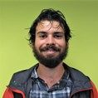
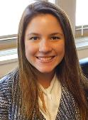
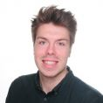
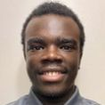
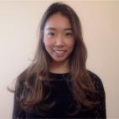
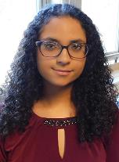
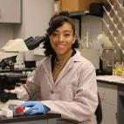
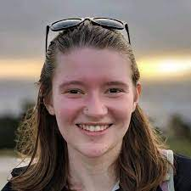
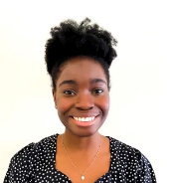
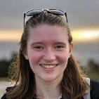
Our GTMS Program
40+ students from almost all BGS grad groups
10-15 students admitted each year

Slide 4
Program Overview
Clinical/Translational Coursework
Monthly GTMS Seminar Series
Annual Multi-School Symposium
Clinical Clerkship

Slide 5
CUrriculum
Develop a curricular plan with your GTMS mentors
TWO courses relevant to your translational interests that also fulfill your graduate group (preferentially elective) requirements.
BIOM 502: Molecular Basis of Disease – specifically for GTMS students
ONE BENCH-TO-BEDSIDE ELECTIVE

Slide 6
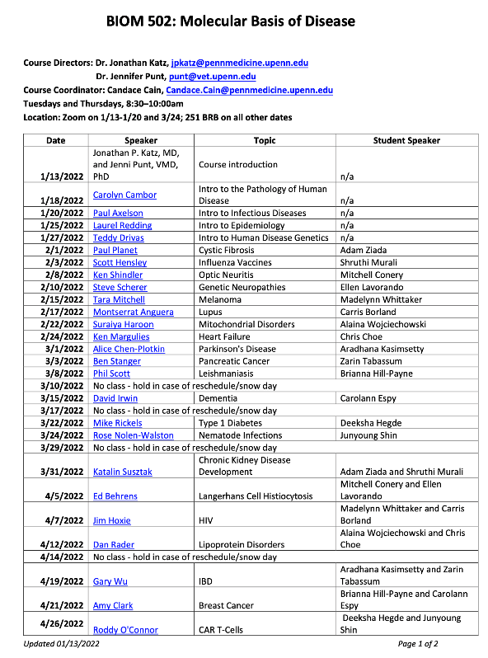
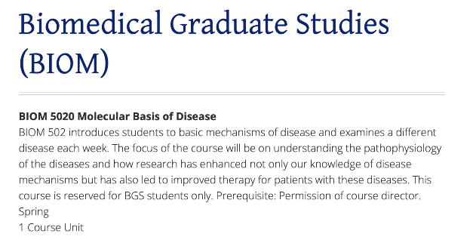
Biom 502
The signature course of the program – and a wonderful one.

Slide 7
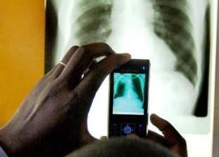
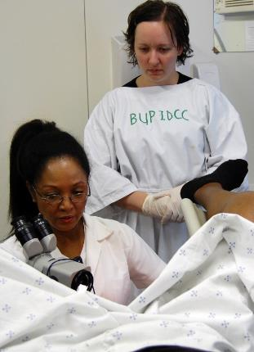
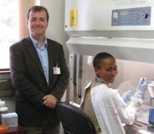
Clinical Clerkship
  Goals:
    Gain insight into drug development, medical care delivery and/or patient-oriented research.
    Expand professional network.
  40 hours in a clinical setting: Flexible and based on your interests
      Attend medical rounds
      Shadow physicians and veterinarians; observe surgeries
      Observe autopsies, necropsies
      Gain familiarity with clinical laboratory diagnostics
      Gain exposure to Penn’s global health clinics
      Gain exposure to clinical trial
  Keep a journal of your clinical experiences
  Present your experience at the GTMS Seminar

Slide 8
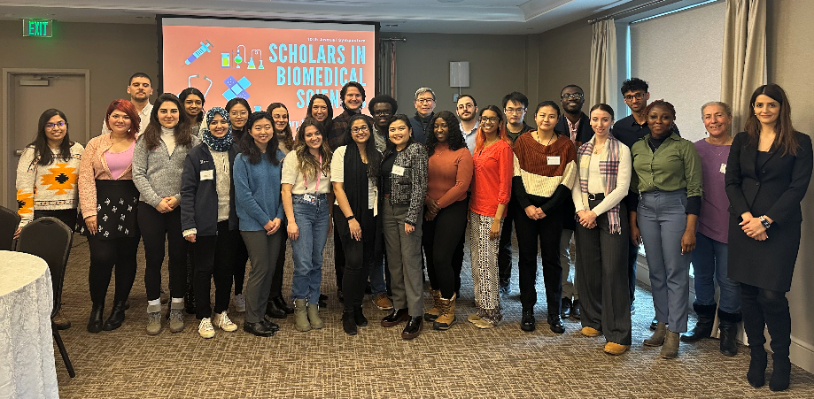
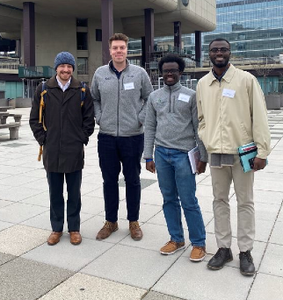
Annual Multi-School Student Symposium
Rotating symposium with Harvard, Yale, Memorial Sloan Kettering, Columbia, Stonybrook and Penn PhD students
    2018-19 Yale
    2019-20 Penn
    2023-2024 Stonybrook
    2024-2025 Harvard
Notes:
This year at Yale, next year at Penn

Slide 9
What are our graduates doing?
Principal Scientist and Director of Scientific Licensing, Janssen Pharmaceuticals
Associate Director of Research and Senior Scientific Advisor, Castleman Disease Collaborative Network
Cancer Prevention Fellow, National Cancer Institute
Assistant Professor of Pathology, Virginia Commonwealth University
Postdoctoral Fellow, Salk Institute
Senior Analyst for Corporate Development, ACADIA Pharmaceuticals
https://www.med.upenn.edu/gtms/former-students.html

Slide 10
GTMS Monthly Seminar
An informal monthly gathering of GTMS students.
Topics and speakers are selected by 2nd year students and include investigators sharing their experiences and expertise in:
    Startup and Entrepreneurship
    Patent and Intellectual Property
    Drug Development
    Clinical Trials: design, monitoring and data analysis

Slide 11
Why join GTMS?
The future of biomedical research depends upon:
  The involvement of the basic science community in addressing important, unmet clinical needs to improve human health
  Communication and collaboration among physicians, veterinarians and basic scientists
You!

Slide 12

Sounds great, but can I still apply?
Accepting applications through September 30th – but please come to the first seminar if you are curious!
Website: http://www.med.upenn.edu/gtms
Administrator:
Candace Cain, Candace.Cain@upenn.edu
Directors:
Jonathan Katz, jpkatz@upenn.edu
Jenni Punt, punt@vet.upenn.edu
https://pixabay.com/

Slide 13
Thanks to our GTMS students
current
and former

