Slide 1

Career Paths Mentoring Program (CPMP)
CPMP Coordinators:
Kim Apodaca, Emily Daley, & Aradhana Kasimsetty

Slide 2
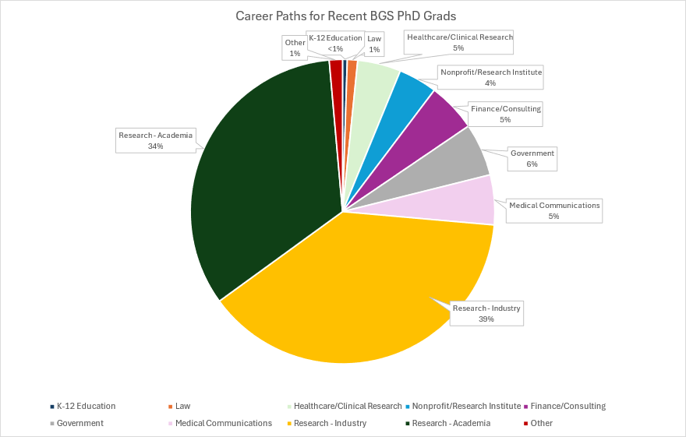
What Career Paths do Penn BGS PhD’s Pursue?
Current Jobs for Penn Graduates
PhD programs focus on academic career trajectories
37% of BGS graduates hold industry roles, but these roles are not well understood by PhD Students
26% of BGS graduates hold “Alternative Career Paths” which are not discussed or advertised to current PhD Students
PhD students have a lack of exposure for a majority (63%) of Current PhD Alumni Jobs
Data Courtesy of BGS Career Development

Slide 3
CPMP – A Program for Current PhD Job Preparedness
Goals of the Program:
Facilitate frequent and long-lasting interactions between trainees and alumni
Encourage networking and professional development including relationship building, teamwork, and mentoring
Provide advice on exploratory approaches to different career paths to effectively compare and contrast future career options
BGS Alumni are recruited to be mentors and are committed to small group meetings with students for the academic year on a monthly basis
Students can select from mentor groups based upon their career interests
CPMP is 100% virtual to encourage mentors from all locations and schedules to be able to participate
Students from all BGS Programs can sign-up

Slide 4
Mentoring Group Compositions 2023-2024
70 BGS Alumni were recruited to the program in 2023.
Each mentoring group consists of 2-3 mentors + 3-5 students
Career Discovery Groups
Academia/Medical Communications (2)
Academia/Industry Research (2)
Academic Postdoc/Industry
Academia/Teaching
Business/Industry (3)
Government/Regulatory Industry
Science Policy/Communications
Research in Different Sectors
Focused Career Groups
Academic Roles
Academic Teaching
Business/Financial
Business Consulting
Consulting/Industry
Business Law
Government/Non-Profit
Medical Field/Public Health
Tech (2)
Industry (8)
Notes:
Every year we put together career discovery groups of professionals from different sectors, and focused career groups for students to explore, compare, and contrast different career options. These groups are formed based on alumni availability, and current student interests. A majority of students are inclined towards learning more about Industry and alternative career paths. Although, earlier career graduate students gravitate towards more career discovery based groups to compare and contrast what they are learning in an academic setting to other job sectors.
Career Group Areas (based on BGS categorization)
Academic Research
Communications
Business/Financial
Government/Nonprofit Research
Industry
Research Clinicians
Academic Research/Teaching

Slide 5
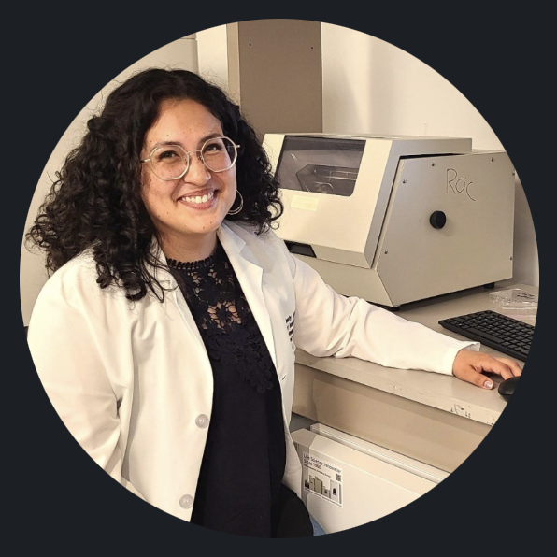


Students Recommend the Program:
“I'm very happy I participated this year. It is a very low pressure and high reward program with mentors who want to help you having been former Penn students themselves.”
“I was able to form a good long-term relationship with my mentors and got valuable feedback on my resume, cover letter, job application process, and I learned about useful job skills that we do not speak about during PhD training.”
Career Paths Mentoring Program
CPMP 2024-2025 Calendar
BGS Alumni Mentor Recruitment (Sept)
Kick Off Mixer (End of Sept)
Graduate Trainee Sign Ups (Oct)
Monthly Mentoring Groups (Nov-May)
Wrap Up Event (June)
Please contact us with any questions and be on the look out for the 2024-2025 CPMP student sign-up form in October!!
Contacts:
Kim Apodaca: kapodaca@pennmedicine.upenn.edu
Emily Daley: Emily.Daley1@pennmedicine.upenn.edu
Aradhana Kasimsetty: arkas@pennmedicine.upenn.edu

