Slide 1
Career development & Exploration
Career Development — Dan Kessler
  Theme: To Build and Capitalize on your Skills & Traits.
Career Paths Mentorship Program — Kim Apodaca

Slide 2
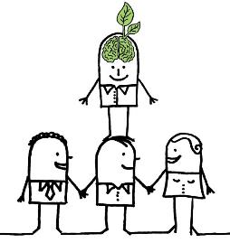
YOUR primary GOAL:
CREATE YOUR ‘PROFESSIONAL SELF’
Become these shoulders to stand on.
You will be here*
The science you do must be:
Responsible, Reproducible
& Rigorous
To what professional purpose will you use the PhD?

Slide 3
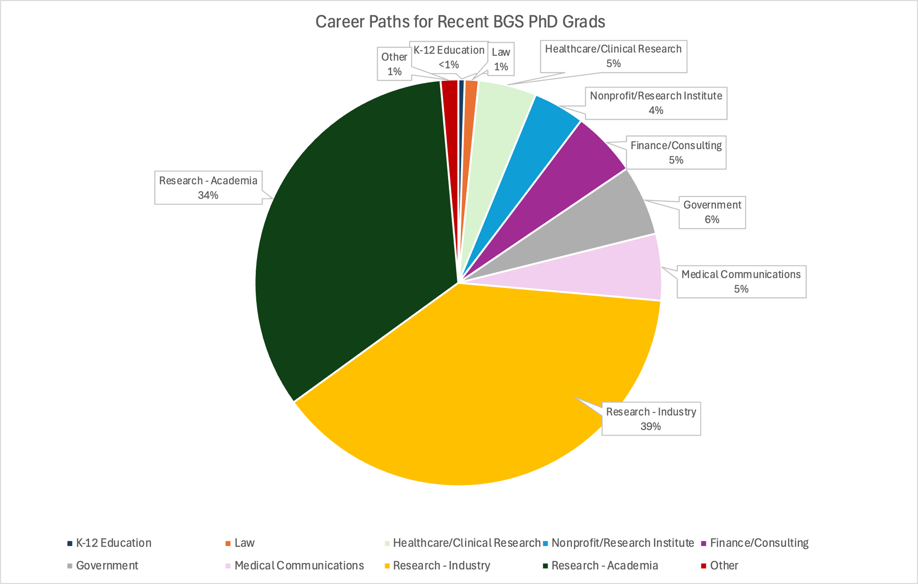
BGS PhD Graduates 2009 – 2018
Notes:
2007-2016

Slide 4
How to enGage in career development?
I. Cultivating research-specific skills and traits.
II. Using an Individual Development Plan (IDP).
III. Exploring career paths.

Slide 5
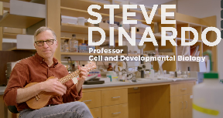
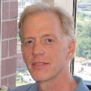
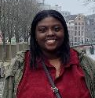
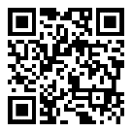
Career Development
Kurt Engleka
Director of Curriculum
(he, him)
Director, Training Support &
Career Development
(he, him)
Candace Cain
Career Development Coordinator
(she, her)
Biomedical Graduate Studies
BGS Career Development Website
Notes:
The idea in today’s talk and panel session is to provide you with a clearer idea of what PhD training is about and how this positions you for employment within different kinds of careers.

Slide 6
what Qualities are gained by
PhD Training ?
PhD Training
Skills
Traits
– an absolute requirement for any
research-intensive scientific endeavor

Slide 7
Skills from your phD

Slide 8
Skills from your phD
Critical Thinking
Acquiring and processing of information
Gauging evidence and arguments
Recognizing assumptions
Recognizing logical relationships
Drawing warranted conclusions
Competence in Mathematical and
Computational Practices
Mathematical reasoning
Statistical inference
Systems-level modeling
Proficiency in Experimental Design
Articulating a scientific premise
Developing a hypothesis
Testing hypotheses/Protocol design
Reagent validation/Troubleshooting
Data management
Management
Time management
Project management
Work ethic; work/life balance
Mentorship
Leading and motivating others
Networking
Conflict management
Communication
Clarity, precision, and intent
Effective listening and feedback
Manuscript writing
Grant writing
Posters/multimedia
Speaking to a scientific audience
Speaking to a lay audience

Slide 9
traits from your phD
Self-motivation & work ethic
Focus
Persistence – Resilience
Curiosity: a desire for answers and the search
Capacity to balance Receptivity with Skepticism
Creativity – Imagination
Kindness – Empathy – Patience
Adapted from Emotional Competency

Slide 10
career success:
Qualities gained by PhD Training
PhD Training
Skills
Traits
– absolute requirements in any form of research-intensive scientific endeavor
– highly valued in a diversity of professions

Slide 11

With The right mix
You can choose your path!
•Skills
•Traits
•Interests
•Values

Slide 12
How to engage in career development?
I. Cultivating research-specific skills and traits.
II. Using an Individual Development Plan (IDP).
III. How to explore career options.

Slide 13
How to engage in career development?
CREATE YOUR ‘PROFESSIONAL SELF’
You will be here*
Do good science!
Cultivate essential skills and traits

Slide 14
How to tackle career development?
I. Focus on developing and cultivating
research-specific skills and traits.
II. Individual development plan (IDP).
III. How to explore?
Notes:
With regard to the specific elements of …. I have just mentioned the first and most important, which is to focus on developing and/or….

Slide 15
Individual Development Plan
A Mentor-Mentee Collaboration
IDP Goals:
  Pause & thoughtfully evaluate
    Strengths and Areas for Development
    Research Progress
  Assess your career objectives
    Short-Term & Long-Term
  Design a plan to achieve your objectives
Update IDP Annually:
  A ‘living document’ that reflects your progress, needs and aspirations

Slide 16
Individual Development Plan
A Mentor-Mentee Collaboration
Added benefits of IDP process:
  An essential Mentor-Mentee planning discussion
  Utilize critical Mentee skills:
    Effective Communication – Active Listening
    Aligning Expectations
    Collaborative Strategies – Defining & Meeting goals

Slide 17
How to engage in career development?
I. Focus on developing and cultivating
research-specific skills and traits.
II. Individual development plans (IDPs).
III. Exploring Career Paths.

Slide 18
BGS PhD Graduates 2009 – 2018
You can and should explore what interests you.

Slide 19
Paths for career Exploration
Graduate group-specific workshops
Training grant-specific workshops
Alumni Career Panels
BGS Certificate Programs
Students Groups
Mentors, Advisors, and Peers
Notes:
There exist within BGS 3 certificate programs that provide an extra dimension to what’s required of you through your graduate group
… to explore such items and science policy, patent law, business
…

Slide 20
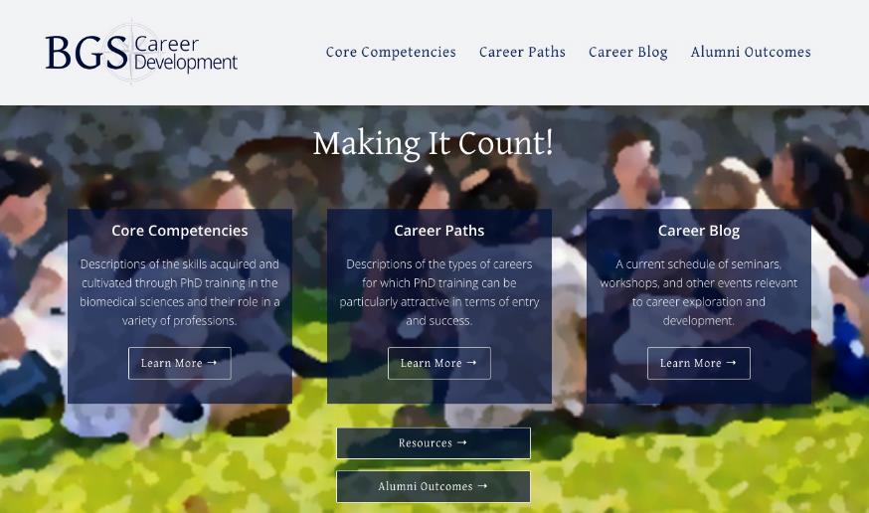
BGS Career development
Website
DiNardo, Jackson, Engleka & Cain

Slide 21
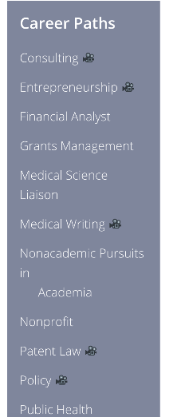
Career development website
Notes:
…..if there’s any kind of career event going on in BGS or something relevant in the university you’re going to find it here. You should really try to access this every week.

Slide 22
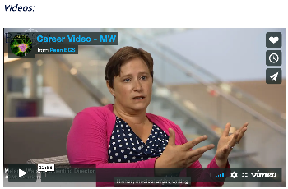
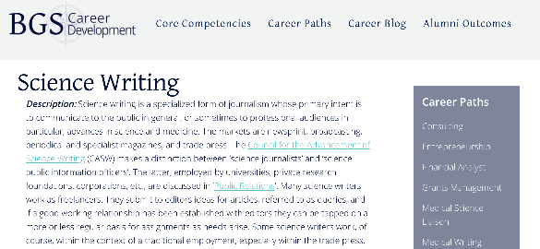
Career development website
Informative video shorts
by Alums
Notes:
…..if there’s any kind of career event going on in BGS or something relevant in the university you’re going to find it here. You should really try to access this every week.

Slide 23
Paths for Career Exploration
Center for Excellence in Teaching, Learning and Innovation: CETLI Teaching Certificate
Penn Center for Innovation: PCI Fellows Program
  https://pci.upenn.edu/pci-fellows/
Career Services: Career Exploration Fellowship
  https://careerservices.upenn.edu/phd-career-exploration-fellowship/#CEFapply
Notes:
Career Services at the University is university-wide, but has two very competent individuals who provide biomedically related programming.
Center for Teaching and Leaning is also University-wide and provides a CTL Teaching Certificate for those interested in teaching as at least one facet of one’s career.
The Penn Center for Innovation is all about the translation of discoveries into new products, services, and businesses. It offers….
… all the support and networking in all kinds of different areas
Career Exploration Fellowship: open to all PhD students; non-faculty career exploration opportunity for doctoral students through networking and fostering mentorship relationships with advanced degree holding professionals in various sectors including industry, non-profit, and government organizations
Many BGS students have participated, fellow spotlight stories here: https://careerservices.upenn.edu/blog/?ctag%5B%5D=phd-career-exploration-fellowship
List of past hosts: https://careerservices.upenn.edu/resources/2024-cef-host-descriptions-packet/

Slide 24
Other Career services Resources
Career Services for graduate students
  Life and Physical sciences
    https://careerservices.upenn.edu/channels/life-physical-sciences/
  Curated “LinkedIn learning” modules
  Career workshops/programming
    Graduate Career Skills Series, Faculty Job Search Camp, Doctoral Career Development Camp, First Generation Graduate Student Week, etc
  Biosciences Career Fair (held every Fall)
  CV/Cover Letter Review
  Handshake
Notes:
Examples of past CS workshops:
Graduate Career Skills Series –week of mostly virtual career related programs centered on helping grad students navigate their careers: https://careerservices.upenn.edu/gcss-2023/
Faculty Job Search Camp - series of workshops and panels for those pursuing faculty careers: https://careerservices.upenn.edu/faculty-job-search-prep-camp-2024/
Doctoral Career Development Camp - multi-week program of afternoon workshops that centers career and professional development of doctoral students: https://careerservices.upenn.edu/dcdc2023/
1st Gen Grad Student Week - week of virtual professional and career development programs with focus on supporting and enhancing experience of first generation graduate students: https://careerservices.upenn.edu/2023-first-gen-graduate-student-week/
Biosciences Career Fair - career fair where students can meet/network w/ employers in life and physical sciences, learn about internships and jobs in a broad range of industries and career fields (this year’s will be September 27): https://careerservices.upenn.edu/biosciences-career-fair-2024-students-and-postdocs/
Handshake – all Penn students receive a Handshake account. You can make appointments with CS staff for career-related advice (interviews/CV/cover letter/etc), register for events and job fairs, and apply to jobs/internships: https://upenn.joinhandshake.com/stu

Slide 25
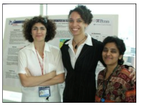
Certificate programs
https://www.med.upenn.edu/bgs/cert-progs.html
Graduate Training in Medical Science (GTMS) Certificate
Public Health Certificate
Environmental Health Sciences
Community Engaged STEM Certificate
Certificate in Biomedical Informatics
Certificate in Language and Communication Sciences
Certificate in Public Health and Cognitive Aging
Certificate in Social, Cognitive and Affective Neuroscience
Certificate of Study in Law
Certificate Program in Regulatory, Translational, or Entrepreneurial Science

Slide 26
BGS supported Career Exploration opportunities
External Course
Externship
Teaching Assistant
IDEAL Research Fellow
Abbvie
Apple
AstraZeneca
Centers for Disease Control
Eli Lilly
Johns Hopkins
Genentech
Gilead Sciences
GlaxoSmithKline
Merck
RazorFish Health
Recursion Pharmaceuticals
Takeda Pharm Co
United States of Care
23 and Me
Notes:
BGS students can do TA/internships with approval and submission of the additional training and compensation form, for paid positions that are up to 10 hours/week: https://www.med.upenn.edu/bgs/assets/user-content/ta-forms/ta-and-other-activities-fillable-pdf.pdf
BGS students can also receive up to $1,500 during their time in program to attend one off-site course

Slide 27
The Bottom line:
Leverage your PhD training to make the greatest possible impact on society.
Whatever path YOU choose, you will have the Skills and Traits to succeed.

