Slide 1

Biomedical Graduate Student Association
The Biomedical Graduate Student Association (BGSA) is the coordinating student body charged with representing all students enrolled in the Biomedical Graduate Studies program at the University of Pennsylvania. We monitor issues of importance to the biomedical graduate students and Master's & Certificate programs student community, represent the concerns of those we represent to the University administration, and advocate for changes to enhance the quality of biomedical graduate education. We also serve as a liaison among the student populations of the biomedical graduate programs and sponsor both academic and social events of interest to the biomedical graduate student and Master's & Certificate student community.

Slide 2
Biomedical Graduate Student Association
Represent Biomedical Graduate Studies students
Represent Masters and Certificate students
Raise issues to the BGS Administration, GAPSA, and other stakeholders at Penn
Funding for student groups and organizations
Planning of BGS and MaC events

Slide 3
Get Involved!
Attend General Assembly Meetings
Selected Tuesdays at 5pm (~3-4 weeks apart)
Vote on funding requests, find out about upcoming events hosted by BGSA, bring issues to our attention
Dinner provided
Open to all BGS and MaC students
Current planned dates: 9/3, 9/24, 10/22, 11/19, 12/10 (subject to change)
Run for an Executive Board Position
Open positions:
Vice-Chair, MaC Affairs (MaC students only)
Social Media Chair
GAPSA Representatives (Research)
GAPSA Representatives (Professional)
Graduate Group Program Representatives
Board members attend monthly GA meetings and EB meetings (5pm monthly onTuesday)
EB plans academic and social events of interest to BGS students, works with student leaders in other G12+ schools, advocates for BGS and MaC students and more.

Slide 4



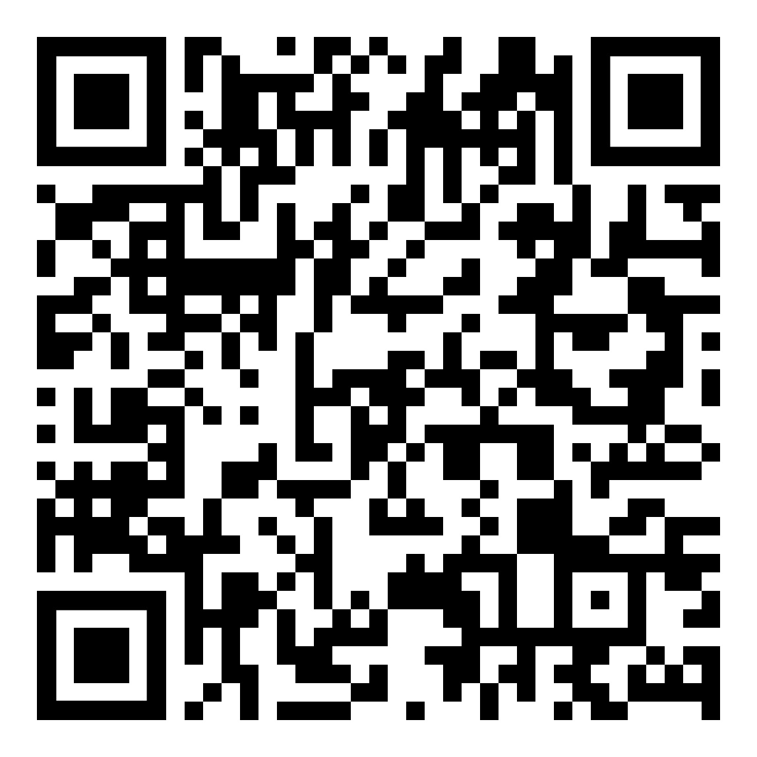
Follow us on social media!
@PennBGSA

