Slide 1



For the Joy of Notebooks:
Guidance, Considerations, and a Call to Action
Benjamin F. Voight, PhD
Associate Professor
Department of Systems Pharmacology and Translational Therapeutics
Department of Genetics
Chair, Genomics and Computational Biology (GCB) Graduate Group
@bvoight28

Slide 2
Your Intuition and Experiences
Have you ever attempted to reproduce:
… Your own experiments?
… Experiments from a lab member?
… A collaborator?
… From a previous published paper?

Slide 3
Your Intuition and Experiences
How many have kept a notebook for their past scientific endeavors?
What types of notebooks did you keep?
What differences/similarities are there in keeping notebooks for wet-lab vs. dry-lab experiments?
How many practiced “eternal vigilance” in notebook keeping?
… What kept you from keeping up?
… What helped you remain vigilant?

Slide 4
You must keep a Notebook.
Utilize a combination of types that suit your projects and approaches.
You should create good habits around notebook keeping. Start now!

Slide 5
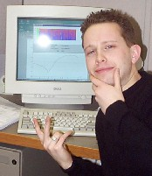

What you might hope it looks like to get science done

Slide 6
What it can actually look like to get science done in practice

Slide 7

What helping keep a notebook can actual do to help get work done now and in the future

Slide 8
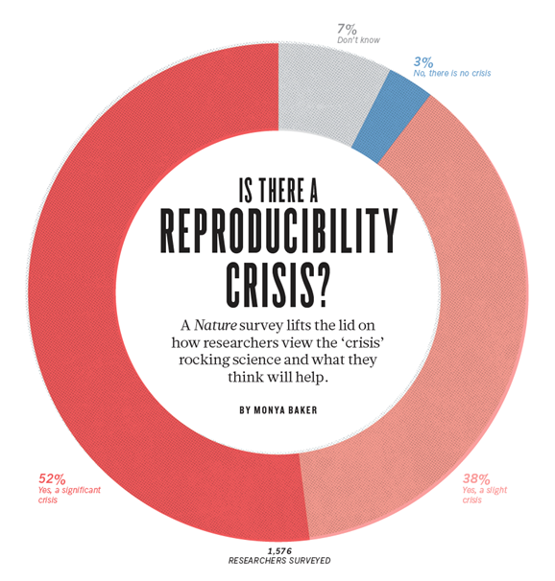
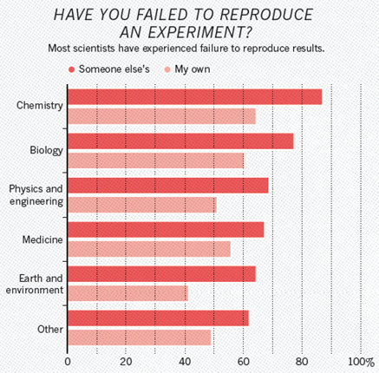
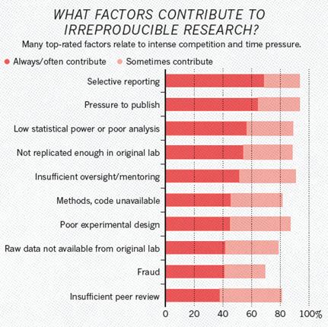
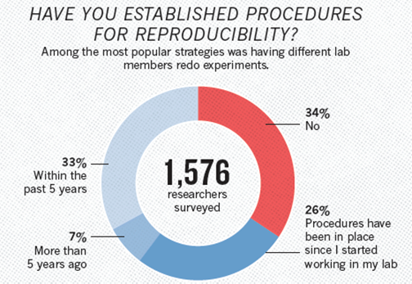
We are in a reproducibility crisis.
Analysis pipelines can’t solve all issues in the (biological) reproducibility crisis.
But specific results from analysis should be 100% technically reproducible! (with any bugs identifiable)
Baker, Nature (2016)

Slide 9
Four Reasons to Keep a Good Notebook
Reproducibility
Time Stamps: Patents
Defending claims of misconduct
Efficiency: Saves Time and Effort

Slide 10
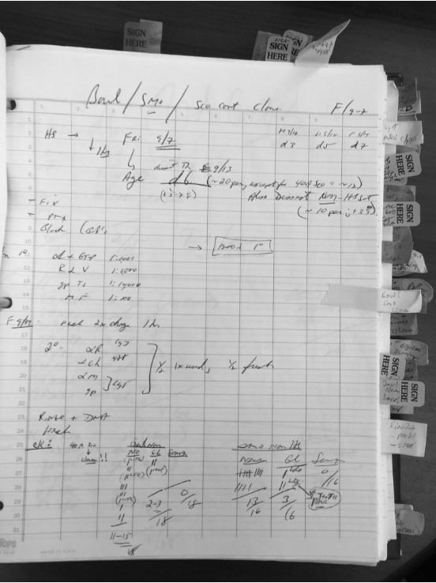

Slide 11
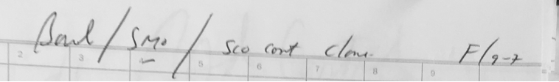

Slide 12
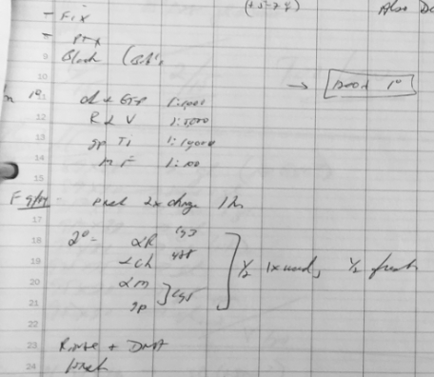

Slide 13
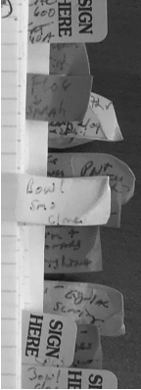

Slide 14
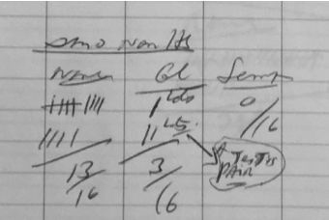

Slide 15
Lots of Issues!
Handwriting
Little if any clear organization or organizing principles
Context absent or turbid
Protocol details lacking
Results or outcome missing or poorly documents
No details on progression, interpretation (“What’s next?”)

Slide 16
Key Standard
Could a colleague read and fully understand experimental details?
Could YOU reproduce the result a year from now?
{Saves time, effort, established Rigor.}

Slide 17
Guidelines: Overview
Stay Organized
Provide Context for Experiments
Document the Protocol
Report Results
Contemplate, interpret, consider next steps
Keep things simple, but sufficiently detailed so you can understand
Date material that you add

Slide 18
Guidelines: Keep Organized
Organization is a critical step
At the level of the entire notebook: Table of Contents
For searchability: Electronic notebooks! (see later talks)

Slide 19
Guidelines: Keep Organized
Organization is a critical step
At the level of the the individual experiment
Daily entries, dated
Permanence: Ink or Electronic
Document everything
Don’t filter out bad experiments! (Future self! What did/did not work; key inflections)
See Responsible Conduct of Research (Shamoo & Resnick) and Scientific Integrity (Macrina)

Slide 20
Guidelines: Provide Context
Provide context for your experiments
What are you proposing?
Why are you doing this?
What are you hoping to find? set expectations on results
You can keep this simple! Accessible to others but also to remind you as you review

Slide 21
Guidelines: Document Protocol
Provide the protocol for what you did
What procedure are you following?
Did you make alterations? If so, enumerate.
Copy and paste can be OK – but if using the same thing, best to refer back
Create versions / updates as needed; if protocol evolves to keep ‘clean’
Anything that was taken forward to a paper needs to be specifically clear (and back referrable)

Slide 22
Guidelines: Report Results
Provide results for your experiments
Provide raw data, link to where kept
Provide synopsis / thoughts – what does this mean?
Consider next steps - what do you need to do?
Keep Entries Simple!

Slide 23
Can I go back and edit?
Of course you can!
Just date things.

Slide 24
Additional Points
Invite your PI to your notebooks (if electronic) - also the chair of your thesis committee
Your PI should, on occasion, review (and sign) your notebooks and approve how you have them organized
Your PI is accountable, you are responsible for them.
Notebooks are the property of the University, and must be retained (for a long period!)

Slide 25
How do I keep on top of this?
Build good habits!
Rotation: Use notebooks to talk about results and data.
Box out start of day, end of day, to populate.
Find a lab “Accountability Buddy”.
BACKUP YOUR DATA AND DOCUMENTS

Slide 26
Additional considerations for those data scientists out there…

Slide 27
What do I even mean by a “Data Scientist”?
Data Visualization
Data Wrangling
Data Intuition
Statistical Intuition
Programming
Comp. Notebook Skills

Slide 28
Additional Considerations for Data Scientist
Step One: A Notebook (Electronic) that documents computational experiments
I.e., follows approach we’ve been discussing up to this point
Step Two: Reproducibility for work from computational engines: Rmarkdown, Jupyter notebooks, etc. “executes code, works on data”
Step Three: Create code repositories in the cloud and build projects which are sharable, e.g. github.
If you don’t know about any of this, that’s OK: ask your colleagues!

Slide 29
Input
Output

Slide 30
Input
Output
Input
Output
...
Automation is key: call your code a bunch of times!

Slide 31
What you should always include in a workflow
Begin and enumerate the central question and rationale.
Identify who created (modified) this pipeline, date creation, contact info.
In the preamble, list the requirements, programs, versions, and/or files that will be required.
Develop a working flow with comments of the steps in human readable terms (not code or pseudo-code) of what is being done at each step and why
Begin with a set of easily obtainable, unmodified files
If you had to modify these files (i.e., quality control), describe why and include additional pipelines, commands, or links to tools that modified them
If possible, include example files that you know can/should work with the tool
At various steps, produce summaries/outputs that can be verified if the pipeline is producing what was previously performed.

Slide 32
Preamble
Who? When? What is the goal? Requirements?
Load Libraries
Load all R packages first (even if you realize you need them later)
Custom Functions
Place any custom functions up front as well
Data Input
Load in all the data files that you plan to use up front
Input processing
After you load, makes sense to parse, store in an object, make checks.
… parse, process, format, prepare the data for analyses, then do analyses
… output summaries, plots, etc., check that it makes sense
… then output summary tables / figures of merit as desired (and repeat)
Data Munging/Analysis
Summaries / Viz
Output

Slide 33
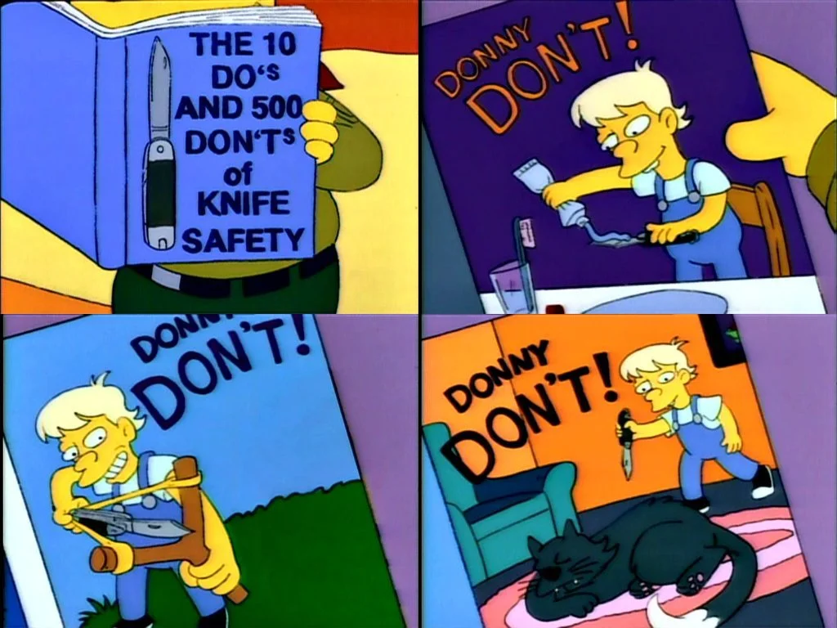
Simple don’t do eets of pipeline building
DON’T make “spaghetti code”. DO make your workflow
move from “top” to “bottom” in sequential steps.
DON’T make uber long chains/pipes/strings. Do break steps down into understandable ‘blocks’ of code that achieve a specific task.
DON’T hard code paths for data/files (static). Instead, ‘encapsulate’ - give users a (current) working directory, have everything they need referred to within it.
DON’T forget to add comments to your code. If you modify / debug, include additional comments and date to remind you what you did and why.
DON’T be lazy to document ‘what worked’. Be diligent, document required libraries, packages, scripts, etc. needed. sessionInfo()!
DON’T overwrite files. If you analyze files with the same name, you can overwrite them. Make sure your file outputs create unique file names!

Slide 34
You must keep a Notebook.
Utilize a combination of types that suit your projects and approaches.
You should create good habits around notebook keeping. Start now!

Slide 35
PGG
Christine Faunce
Julia Ferrante
Sydney Gang
Paul Kamitsuka
CAMB
Kassidy Cantwell
Annastelle Cohen
Megan Costa
Atharva Ankush Dhamale
Noah Ford
Ari Geller
Suzana Hossain
Keegan Krick
Jaydeen Sewell
Rachel Sklutuis
Ananya Talikoti
Ian Yannuzzi
Maxime Zamba-Campero
IGG
Laura Anderson
Montserrat Arreguin
Oishi Bardhan
James Chang
Lauren Cominsky
William Molina
Jason Shoush
BBCB
Rhiannon McCracken
Stay Tuned! Next up:
Data and File Organization - Chelsea Thorsheim
What’s an e-Notebook? - Kara McGaughey
Work in Computational Areas - Jeremy Rubin
Hands-On Training: Lab Archives, Benchling, One Note
Tomorrow:
RCR/SRR - Lab Notebooks - Kurt Engleka

