Slide 1
RCR AND SRR at PENN
New Student Welcome and Orientation
2024
Kurt A. Engleka (Ingelkay, hard “g”) (he/him)
Adjunct Assistant Professor, Cell & Dev Biol
Director of Curriculum, BGS
kengleka@pennmedicine.upenn.edu
orcid.org/0000-0001-5539-4076
Notes:
More acronyms! Is this the hardest part of graduate school?

Slide 2
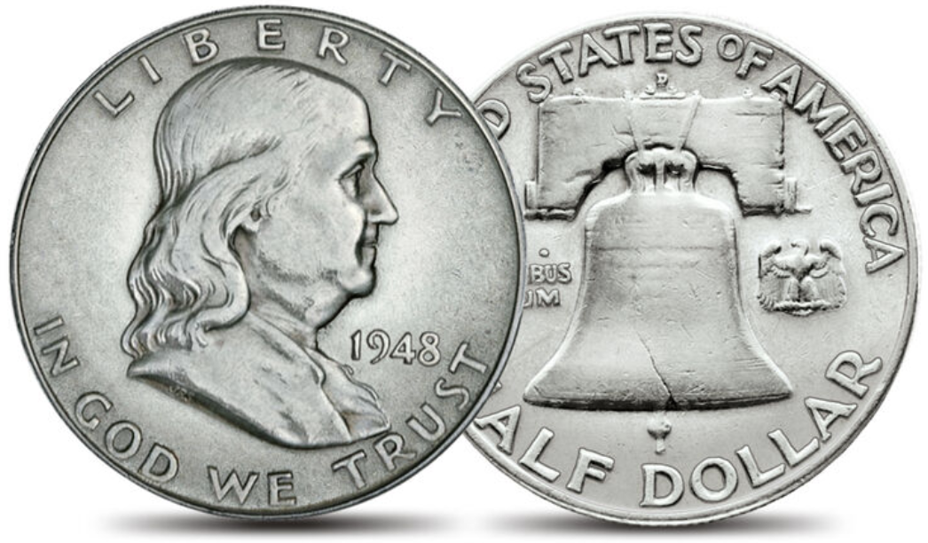
Two Sides of Same Coin
- either side you win -
Responsible Conduct of Research
(RCR)
Scientific Rigor and Reproducibility
(SRR)
Mandate that research be ethically sound and of rigorous methodological quality.
2
Notes:
Think about what I am going to tell you about today as two sides of the same (precious) coin: research integrity and reproducibility. Coin of the realm!
Goal of RCR/SRR efforts: demanding that research be ethically sound and of rigorous methodological quality
Institutions like UPenn support a continuing debate on attitudes and behaviors capable of compromising research integrity.
Encourage scientists to confront their own attitudes and behaviors.
The goals of RCR education and training are to:
Develop, foster, and maintain a culture of integrity in science;
discourage and prevent unethical conduct;
empower researchers to hold themselves and others accountable to high ethical standards;
increase knowledge of, and sensitivity to, ethical issues surrounding the conduct of research by researchers with diverse backgrounds;
improve the ability to make responsible choices when faced with ethical dilemmas involving research;
provide an appreciation for the range of accepted scientific practices for conducting research;
inform scientists and research trainees about the regulations, policies, statutes, and guidelines that govern the conduct of U.S. Public Health Service-funded research and promote compliance with the same; and,
promote a career-long positive attitude toward research ethics and the responsible conduct of research.
https://oir.nih.gov/sourcebook/ethical-conduct/responsible-conduct-research-training

Slide 3

Goals for today
Develop an awareness of best scientific practices.
Provide you with a basic set of resources and tools to promote your use of best scientific practices during your training, research, and career.
3
Notes:
This is an early discussion in the process of in engaging all BGS students in RCR and SRR initiatives. Today’s discussion serves as one step to be followed by many as part of life-long training in achieving excellence in science.
Our past selves – meaning scientific generations before you - are not innocent of mistakes and are part of the reason for RCR and SRR programs.
“improving the ability to judge and ‘do’ science well.”

Slide 4
YOU as A SCIENTIst
Self-
Learning
Institutional
Other
Scientists
You as a
Scientist
Funding
Applications
Publications
Research
4
Notes:
Before you can do great research, you have to truly internalize what great research in your field is.
NIH/NSF/Penn/CHoP/Wistar
Institutions have responsibilities they follow in terms of training and supervision, ethical standards and procedures, and the promotion of open science, particularly with regard to data management, publication, and disseminating study results.
Self-Learning
Learn by observation and imitation
Evaluation of yours and others’ experiments/results
Reading
Doing Experiments
Pay attention to speakers: what kinds of information are they telling the audience? How do they weave theory and experiments together? How do they present their findings? What kinds of questions do people in the audience ask? This will provide implicit learning opportunities. Reading papers is another way to do so, but in-person observation experiences can be irreplaceable.

Slide 5
What Are YOUR PRIMARY GOALs?
PERFORM GOOD SCIENCE
KNOW HOW TO IDENTIFY GOOD SCIENCE
HELP OTHERS IDENTIFY AND DO GOOD SCIENCE
All, as you CREATE YOUR ‘PROFESSIONAL SELF’!
Other scientists will know you first from quality of your work – that is your ‘professional self’.
5
Notes:
What are your goals? Give me some words…
Do good science – we are all curious and like solving problems
Recognize good science
Help Others – Kelly Jordan-Sciutto talked about this a lot from the point of view of you getting mentorship from others. Remember that you guide others, too
You are creating your professional self.
One characteristic of some highly-successful trainees: always had a plan for the next step in their career. When they started their PhDs, they were already thinking about where they would do their postdocs.

Slide 6
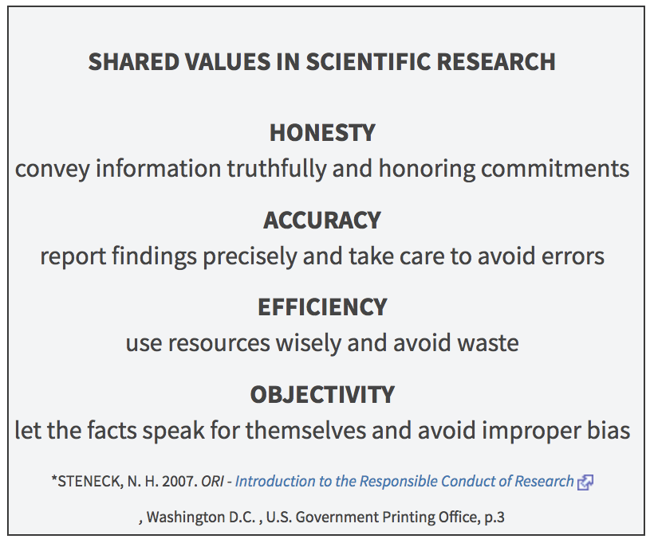
RESEARCH INTEGRITY
6
Notes:
Good science codified!
https://grants.nih.gov/policy/research_integrity/what-is.htm
Honesty
reporting the research process accurately
taking alternative opinions and counterarguments seriously
being open about margins of uncertainty
refraining from making unfounded claims
refraining from fabricating or falsifying data or sources and refraining from presenting results more favorably or unfavorably than they actually are
Scrupulousness
Using methods that are scientific or scholarly
Exercising the best possible care in designing, undertaking, reporting and disseminating research
Transparency
ensuring that it is clear to others what data the research was based on, how the data were obtained, what and how results were achieved and what role was played by external stakeholders
line of reasoning must be clear and that the steps in the research process must be verifiable
Objectivity
not guided by non-scientific or non-scholarly considerations (e.g., those of a commercial or political nature)
Impartiality/avoiding bias
letting the data speak for itself and
Responsibility
Consider the legitimate interests of human and animal test subjects, as well as those of commissioning parties, funding bodies and the environment
Conducting research that is scientifically and/or societally relevant.
code of conduct
(https://www.universiteitenvannederland.nl/files/documents
/Netherlands%20Code%20of%20Conduct%20for%20Research%20Integrity%202018.pdf)

Slide 7
Research Misconduct
Fabrication - Making up data or results and recording or reporting them.
Falsification - Manipulating research materials, equipment, or processes, or changing or omitting data or results such that the research is not accurately represented in the research record.
Plagiarism - The appropriation of another person’s ideas, processes, results, or words without giving appropriate credit.
7
Notes:
Academic plagiarism: intellectual theft.
Paraphrasing is academically dishonest: cite the source when using the idea.
Using content generated by generative AI in any context without providing clear and proper attribution of its origins is plagiarism.

Slide 8
AI and Plagiarism
Using content generated by generative AI in any context without providing clear and proper attribution of its origins is plagiarism.

Slide 9
Research Misconduct
Serious deviation from accepted practices
  stealing, destroying, or damaging the research property of others with the intent to alter the research record
  directing or encouraging others to engage in fabrication, falsification or plagiarism
Other policies cover misconduct that occurs in the research setting but that does not affect the integrity of the research record:
misallocation of funds
sexual harassment
discrimination
9
Notes:
Serious deviation from accepted practices includes but is not limited to stealing, destroying, or damaging the research property of others with the intent to alter the research record; and directing or encouraging others to engage in fabrication, falsification or plagiarism. As defined here, it is limited to activity related to the proposing, performing, or reviewing of research, or in the reporting of research results and does not include misconduct that occurs in the research setting but that does not affect the integrity of the research record, such as misallocation of funds, sexual harassment, and discrimination, which are covered by other University policies.
As defined here, it is limited to activity related to the proposing, performing, or reviewing of research, or in the reporting of research results and does not include misconduct that occurs in the research setting but that does not affect the integrity of the research record, such as misallocation of funds, sexual harassment, and discrimination, which are covered by other University policies.

Slide 10
Research Misconduct
Fabrication
Falsification
Plagiarism
Serious deviation from research practices
Does not include honest error, differences of opinion
  Proposing
  Performing
  Reviewing
  Reporting
…research or research results.
10
Notes:
Fraud is thought to be minor component of research enterprise BUT it is easy to detect using algorithms and data analysis.
Journals and other professionals screen publications and proposals for plagiarism, altered figures, etc using data analysis and sophisticated algorithms.

Slide 11
Unreliable Research …
Stifles advances in science and medicine
  Research (including yours) relies on rigor of previous work
  Barrier to effective therapies for patients and increasing life- and health spans
Wastes resources (including yours)
Fails current (you) and future generations
Damages credibility of the scientific community and reduces public support
11
Notes:
Robust research is particularly important because it forms the foundation on which future studies are built.
Clinical trials depend on high quality, robust preclinical data.
Unreliable research is inefficient and wasteful.
Time and money wasted due to failure of research projects based on irreproducible findings
Adverse effect on reputation and career prospects
Affects all stakeholders in preclinical life sciences research: funders, researchers, journals, industry, nonprofits, patients, the public
Shai Silberberg from https://www.physiology.org/career/policy-advocacy/reproducibility-in-research/reproducibility-in-research?SSO=Y#0
New knowledge in the biomedical sciences is built upon established and proven results.
A significant amount of research cannot be replicated. Late-stage clinical-trial failures.
Clinical trials depend on high quality, robust preclinical data.
“Millions of mice and rats are used in research each year. But one-third to one-half of animal experiments are never published, and of those that are, many are too poorly conducted to be reliable.”
Baker M. Animal registries aim to reduce bias. Nature. 2019 Sep;573(7773):297-298. doi: 10.1038/d41586-019-02676-4. PMID: 31501583.
Patients may be subjecting themselves to a trial of a regimen or agent based on research of low quality.
Safeguarding public confidence in research outcomes.
There are many examples of outstanding research that has been rapidly and reliably translated into clinical benefit.

Slide 12
Which reward system leads to misconduct and questionable research practices?
Survival
Publish lots of papers
Get lots of citations
Acquire funding
Get promoted
Good Research Practices
Rigor/reproducibility
Scientific collaboration
Unrestricted access
Freely sharing data
Value constancy of results with the goal of building reliable knowledge about the world.
12
Notes:
The pressure to increasingly publish in high-impact journals, receiving numerous citations, obtain funding for research, or be appointed to a certain positions are major drivers of misconduct and questionable research practices. Responsible scientific behavior and success are increasingly at odds.
Current system: fierce competition for scarce resources leads to choices that do not really align with the goal of building reliable knowledge about the world.
Don’t think it is better to be first rather than right.
Many questionable research practices stem from methodological flaws.
Role of supervisors, PI’s, and mentors: which reward system?
Competitiveness often drives science onto sidetracks, away from addressing the most important questions and pursuing transformative ideas as people are forced or incentivized to go for low-hanging fruits and trends. (Sara Wickström)
Are we training students/post-docs how to be good paper publishers and not discoverers of new knowledge?

Slide 13
TRAGEDIES
Entitlement
I’ve worked so hard on this, and I know this works, and I need to get this publication.
Temptation
Getting my name on this article would look really good on my CV.
Deception
I’m sure it would have turned out this way (if I had done it).
Rationalization
It’s only a few data points, and those runs were flawed anyway.
Incrementalism
It’s only a single data point I’m excluding, and just this once.
Ambition
The better the story we can tell, the better a journal we can go for.
Embarrassment
I don’t want to look foolish for not knowing how to do this.
Group and Authority Pressure
The PI’s instructions don’t exactly match the protocol approved by the ethics review board, but she is the senior researcher.
Stupid Systems
It counts more if we divide the manuscript into three submissions instead of just one.
13
Notes:
Gunsalus CK, Robinson AD. Nine pitfalls of research misconduct. Nature. 2018 May;557(7705):297-299. doi: 10.1038/d41586-018-05145-6. PMID: 29769690.

Slide 14
areas that require
Responsible Conduct
Acquisition and Management of Data
Collaborative Science
Conflicts of Interest and Time
Mentoring
Peer Review
Research Misconduct
Responsible Authorship and Publication
Scientists as Responsible Members
of Society
Use of Animals in Research
Use of Humans in Research
Provide you with resources and tools to promote best practices
ETHICAL QUESTIONS
CAN WILL ARISE
IN THESE
SUBJECT AREAS
14
Notes:
research misconduct and questionable research practices;
data management - i.e., data acquisition, record-keeping, retention, ownership, analysis, interpretation, and sharing;
scientific rigor and reproducibility;
responsible authorship and publication;
peer review;
conflicts of interest in research;
mentor/mentee responsibilities and relationships;
collaborative science;
civility issues in research environments, including but not limited to, harassment, bullying, and inappropriate behavior;
policies regarding laboratory safety, biosafety, and human and animal research subjects;
views about scientists as responsible members of society;
social and environmental impacts of research; and,
contemporary ethical issues in biomedical research.
https://oir.nih.gov/sourcebook/ethical-conduct/responsible-conduct-research-training

Slide 15

Training in RCR/SRR
Your training in RCR/SRR is continual.
Why?
See concepts several times; In different contexts
= they are “sticky”!
  On-line instruction (‘Knowledge Link’)
  Workshop-based using ‘Case Studies’
  RCR-focused lab meetings
15
Notes:
So, with regard to the nuts and bolts of training, know first that NIH requires training of us and other biomedical institutions in RCR.

Slide 16

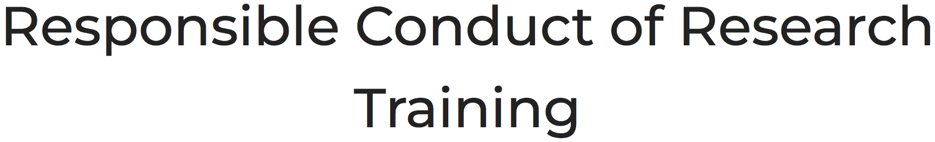
NIH RCR Resources
“…applies to all NIH Institutional Research Training Grants, Individual Fellowship Awards, Career Development Awards (Institutional and Individual), Research Education Grants, Dissertation Research Grants, or other grant programs with a training component …”
16
Notes:
https://oir.nih.gov/sourcebook/ethical-conduct/responsible-conduct-research-training

Slide 17

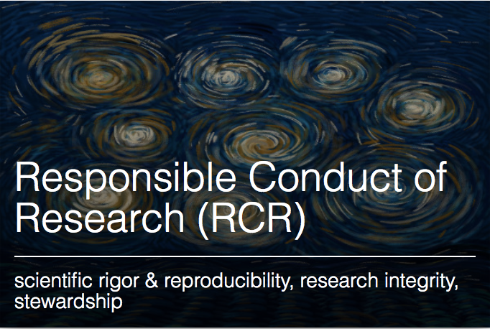
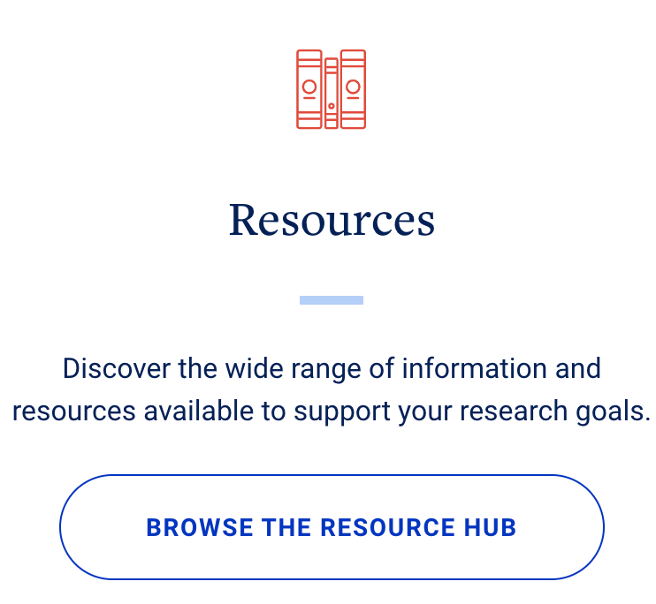
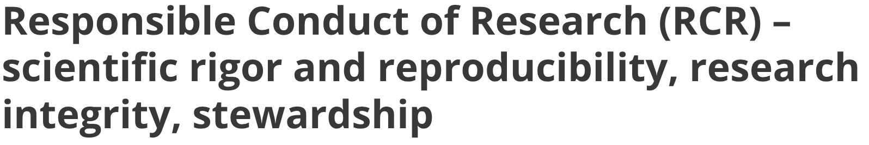
https://research.upenn.edu/research-support/
17

Slide 18

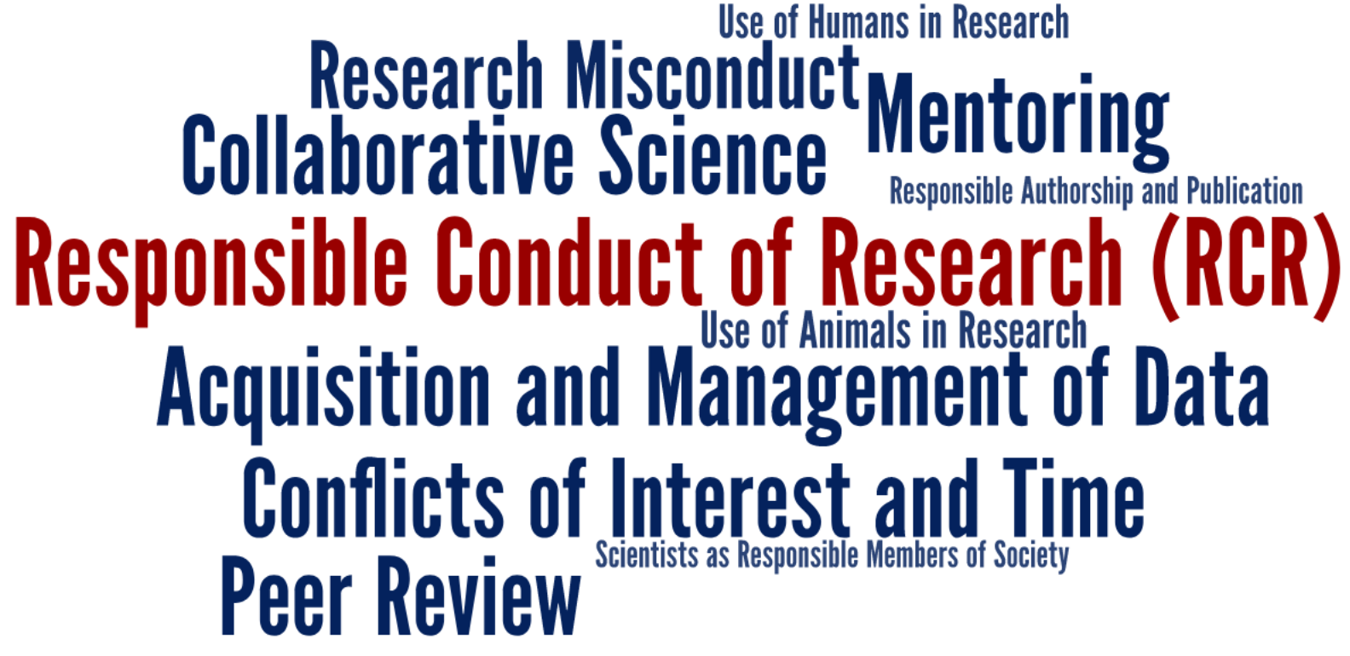
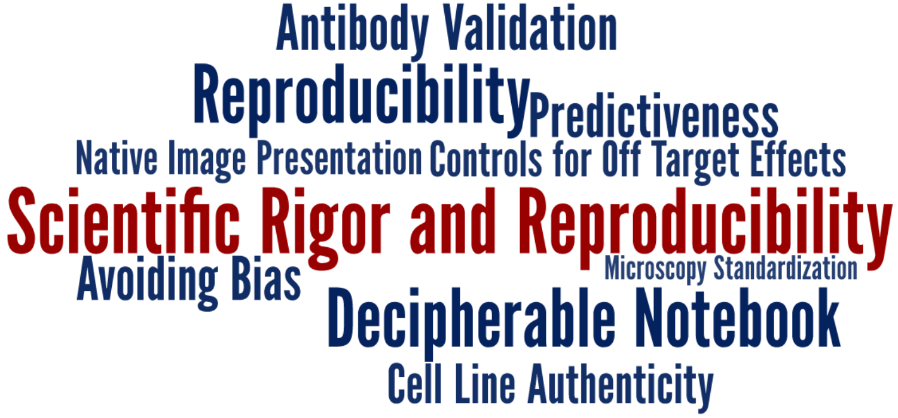
https://www.med.upenn.edu/bgs-rcr-exdes/
18
Notes:
So, with regard to the nuts and bolts of training, know first that NIH requires training of us and other biomedical institutions in RCR.
Rigor, Reproducibility & Transparency (R2T)

Slide 19
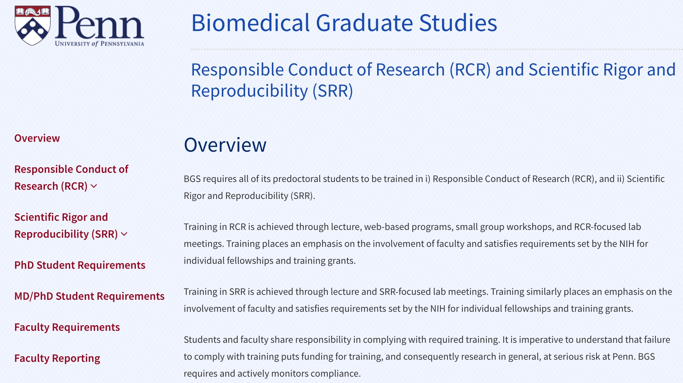
BGS RCR/SRR Website
19

Slide 20
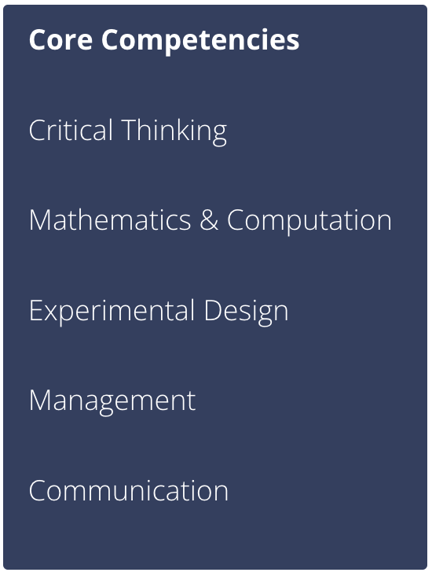

BGS Career
Development Website
Premise
System
Statistics
Controls
Variables
Validation
Robust/unbiased results
20
Notes:
https://bgscareerdevelopment.com/core-competencies/proficiency-experimental-design

Slide 21
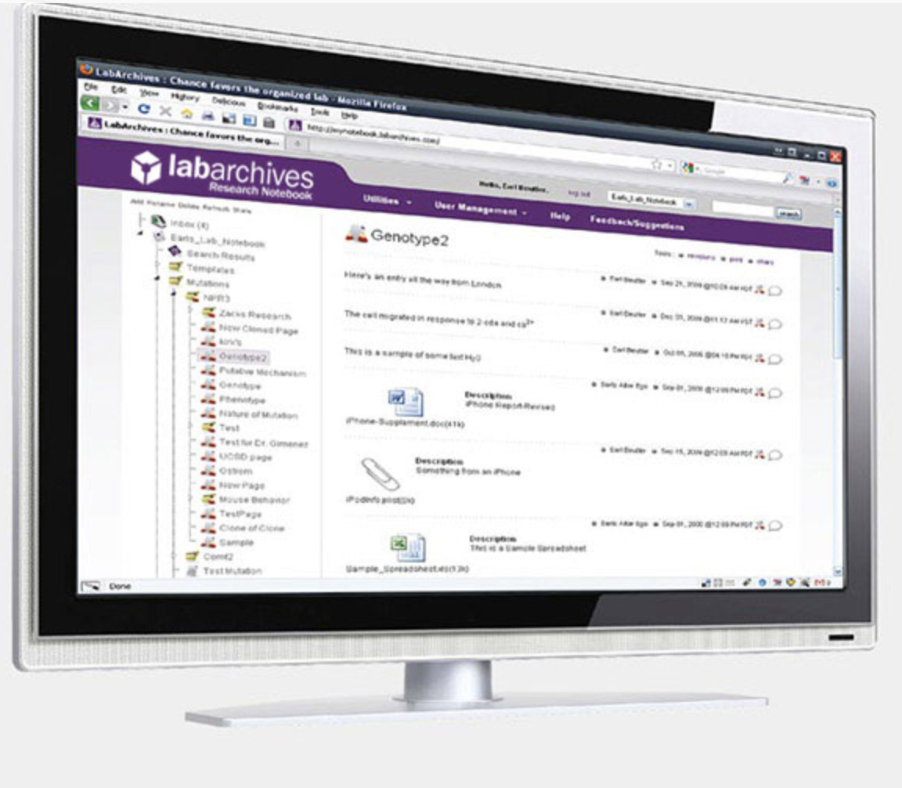

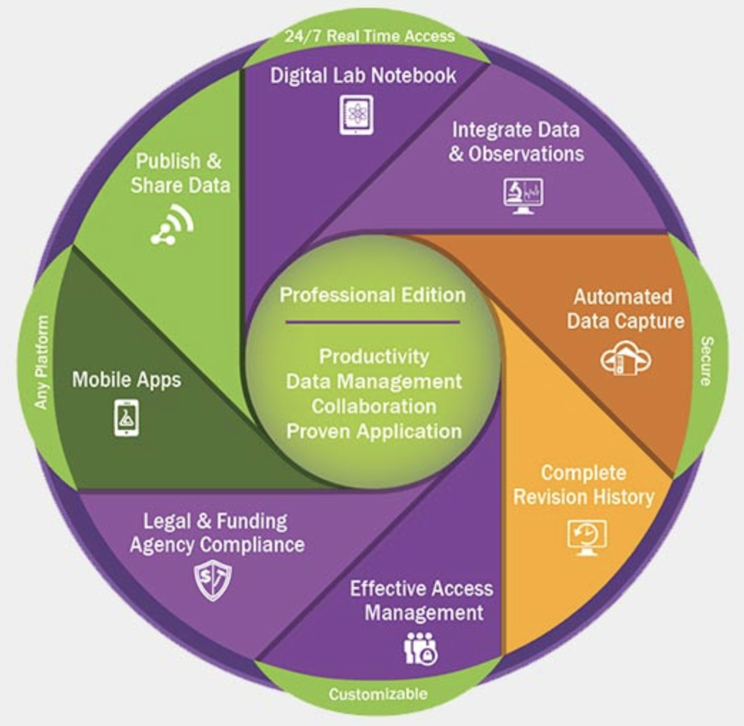
UPENN: LabArchives
- electronic Notebooks -
Also
Benchling
OneNote
No cost!
https://research.upenn.edu/resource/labarchives/
https://research.upenn.edu/support-topic/data-management/
21
Notes:
Institutions have responsibilities they should follow in terms of training and supervision, ethical standards and procedures, and the promotion of open science, particularly with regard to data
management, publication, and disseminating study results.
Careful documentation of the experimental set-up is crucial to improving the replicability of experiments.
Is it misconduct if published experiments are not reproducible?
No, but …
if it is your work that is not reproducible, you want to be the first to address or take the lead in addressing.
Reproducibility does not have to do with ensuring the ‘correctnessʼ of results, but rather with ensuring the transparency of exactly how the research was performed.

Slide 22




DATA MANAGEMENT/Code
Large data sets, including all metadata, should be deposited in public data repositories to generate findable, accessible, interoperable, and reusable (FAIR) data
  https://fairsharing.org
  https://www.go-fair.org/fair-principles/
Bioinformatic analytic pipelines and scripts can easily be shared via Github, Anaconda, or computational containers such as Singularity
Resources/Tools
Notes:
How many times have you found a paper that does exactly the thing you are struggling to do but you go to the methods and you get vague sentences/no code?
Wilkinson MD, Dumontier M, Aalbersberg IJ, Appleton G, Axton M, Baak A, Blomberg N, Boiten JW, da Silva Santos LB, Bourne PE, Bouwman J, Brookes AJ, Clark T, Crosas M, Dillo I, Dumon O, Edmunds S, Evelo CT, Finkers R, Gonzalez-Beltran A, Gray AJ, Groth P, Goble C, Grethe JS, Heringa J, 't Hoen PA, Hooft R, Kuhn T, Kok R, Kok J, Lusher SJ, Martone ME, Mons A, Packer AL, Persson B, Rocca-Serra P, Roos M, van Schaik R, Sansone SA, Schultes E, Sengstag T, Slater T, Strawn G, Swertz MA, Thompson M, van der Lei J, van Mulligen E, Velterop J, Waagmeester A, Wittenburg P, Wolstencroft K, Zhao J, Mons B. The FAIR Guiding Principles for scientific data management and stewardship. Sci Data. 2016 Mar 15;3:160018. doi: 10.1038/sdata.2016.18. Erratum in: Sci Data. 2019 Mar 19;6(1):6. PMID: 26978244; PMCID: PMC4792175.
making raw data openly available is not only important for reuse and data mining
Authors should list and cite all programs used, including version numbers and parameters.
Make data FAIR (that is, findable, accessible, interoperable and reusable).

Slide 23
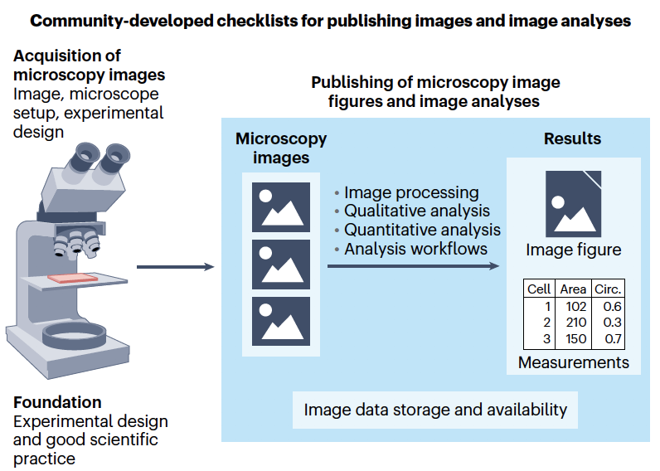
Publishing Images and Image analyses
Notes:
Schmied, C., Nelson, M.S., Avilov, S. et al. Community-developed checklists for publishing images and image analyses. Nat Methods 21, 170–181 (2024). https://doi.org/10.1038/s41592-023-01987-9

Slide 24
NIH: Data Management and sharing policy (DMSP)
“As of Jan 25, 2023, ALL grant or renewals that generate Scientific Data to include a robust and detailed plan to manage and share data during the funding period”
Plan & Budget for the Management and Sharing of Data
Submit a DMSP for Review when applying for Funding
datasets, imaging files, etc. (not lab notebooks)
Comply with the Approved DMSP
“… reasonable efforts will be made to digitize all scientific data.”
Data Management and Sharing Plan Format
https://www.med.upenn.edu/evdresearch/nih-data-management/
Resources/Tools
24
https://guides.library.upenn.edu/dmp/dmp_penn
Notes:
NIH:
https://sharing.nih.gov/data-management-and-sharing-policy/planning-and-budgeting-for-data-management-and-sharing/writing-a-data-management-and-sharing-plan#elements-to-include-in-a-data-management-and-sharing-plan
Scientific data does not include: laboratory notebooks, preliminary analyses, completed case report forms, drafts of scientific papers, plans for future research, peer reviews, communications with colleagues, or physical objects, such as laboratory specimens.
Examples of DMSPs: https://www.med.upenn.edu/evdresearch/sample-templates.html
https://guides.library.upenn.edu/dmp/dmp_penn
Laboratory Management
Day-to-day reproducibility workflow
Equipment/reagent/protocol standardization with controls
Routinely seek to reproduce a scientific claim/reagent before commencing a research project/experiment
Archive management plan
Organization: Electronic notebooks/documentation
File naming (latest version, location)
Computer codes (versions, settings)
Data analysis workflows
Accessibility/dissemination and sharing by all lab members

Slide 25
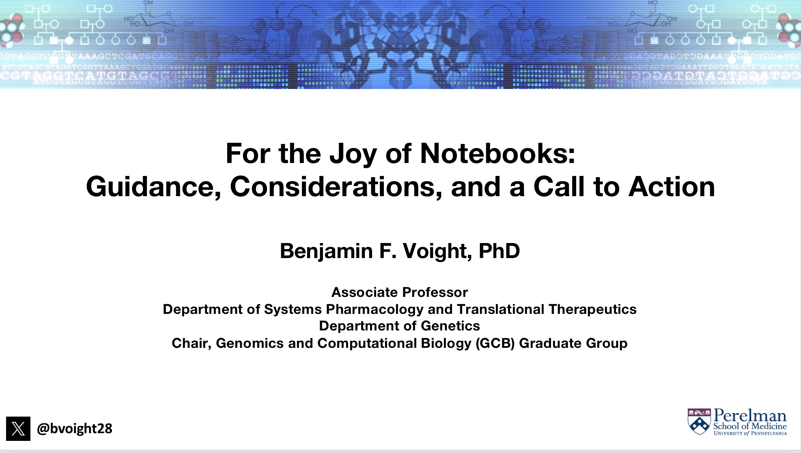
Laboratory Notebooks
Responsible Authorship & Publication
  Table of Contents
    ID #’s for each experiment
  Document each experiment:
    daily entries, dated, indelible, readable
    document everything: omitting data is dishonest
    context: purpose and expectations
    Procedure
      Include details: lot numbers, expiration dates
    Results
    Discussion/Future Directions
    Authentication
Resources/Tools
25
Notes:
Problems:
illegible handwriting; not understandable/poor readability
lack of context
Insufficient detail
Unclear research direction
Can you and others repeat your work or even provide a satisfactory summary after looking at your notebook?
Exercise: ask lab mate/PI to look at notebook and summarize experiment
Authentication by your PI: Review, sign, date
ELNs are searchable, cannot be damaged or misplaced, and are easy to back-up and share with collaborators.
Write while your ideas are fresh. Memories are faulty.
The lab notebook does not belong to you or even the lab – it is the property of UPenn. It should not be taken off campus without permission. At any time, such as a fraud investigation, legal may confiscate notebooks to evaluate scientific practices.
__________________________________________________________
mcmanuslab.ucsf.edu

Slide 26
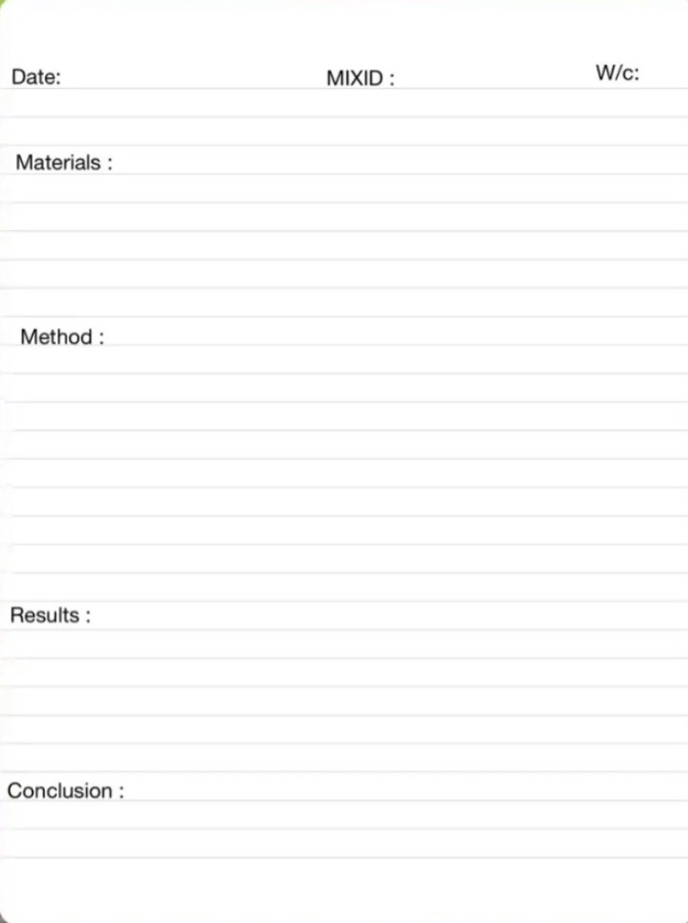
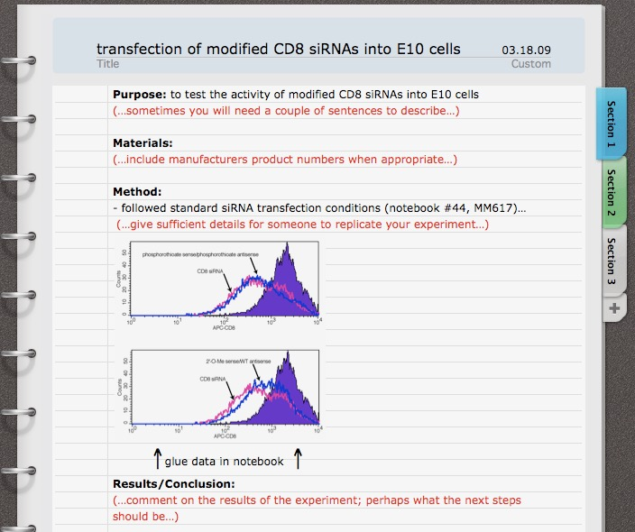
Laboratory Notebooks
Responsible Authorship & Publication
Resources/Tools
26
Notes:
Problems:
illegible handwriting; not understandable/poor readability
lack of context
Insufficient detail
Unclear research direction
Can you and others repeat your work or even provide a satisfactory summary after looking at your notebook?
Exercise: ask lab mate/PI to look at notebook and summarize experiment
Authentication by your PI: Review, sign, date
ELNs are searchable, cannot be damaged or misplaced, and are easy to back-up and share with collaborators.
Write while your ideas are fresh. Memories are faulty.
__________________________________________________________
mcmanuslab.ucsf.edu
https://mcmanuslab.ucsf.edu/uc-lab-notebook-guidelines
https://datamanagement.hms.harvard.edu/

Slide 27
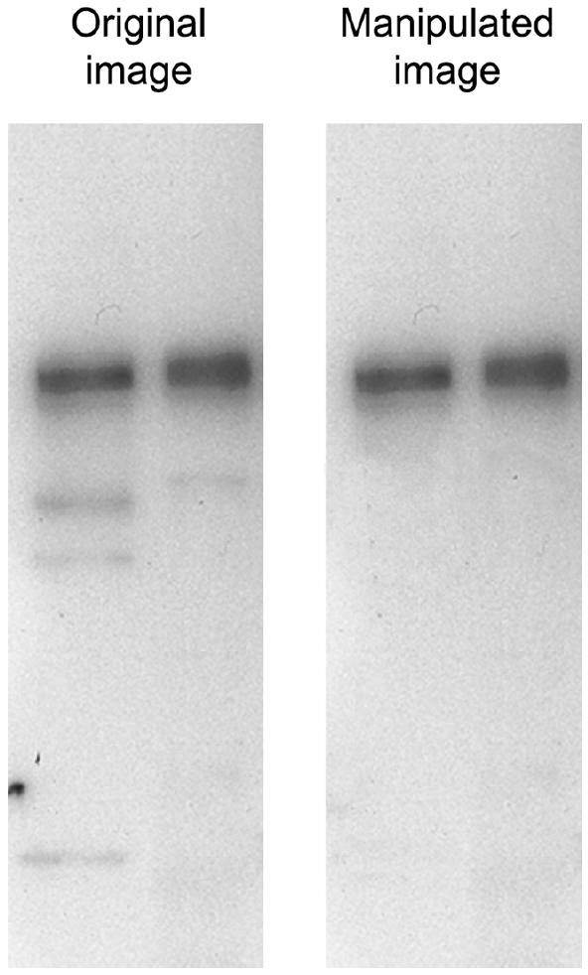
Quality Control pipeline
Plagiarism
Image Integrity
Scribbr/Turnitin
iThenticate
Plagaware
Quetext
Grammarly
Manipulation
Proofig
Duplication
Image Twin
When you write it up ….
27
Notes:
Accidental-word-copying/use of AI without attribution.
Online image manipulation and plagiarism detection tools
Self-checks/quality by design
No good excuse but it happens:
Sloppiness/ laziness (not deception)
Failure of review
Lack of quality control
Is my content original?
Can a PI get in trouble even if they are unaware of misconduct? Yes, they can!
AI detectors: GPTZero, AI Content Detector (https://copyleaks.com/ai-content-detector)
__________________________________
Rossner M, Yamada KM. What's in a picture? The temptation of image manipulation. J Cell Biol. 2004 Jul 5;166(1):11-5. doi: 10.1083/jcb.200406019. PMID: 15240566; PMCID: PMC2172141.

Slide 28
Case Studies
You will read ‘Case Studies’ often
These are a source for discussion
In small groups to promote comfortable discussion
Each group has a ‘facilitator’
  One who guides, not lectures
  (for some topics) there will be no perfect answer
28
Notes:
We use case studies *a lot*. You had first exposure with mentorship case studies and inclusive culture case studies during the first week of orientation.
When going through case studies, think about what “cultures of excellence” entails and your values and choices.

Slide 29
CASE STUDY
The researcher rationalizes that 2 of the runs were flawed, and only reports the single “best” run during a lab meeting.
The result excites the PI so much they include it as a figure in a submitted grant proposal.
A researcher repeats an experiment 3 times and in each the positive and negative controls worked well but when they look at the raw data, there is such a high degree of variability in the experimental samples from experiment to experiment, they are initially not even inclined to analyze the data.
29

Slide 30
CASE STUDY
How do you rate this researcher in terms of
What about the PI? What is/was their role?
30

Slide 31
TRAGEDIES
Entitlement
I’ve worked so hard on this, and I know this works, and I need to get this publication.
Temptation
Getting my name on this article would look really good on my CV.
Deception
I’m sure it would have turned out this way (if I had done it).
Rationalization
It’s only a few data points, and those runs were flawed anyway.
Incrementalism
It’s only a single data point I’m excluding, and just this once.
Ambition
The better the story we can tell, the better a journal we can go for.
Embarrassment
I don’t want to look foolish for not knowing how to do this.
Group and Authority Pressure
The PI’s instructions don’t exactly match the protocol approved by the ethics review board, but she is the senior researcher.
Stupid Systems
It counts more if we divide the manuscript into three submissions instead of just one.
31
Notes:
What TRAGEDIES are apparent here?
Gunsalus CK, Robinson AD. Nine pitfalls of research misconduct. Nature. 2018 May;557(7705):297-299. doi: 10.1038/d41586-018-05145-6. PMID: 29769690.

Slide 32
CASE STUDY
You seek out your mentor who encourages you to quantify the outcomes. You find a result that, although statistically insignificant, appears highly reproducible.
You are unsure how to proceed as the result really does not answer your original question and is not significant anyways.
You repeat an experiment 3 times and in each the positive and negative controls worked well but when you look at the raw data, there is such a high degree of variability in the experimental samples from experiment to experiment, you are initially not even inclined to analyze the data.
32

Slide 33
CASE STUDY
What would you do in this case?
It is significant that a result is repeatable especially with working controls and a quantified outcome!
It is often worth re-thinking both the design and premise of your experiment in these cases.
Perhaps there is some critical uncontrolled variable or there are multiple underlying causative factors.
There may be an exciting discovery that is distinct from the original question!
33
Notes:
Lessons: Experiments are not complete until data is quantified! Listen to what your data is telling you!
Report all data – variability is part of biology!
Learn to view a “failure” as simply something that teaches you about your research question and approach. Don’t be afraid of being wrong.

Slide 34
RCR TAKEAWAYS
Identify and perform good science marked by
  Rigor/reproducibility
  Transparency
  Scientific collaboration
Know and understand your institution's policies, standards and expectations on research
  Adhere to good scientific practices
  Know and uphold shared values in scientific research
34
Notes:
Endeavor to uphold the shared values in your work and in your conduct
Adhere to good scientific practices & ensure scientific rigor
As members of the public
demand responsible conduct in scientific research
demand accountability from the scientific community
https://grants.nih.gov/policy/research_integrity/done.htm

Slide 35
RCR TAKEAWAYS
If you observe misconduct or feel you are being pressured to perform misconduct, seek out a colleague who you trust and can assist you.
PI, senior lab member, faculty advisor, program administrator
Go up the chain step-by-step
Science self-corrects so give involved scientists chances to remedy any disagreement.
35

Slide 36
RCR TAKEAWAYS
If your work comes under scrutiny, you want to be the
First to Fix
Be the first to address or take the lead in addressing
36
Notes:
Policies for handling misconduct
Is it misconduct if published experiments are not reproducible?
No, but …
if it is your work that is not reproducible, you want to be the first to address or take the lead in addressing.
Reproducibility does not have to do with ensuring the ‘correctnessʼ of results, but rather with ensuring the transparency of exactly how the research was performed.

Slide 37
RCR TAKEAWAYS
PERFORM GOOD SCIENCE
KNOW HOW TO IDENTIFY GOOD SCIENCE
HELP OTHERS IDENTIFY AND DO GOOD SCIENCE
Value results
that are
useful
All, as you CREATE YOUR ‘PROFESSIONAL SELF’!
Other scientists will know you first from quality of your work – that is your ‘professional self’.
37
Notes:
What are your goals? Give me some words…
Do good science – we are all curious and like solving problems
Recognize good science
Help Others – Kelly Jordan-Sciutto talked about this a lot from the point of view of you getting mentorship from others. Remember that you guide others, too
You are creating your professional self.
One characteristic of some highly-successful trainees: always had a plan for the next step in their career. When they started their PhDs, they were already thinking about where they would do their postdocs.

Slide 38

Ready, Set, Experiment!
New Student Welcome and Orientation
2024
Kurt A. Engleka (Ingelkay, hard “g”) (he/him)
Adjunct Assistant Professor, Cell & Dev Biol
Director of Curriculum, BGS
kengleka@pennmedicine.upenn.edu
orcid.org/0000-0001-5539-4076
Notes:
I will briefly talk to you today about the importance of the theory and practice guiding the design of experiments. This session represents our first steps in providing intellectual and physical resources that will help you plan and perform the best experiments you can, pursuing science at the highest level, that yield results that you and others can reliably build upon to discover something new. At least within the limits of time, money, energy, encouragement and thought at your disposal.
It is a little overwhelming to singularly stand here in front of all the talent in these seats. I sense your eagerness to be unleashed into the labs to conduct experiments. Think of how many different types of experiments and accompanying bytes of data you are about to bring into existence! Consider, though, that effective experiments, even seemingly simple ones, require a well-conceived plan PRIOR to the actual conducting of the experiment. How EXACTLY is the experiment performed? What EXACTLY is measured? What EXACTLY will you learn? A good experimentalist answers such questions BEFORE the actual conducting of the experiment. This is why we are introducing experimental design during orientation, so it is at the forefront before you begin experiments in the labs.
“Are you ready to perform experiments at Penn!” You are fortunate to be in an institution where you can do almost any experiment you want.
“What kind of data are you going to produce? Is the data from an experiment that was the best experiment you could perform under the circumstances? Is the data reproducible by you and others? Is it predictive so that you and others can build upon the results?”

Slide 39
Two Sides of Same Coin
- either side you win -
Responsible Conduct of Research
(RCR)
Scientific Rigor and Reproducibility
(SRR)
Mandate that research be ethically sound and of rigorous methodological quality.
39
Notes:
How many of you have experienced failure to confirm results, validate reagents, chemicals, specialty reagents?
How many times have you found a paper that does exactly the thing you are struggling to do but you go to the methods and you get vague sentences/no code?
There is a growing movement to encourage reproducibility and transparency practices in the scientific community.
Most scientists experience failure to reproduce results.
A recent survey (2016) revealed that about 70% of biology and medical scientists were unable to reproduce experiments from other scientists as well as the inability of around 60% to reproduce their own work.
The concerns raised and open debate about SRR reinforces the strength of our system. Strive for the most efficient, effective use of precious research efforts.
Conduct the best experiments you can.

Slide 40

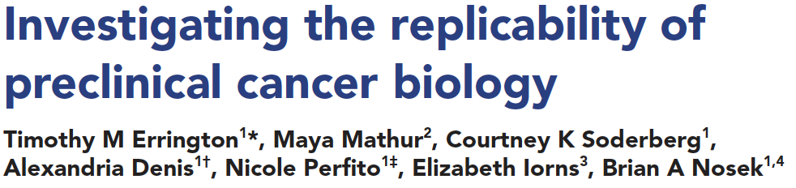
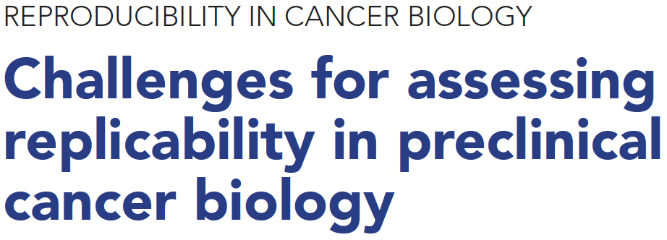
Reproducibility is foundational but difficult to achieve
46%
replication
rate
40
Notes:
Self-appointed teams are even going back through old work, manually, to see what holds up and what doesn’t
Ensuring reproducibility and replicability has been an issue in many scientific disciplines in the past decade. I’m assuming that current students and post-docs are maybe more attuned to this than their more senior colleagues (my generation!). I’ll only highlight recent developments here. One is recent release of highly-anticipated results from the Reproducibility Project in Cancer Biology indicating faithful replication of less than half of experiments it re-ran. This is actually an improvement over previous systemic efforts to repeat selected biomedical studies. These gave 25% or less replication rates.
Science is hard!
The Reproducibility Project:Cancer Biology (RP:CB) was able to replicate just 46% of the preclinical experiments it re-ran, the team behind the landmark initiative reported in eLife.
Systematically test whether selected experiments in highly cited papers published in prestigious scientific journals could be replicated
wake of reports from drug companies that they could not replicate findings in many cancer-biology papers
50 experiments from 23 papers were repeated, generating data about the replicability of a total of 158 effects.
The success rate of 46% is higher than previous systematic efforts to reproduce published results
2021: The Reproducibility Project: Cancer Biology (RP:CB) was able to replicate just 46% of the preclinical experiments it re-ran
Effects of an experimental treatments were drastically smaller.
The effect sizes the replicators observed were on average 85% smaller than originally reported
Animal experiments fared worse than in vitro experiments (animals are not little people in furry costumes)
None of the papers selected contained enough detail for the researchers to repeat the experiments.
Authors could often not provide details (information not recorded/ personnel no longer in lab) or were uncooperative
None of the papers selected contained enough detail for the researchers to repeat the experiments.
Inability of original authors to reproduce their own experiments
Replication failure is the norm.
In fiscal year 2022, the NIH awarded $33.3 of its $45.2 billion appropriation to more than 58,300 new and renewed meritorious research grants. This represents around 0.2% of US GDP.
U.S. medical and health R&D reached $245.1 billion in 2020.
Nature. 2021 Dec;600(7889):359-360. doi: 10.1038/d41586-021-03736-4. PMID: 34912092
Errington TM, Mathur M, Soderberg CK, Denis A, Perfito N, Iorns E, Nosek BA. Investigating the replicability of preclinical cancer biology. Elife. 2021 Dec 7;10:e71601. doi: 10.7554/eLife.71601. PMID: 34874005; PMCID: PMC8651293.
Errington TM, Denis A, Perfito N, Iorns E, Nosek BA. Challenges for assessing replicability in preclinical cancer biology. Elife. 2021 Dec 7;10:e67995. doi: 10.7554/eLife.67995. PMID: 34874008; PMCID: PMC8651289.
Begley CG, Ioannidis JP. Reproducibility in science: improving the standard for basic and preclinical research. Circ Res. 2015 Jan 2;116(1):116-26. doi: 10.1161/CIRCRESAHA.114.303819. PMID: 25552691.
Difficult-to-match factors.

Slide 41
Factors that Affect Reproducibility
Technical
Unvalidated reagents
  antibodies, cell lines
  RNAi
Contaminated cell lines
  Batch effects
  Sophisticated techniques
  Natural variability
Experimental Design
Study design flaws
  small sample size
  non-validated system
Inappropriate statistics
  HARKing
  P-hacking/multiple testing
  Confirmation bias
Human
  Inadequate method reporting
  Poor archiving
    Reagents, data, code
  Mistakes/fraud (minor)
Culture
Publication bias
Novelty over replication
Lack of incentives
Hyper competitiveness
41
Notes:
Science Self-Corrects In the Long Term but Not Short term
What short-circuits self-correction?
Poor Training in Experimental Design/Statistics
Lack of Openness/Transparency
Publication Practices – Blind to negative data
Culture – “Survival” reward system
Technical
Do experiments measure what we think they are measuring
Batch effects - refers to an individual group of samples that are processed differently relative to other samples in the experiment
Sophisticated techniques: unequal amplification during PCR, cell lysis, reverse transcriptase enzyme efficiency, and stochastic molecular sampling during sequencing.
Differences in physiology: preclinical to clinical
Separating meaningful experimental changes from background variability is a challenge in epigenomic studies
Experimental Design - Poor research practices and experimental design
Flexible study designs and statistical analyses can present anything as significant (listening to the Beatles makes you younger); running small studies with low statistical power (because of low sample size or small effects or both)
Failing to consider all biological variables (sex, gender, race, microbiome, environment, weight, confounding health issues, social economic status, background, etc.)
Use of misidentified, cross-contaminated, or over-passaged cell lines and microorganisms.
Unauthenticated antibodies
Inability to manage complex datasets
HARKing - hypothesizing after results are known
“the idea is to cut down on the statistical shenanigans and memory-holing of negative results that got the field into this mess. No more collecting a giant blob of data and then combing through it for a publishable outcome
P-hacking - collect or select data or statistical analyses until nonsignificant results become significant.
easy to find an effect if explore the data after collecting results
Confirmation bias – “reasoning with an agenda”; hypothesis myopia
Human
Fraud and misconduct (minor part of the problem)
Cognitive bias
Culture
Pressure, competition, ambition
Publication bias - ‘negative’ studies are left unpublished
distorted view of drug efficacy if multiple redundant studies of a drug but only one shows a benefit, but that is the one that is published
Scientists are amplifying their story lines and weakening their self checks, while constantly searching for more funding
Publishing in “top-tier” journals and gaining media attention is good for careers but is it good for science
Others: economics
Science is hard! Most of the common diseases that we study and questions trying to answer are exceedingly complex.
Are we training students/post-docs how to be good paper publishers and not discoverers of new knowledge?

Slide 42
Science Self-Corrects In the Long Term but Not Short term
What short-circuits self-correction?
Poor Training in Experimental Design/Statistics
Lack of Openness/Transparency
Publication Practices – Blind to negative data
Culture – “Survival” reward system
42
Notes:
Inadequate training in experimental design and methodology
Open science
Publication practices
Difficulty publishing negative findings
Overemphasis on the “exciting, big picture” findings; leaves out necessary details
Current “hyper-competitive” environment
Historically low funding rates
Grant review and promotion decisions depend too much on “high profile” publications
Culture
Time pressure
Bureaucracy and pressure to publish in high impact journals
Competition for research grants and mentorship
Systemic pressures and misplaced incentives prevent researchers from devoting more time for careful planning, design and execution of scientific research including the use of appropriate experimental methods and statistical analysis, which are necessary to arrive at a good and a reproducible research outcome.
Technical
randomization, bias, replication, statistical analysis
variations in sophisticated methods/techniques that are difficult to replicate
variability in black box reagents: chemicals and reagents especially antibodies, serum

Slide 43
YOU as experimentalist
Self-
Learning
Institutional
Other
Scientists
You as experimentalist
Recognize good science!
Funding
Applications
Publications
Research
43
Notes:
Before you can do great research, you have to truly internalize what great research in your field is. Might not be the flashiest thing!
Penn/CHoP/Wistar
Institutions have responsibilities they follow in terms of training and supervision, ethical standards and procedures, and the promotion of open science, particularly with regard to data management, publication, and disseminating study results.
Self-Learning
Learn by observation and imitation
Evaluation of yours and others’ experiments/results
Reading
Doing Experiments
Pay attention to speakers: what kinds of information are they telling the audience? How do they weave theory and experiments together? How do they present their findings? What kinds of questions do people in the audience ask? This will provide implicit learning opportunities. Reading papers is another way to do so, but in-person observation experiences can be irreplaceable.

Slide 44
A Good experimentalist…
Designs non-biased, effective experiments using a well-conceived plan
Produces results with
-high reproducibility
-high predictive value
Key concepts:
AWARENESS of different frameworks
  hypothesis, model, question
Parameters defined PRIOR to experimentation
AVOID biases and inappropriate data filters
44

Slide 45
Experiments are
Well-Conceived Plans
Experiment is: the whole
Experimental design
    Clearly-defined hypothesis including statistical procedures
    System validation
Data collection
Analysis
Interpretation
Publication
Observe/
Next
Experiment
Evaluate
Results
Generate
Hypothesis
Analyze
Data/
Test
Hypothesis
Design
Experiment
Perform
Experiment
45

Slide 46
Good experimentalists are aware of traps
Poor
Reporting
Non-transparent/
Poor data
visualization
Publication
Publication
bias
Observe/
Next
Experiment
Evaluate
Results
Generate
Hypothesis
HARKing
Analyze
Data/
Test
Hypothesis
Failure to control
for bias
Design
Experiment
Poor statistics/
Low statistical power
Perform
Experiment
P-hacking
Poor quality
control
46
Notes:
HARKing - hypothesizing after results are known
“the idea is to cut down on the statistical shenanigans and memory-holing of negative results that got the field into this mess. No more collecting a giant blob of data and then combing through it for a publishable outcome
P-hacking - collect or select data or statistical analyses until nonsignificant results become significant.
easy to find an effect if explore the data after collecting results

Slide 47
Good experimentalists AVOID traps
Transparent/
Informational data
figures
Publication
Reward
reproducibility
Balance with
novelty/impact
Observe/
Next
Experiment
Evaluate
Results
Generate
Hypothesis
Follow
through
Analyze
Data/
Test
Hypothesis
Control
for bias
Design
Experiment
Correct statistics/
High statistical power
Perform
Experiment
Stick to
the plan
Good quality
control
47
Notes:
Randomize, blinded studies (even for tissue culture experiments), positive/negative controls for each experiment, use of validated reagents, replication in different models, dosage/time courses instead of isolated data points, presentation of representative data
Power calculation to determine sample size, large sample sizes
Validate experimental systems: measuring what supposed to be measuring
Consider biological variables (sex, weight)
Following original design plan and analyzing all results (not stopping or dropping samples that “aren’t working”); avoids HARKing and P-hacking
Full data deposition; code/software sharing
Resist the need to be first, with its concomitant rewards, will trump the need to be right.
Lose the bar/ line graphs for color-coded dot plots, box plots, violin graphs, with exact p values (not p < 0.05), etc.
Align career success with reproducibility: system should equally reward reproducibility balanced with novelty/impact.
Reward confirmatory experiments, and publishing negative data,

Slide 48
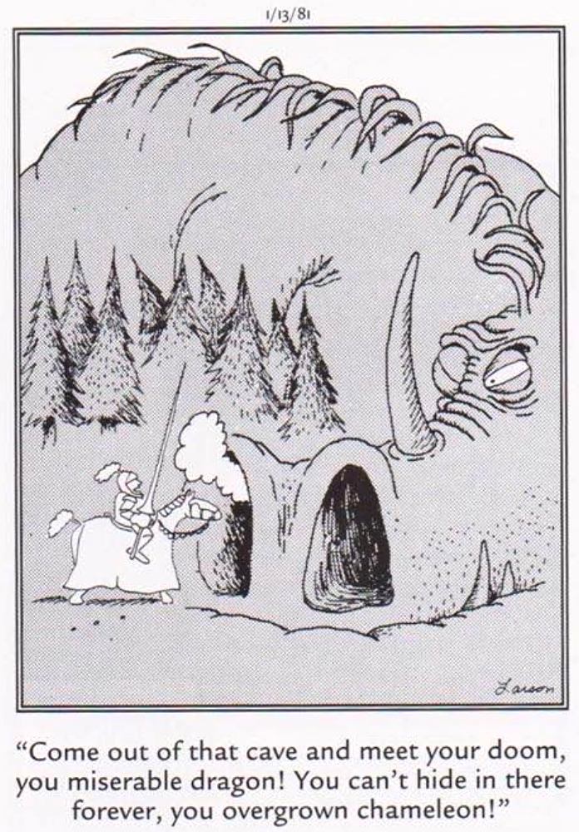
Be aware: Opportunities for deception are plentiful.
Your expectations can influence what you see.
It is easy to be fooled!
Good experimentalists are aware of these traps.
Far Side, Gary Larson
48

Slide 49
What’s in it for you?
  Promotes experimental quality: learn something new every experiment
  Facilitates reproducibility
  Avoids bias
  Saves time, resources, and avoids frustration
49
Notes:
SRR – What’s in it for you
Promotes experimental quality: learn something new every experiment
Facilitates reproducibility
Avoids bias
Saves time, resources, and avoids frustration (mainly yours)

Slide 50
experimental design within BGS
Self-
Learning
RCR and SRR
Training
Thesis Research
Classes
You as experimentalist
Other
Scientists
Lab
Rotations
Thesis
Defense
Preliminary
Exams
50
Notes:
For the remaining minutes, I would like to explain the myriad ways you will be trained and exposed to aspects of experimental design as part of your formal graduate education at Penn.
Critical Scientist
Lab Rotations/Modeling: Labs perform science differently. Scientists can be passionately critical of different approaches to a given problem.
Preliminary Exams: is a detailed plan of your thesis research
Training
Connectivity with Responsible Conduct of Research and Scientific Rigor and Reproducibility
Classes
Basis of knowledge
Exam Questions
Class Participation
Thesis Research
Repeating experiments. (yours and others)
Extending
Throughout all your training, you will have to filter and execute.
At the end of your grad school career: Have I done the experiment as well as I possibly could?

Slide 51
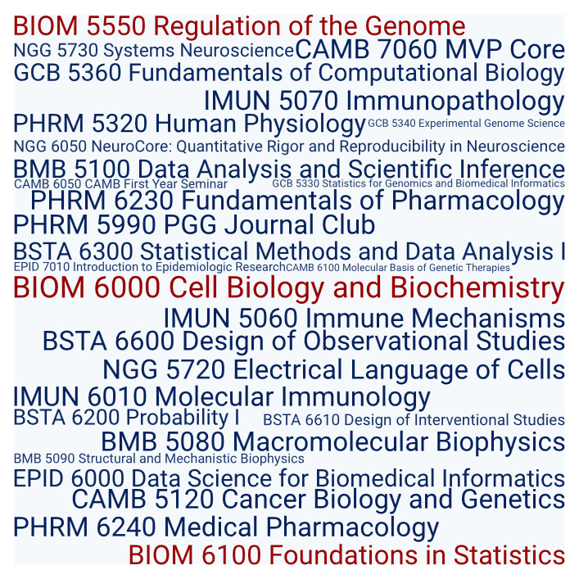
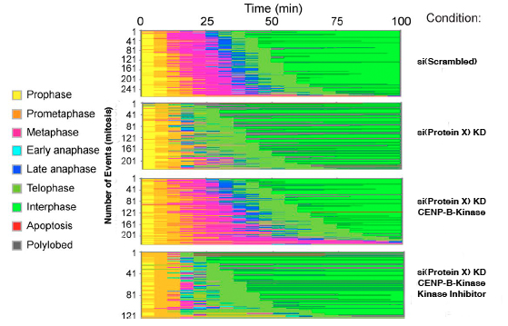
Courses
You will be asked about the experimental basis of knowledge!
Example Exam Question
Given an observation
  describe/interpret data
  formulate a hypothesis
  describe experiments to test the hypothesis
  describe controls
  make predictions
  summarize the results and analysis
  make own conclusions
51
Notes:
In order to design an experiment that effectively adds to current knowledge, it is necessary to understand the current state of knowledge, as well as to have an idea of what the outcome of the experiment will add.

Slide 52
Scientists Perform Science Differently
Alternative hypotheses/interpretations
considered or hypothesis myopia?
Raw data with all controls shown to
the PI? Other senior lab member(s)?
Equipment/protocols/workflows validated to answer a scientific question? Are there checks embedded to maintain rigor/reproducibility?
Statisticians/data analysts consulted before experiments?
Data/code organized, archived and open to all?
52
Notes:
Lab Rotations
Lab cultures differ in structure, philosophy and mission. Lab rotations allow sampling of different styles of performing science to see which best aligns with your values.
No hard, fast rules – no mandate about science; not just one way to think about experimental design
Its consideration applies to whether a lab would be a good fit as all PI's do not share ideas in exactly the same way.
Example, focus on one well-developed project at a time or multiple less-developed ideas that have big payoffs (see Feasibility/Risk case study)
Hypothesis myopia – collecting evidence in support a hypothesis, not looking for evidence against it, and ignoring other explanations.
Lab members encouraged to speak up about things that failed. If PI is absent, senior lab members are in place.
Day-to-day reproducibility workflow
Equipment/reagent/protocol standardization with controls
Routinely seek to reproduce a scientific claim/reagent before commencing a research project/experiment
Introducing checks (example: Independent observations in an objective manner
Data management, publication, and disseminating study results.
Data Management and sharing policy (DMSP)
Is the best experiment published rather than referencing the entire data set?
Laboratory Management
Day-to-day reproducibility workflow
Equipment/reagent/protocol standardization with controls
Routinely seek to reproduce a scientific claim/reagent before commencing a research project/experiment
Archive management plan
Organization: Electronic notebooks/documentation
File naming (latest version, location)
Computer codes (versions, settings)
Data analysis workflows
Accessibility/dissemination and sharing by all lab members

Slide 53
Candidacy Exams
Two years from now you will face your preliminary exam where you will submit and defend a detailed plan about research.
What will you do?
Why will you do it?
Where will you do it?
Who will help you?
How will you do it?
How well do you have to do it?
When will you do it?
How many times will you do it?
How will you interpret the data?
What will happen if you see only a slight difference?
53
Notes:
Once the hypothesis, question, or model is set, you will need to define in depth the path to test the hypothesis, answer the question, or probe the model.
think through the whole process from end-to-end
identify the novel parts, the easy and hard parts
define the key milestones and create a road map
Statistics
Statisticians need this information up front
How to collect
What to control for
Number of data points
What things you will quantify?
Vet experimental details with your PI or some other qualified researcher.

Slide 54
Experimental design…
requires a detailed plan and sticking to it!
How EXACTLY is the experiment performed?
What EXACTLY is measured?
What EXACTLY will you learn?
Details are critical and we want to hear them!
54
Notes:
Statements can be vague and provoke misunderstandings.
Example: is there a difference between “transcription factor X activates the expression of gene Y” and “transcription factor X promotes the expression of gene Y”? Mathematical equations provide clarity over language descriptions.

Slide 55
It Begins with you
The main goal of a good experimentalist: perform non-biased, effective experiments using a well-conceived plan.
Design experiments so that you learn something each time.
55
Notes:
Careful documentation of the experimental set-up is crucial to improving the replicability of experiments.
Keep good scientific records
Develop practices for curating and preserving all the data that underpin a paper, including replicates
a designated central drive
provide an honest representation of what you have found
provide video of methods so other laboratories can see every procedural detail

Slide 56
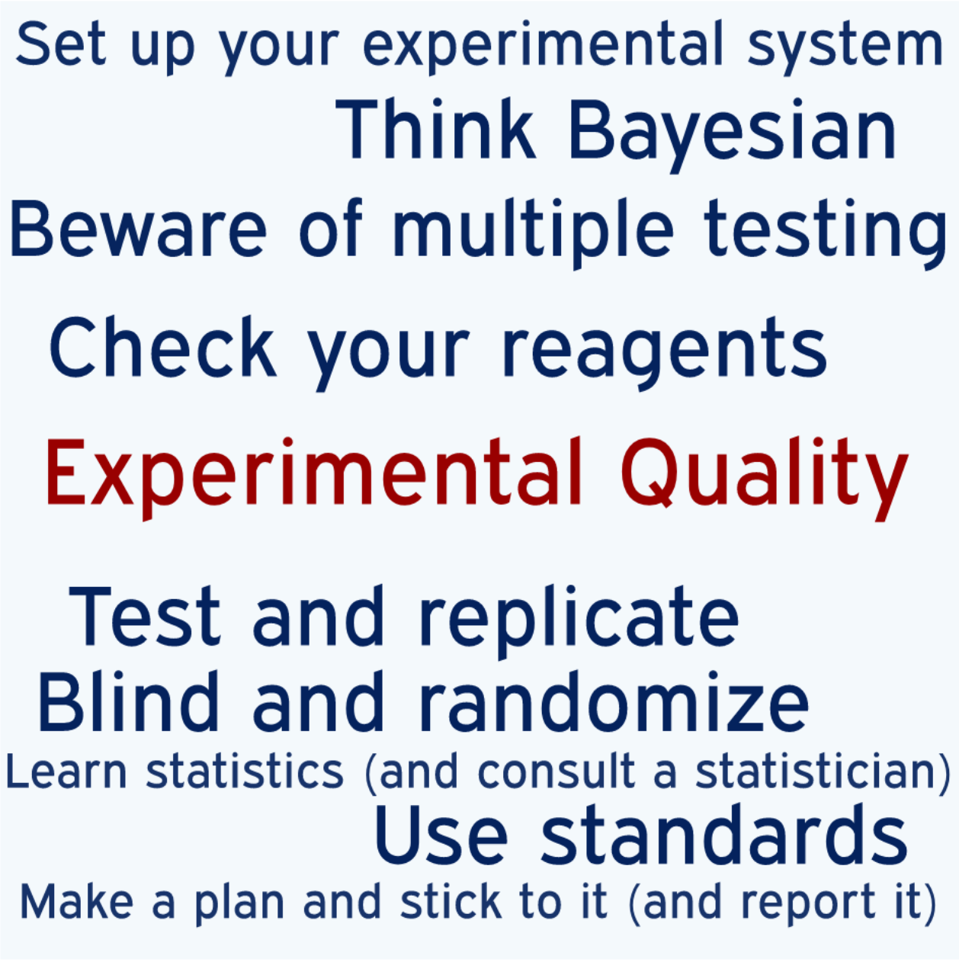
Science Delivers!
Perform Experiments!
Give the data the final word!
56
Notes:
Science is in the business of learning from its mistakes.
Science course-corrects as new insights are gained and as old theories are overturned. And despite the important debates about research integrity, reproducibility, robustness and the factors that can pull against good practice in these times of scarce funding, the system and the culture of science delivers. Knowledge is advanced, new medicines are made, human suffering is reduced.
Self-correcting
United in the spirit of inquiry
Importance of being open about methods, data and mistakes

Slide 57
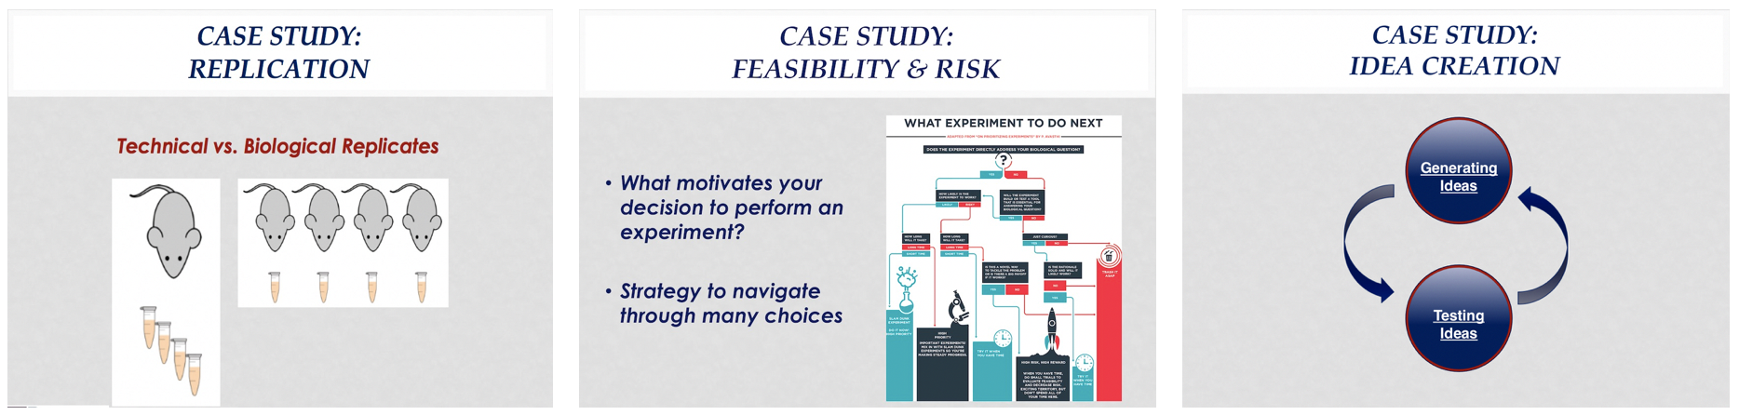
Case studies
Replication
Feasibility and risk
Idea Creation
57
Notes:
The case studies are starting points for discussion. There are no right/wrong answers.

Slide 58
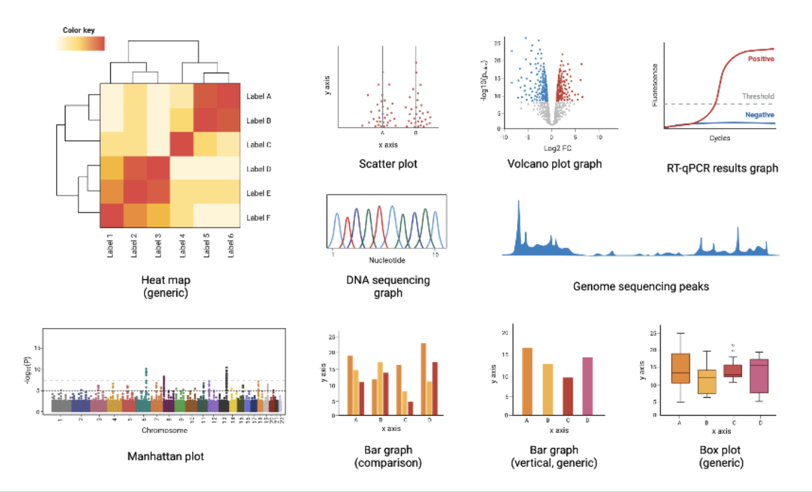
Small Groups
See Canvas or me for your small group number and location.
Groups 1-5 BRB 252
Groups 6-14 BRB Lobby
Group 15-20 BRB Aud
Group 21-22 BRB 253
Group 23 BRB Aud (front)
Spillover BRB Auditorium
58

Slide 59
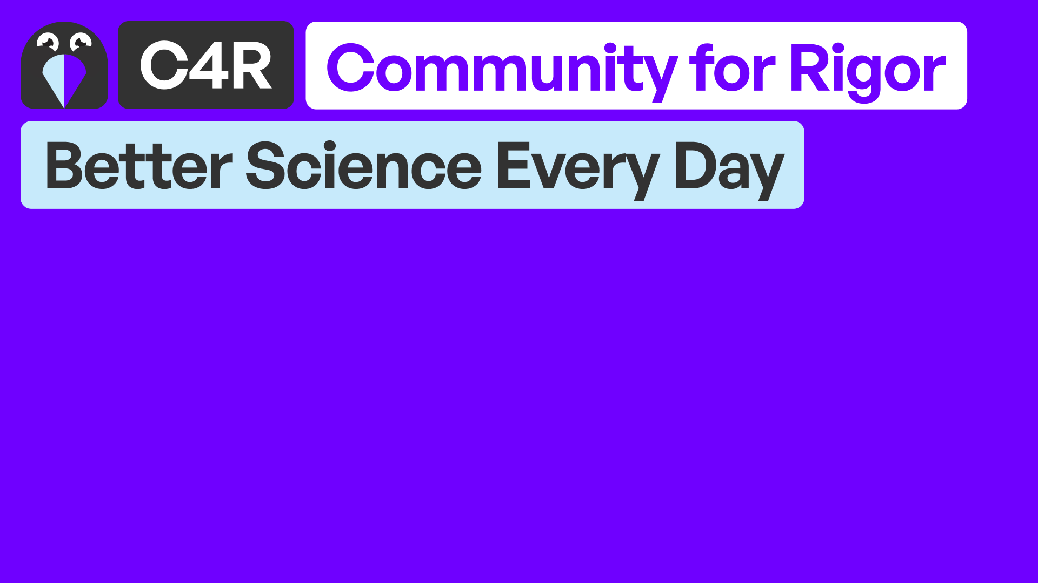

LOOK FOR THIS
Make responsible and reliable science an exciting and compelling every-day practice
https://c4r.io/
59
Notes:
https://c4r.io/
Community for Rigor is an open-access educational resource network that helps researchers of all kinds learn, practice, and promote scientific rigor.
Find answers to topic-specific questions
Learn how to question “best” practices
Collaborate for positive change
Practice your skills with interactive learning modules
Connect directly with peers for actionable support
Share your knowledge through open-source curriculum

Slide 60
60

Slide 61


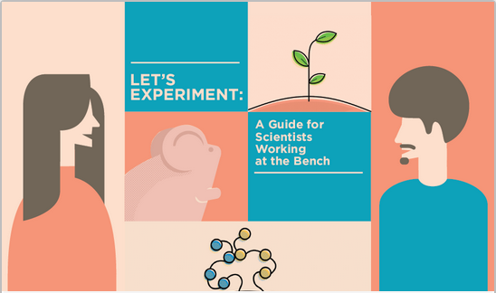
Resource
Free online course available self-paced, anytime
Tailored for students BEFORE stepping into the lab
https://courses.ibiology.org/courses
61

Slide 62
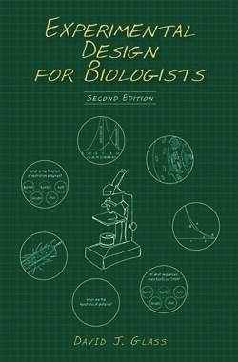
Resource
Based on Experimental Design for Biologists by David J. Glass
2nd ed. 2014. Cold Spring Harbor, NY: Cold Spring Harbor Laboratory Press.
62

Slide 63
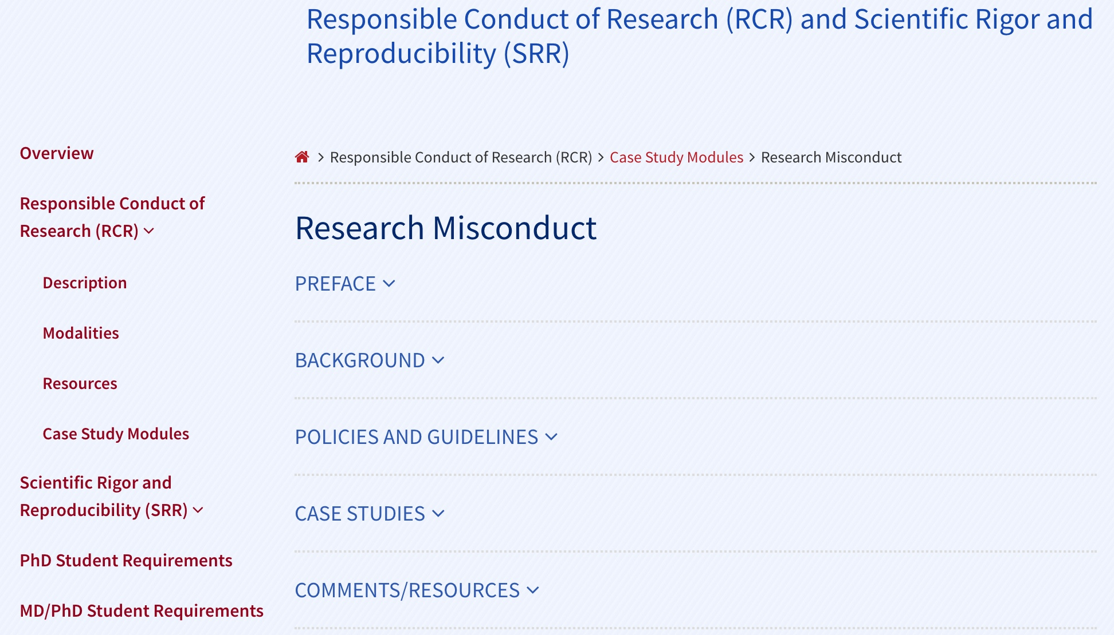
BGS RCR/SRR Website
63

